Slide 1
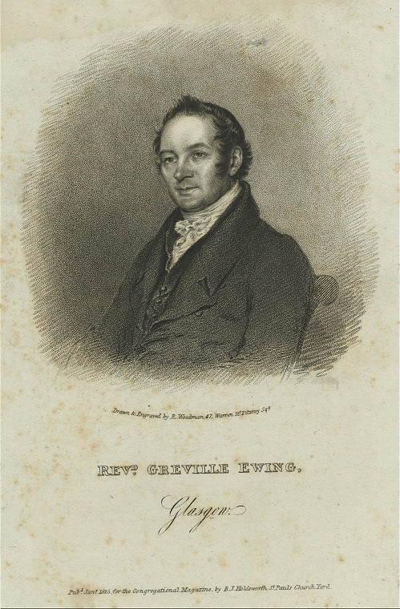
The Restoration in Scotland, and the Role of Greville Ewing

Slide 2
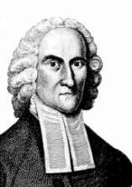
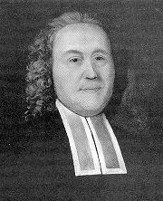
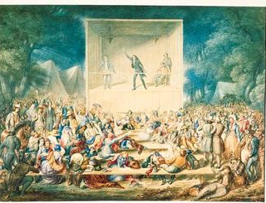
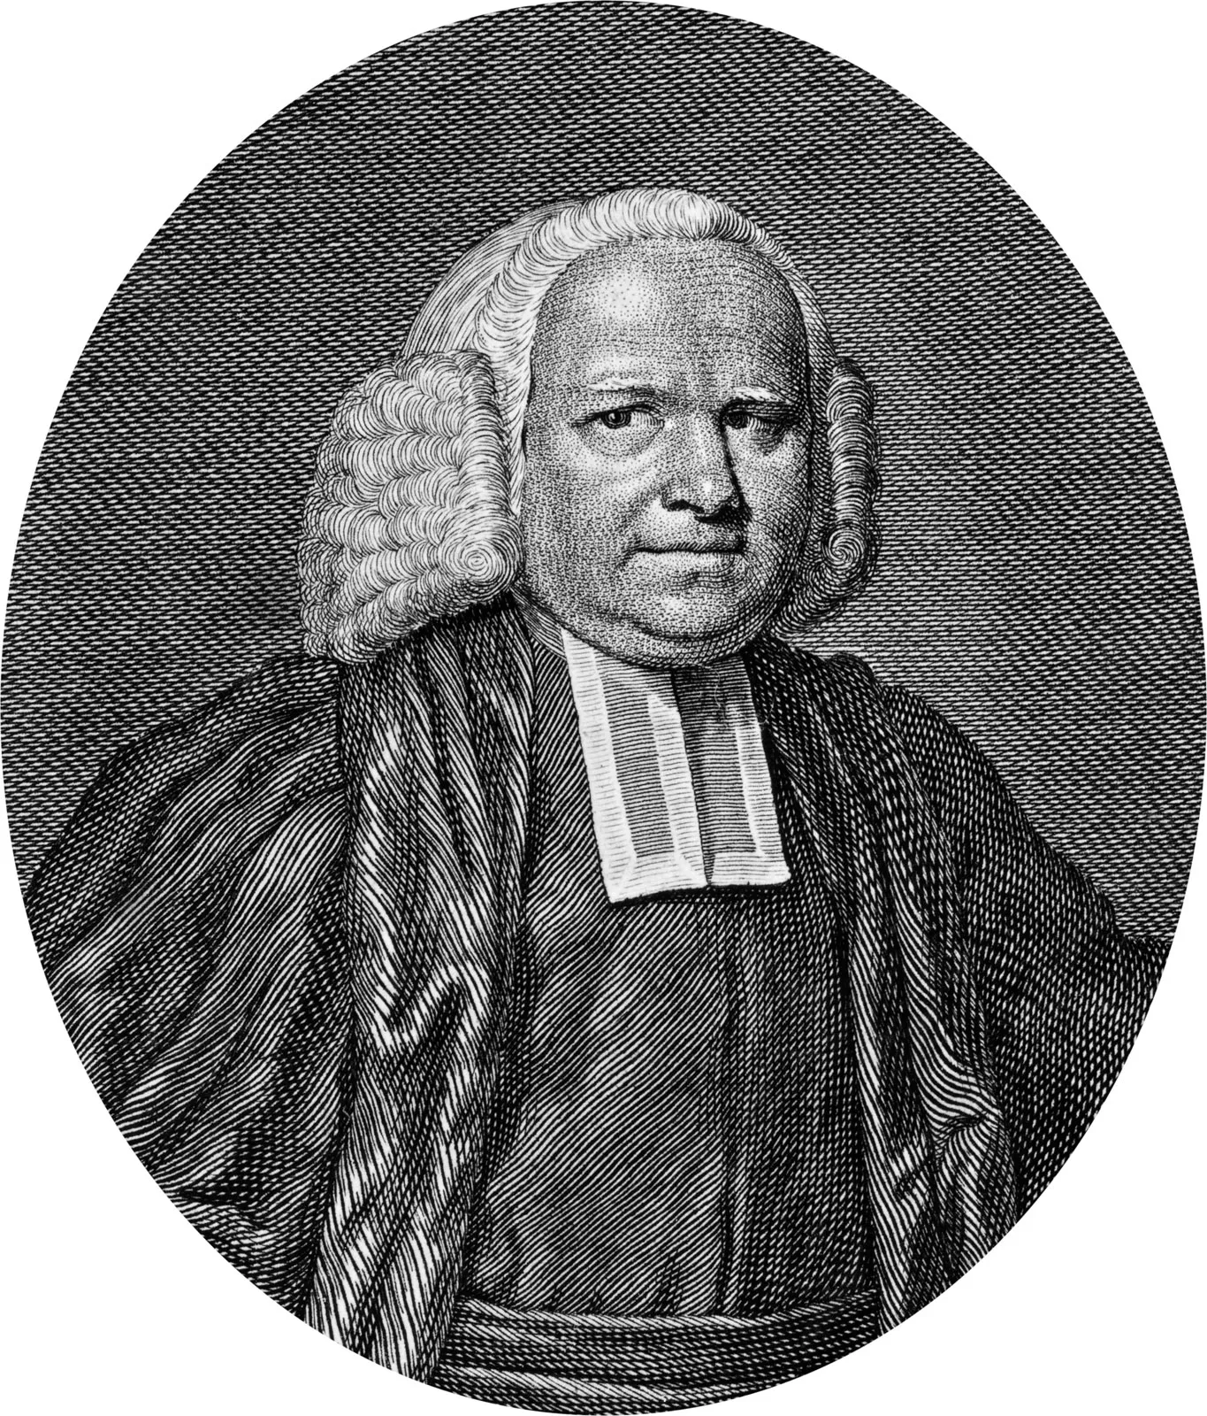
1st Religious Awakening In America – 1730s-40s
Jonathan Edwards 1703-1758 Congregationalist New England
Gilbert Tennent 1703-1764 Pennsylvania Presbyterian
George Whitefield 1714-1770 COE, Anglican British Isles
Notes:
Gilbert Tennent was born in Armagh, County Armagh, in 1703. 85 years later, in the same county, just across Lough Neagh (lok-nay) to the north in Ballymena, where another religious leader was born in the person of Alexander Campbell. Tennent was a Presbyterian minister who preached revival.

Slide 3
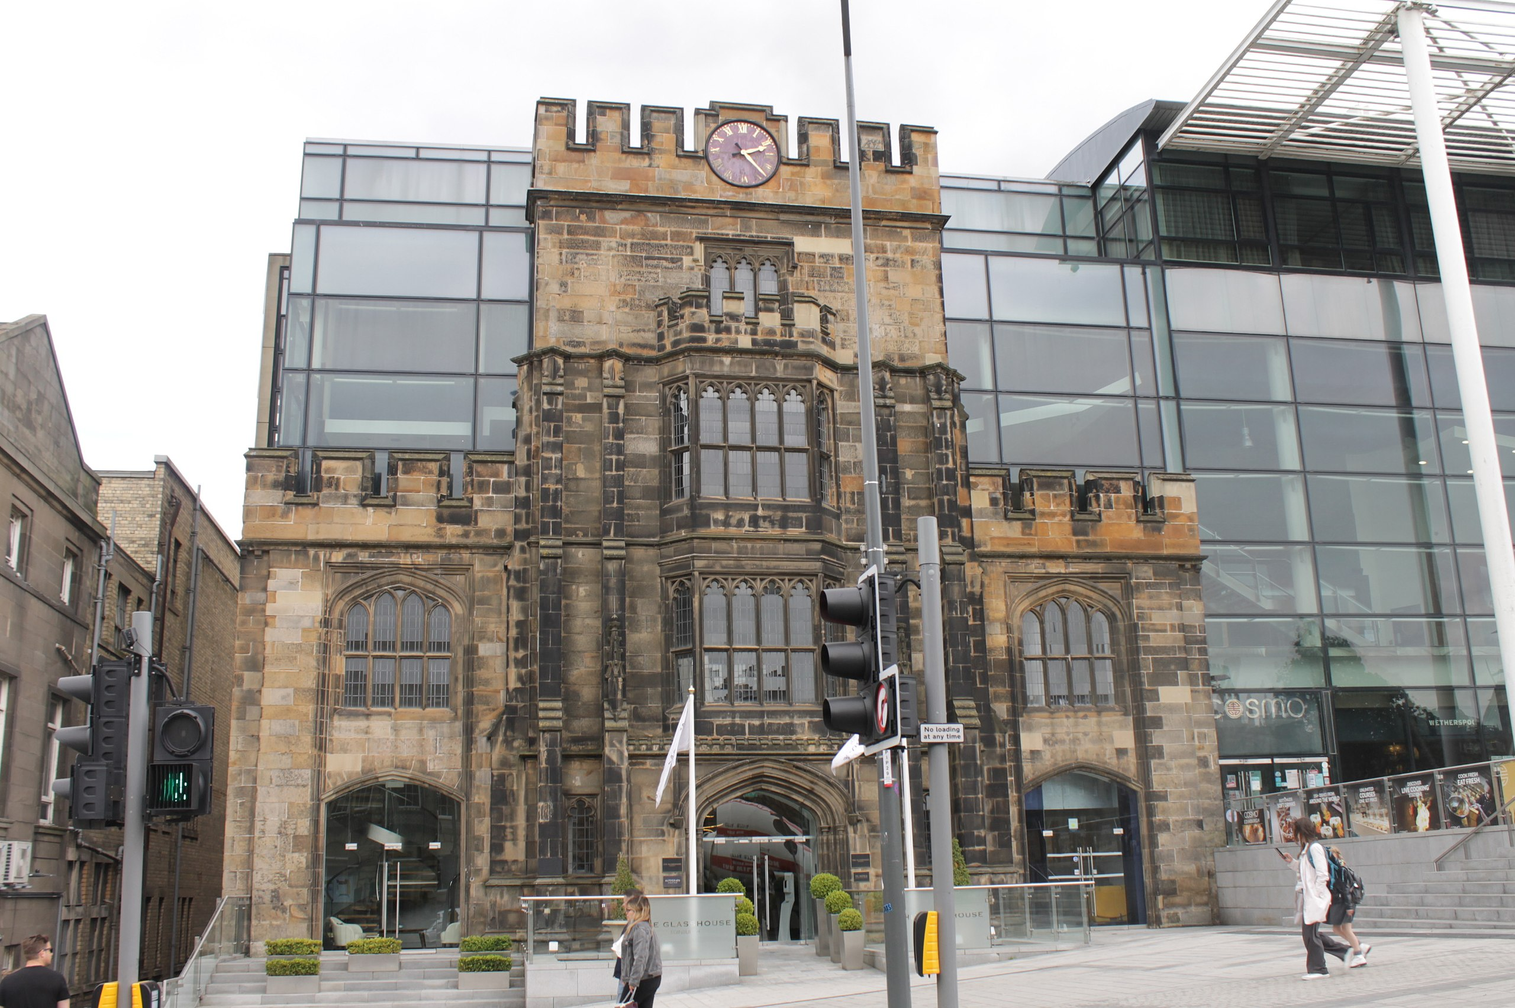
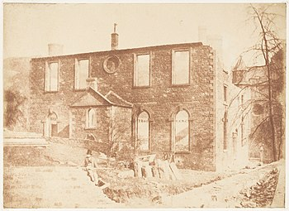
From Greyfriars to Lady Glenorchy’s Chapel
https://en.wikipedia.org/wiki/Lady_Glenorchy%27s_Church
https://en.wikipedia.org/wiki/Greyfriars_Kirk
Lady Glenorchy’s Chapel
1772-1834
Greyfriars Kirk – 1598-Present

Slide 4
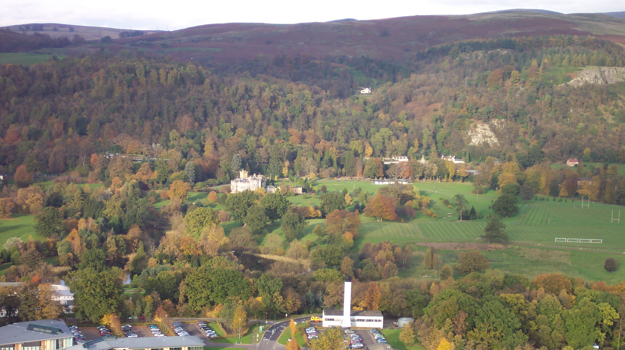
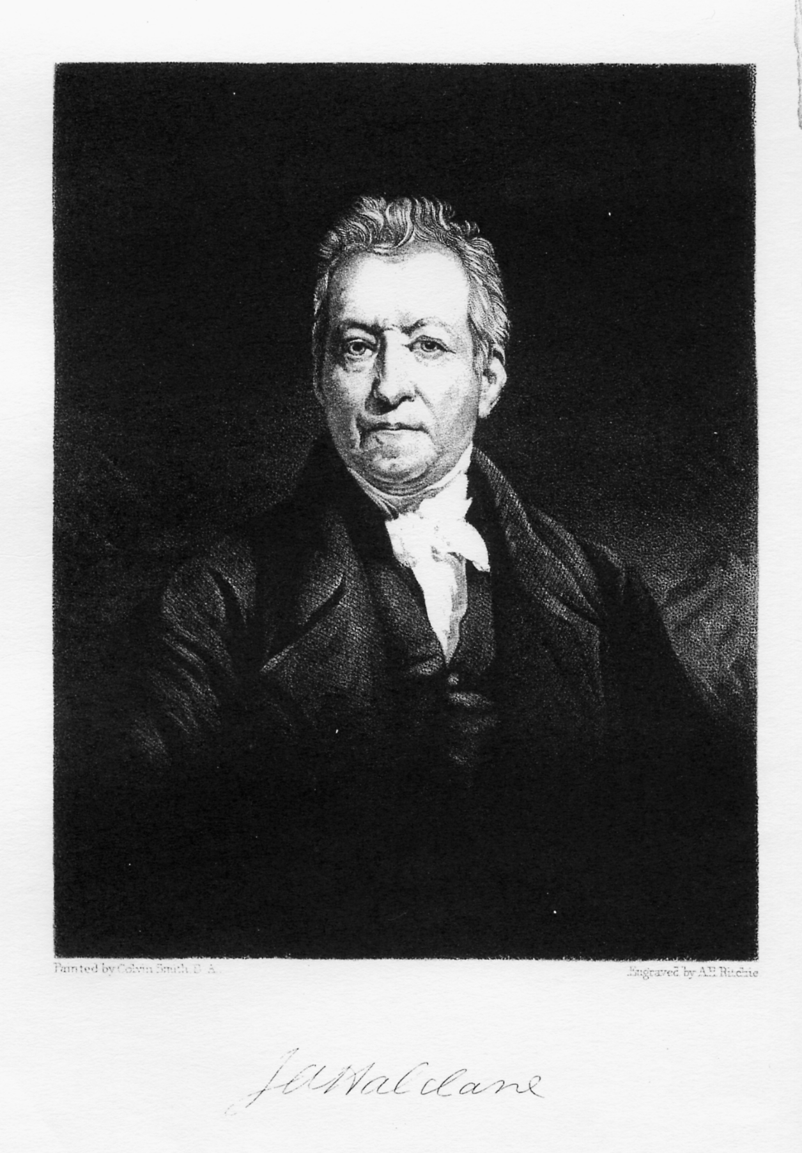
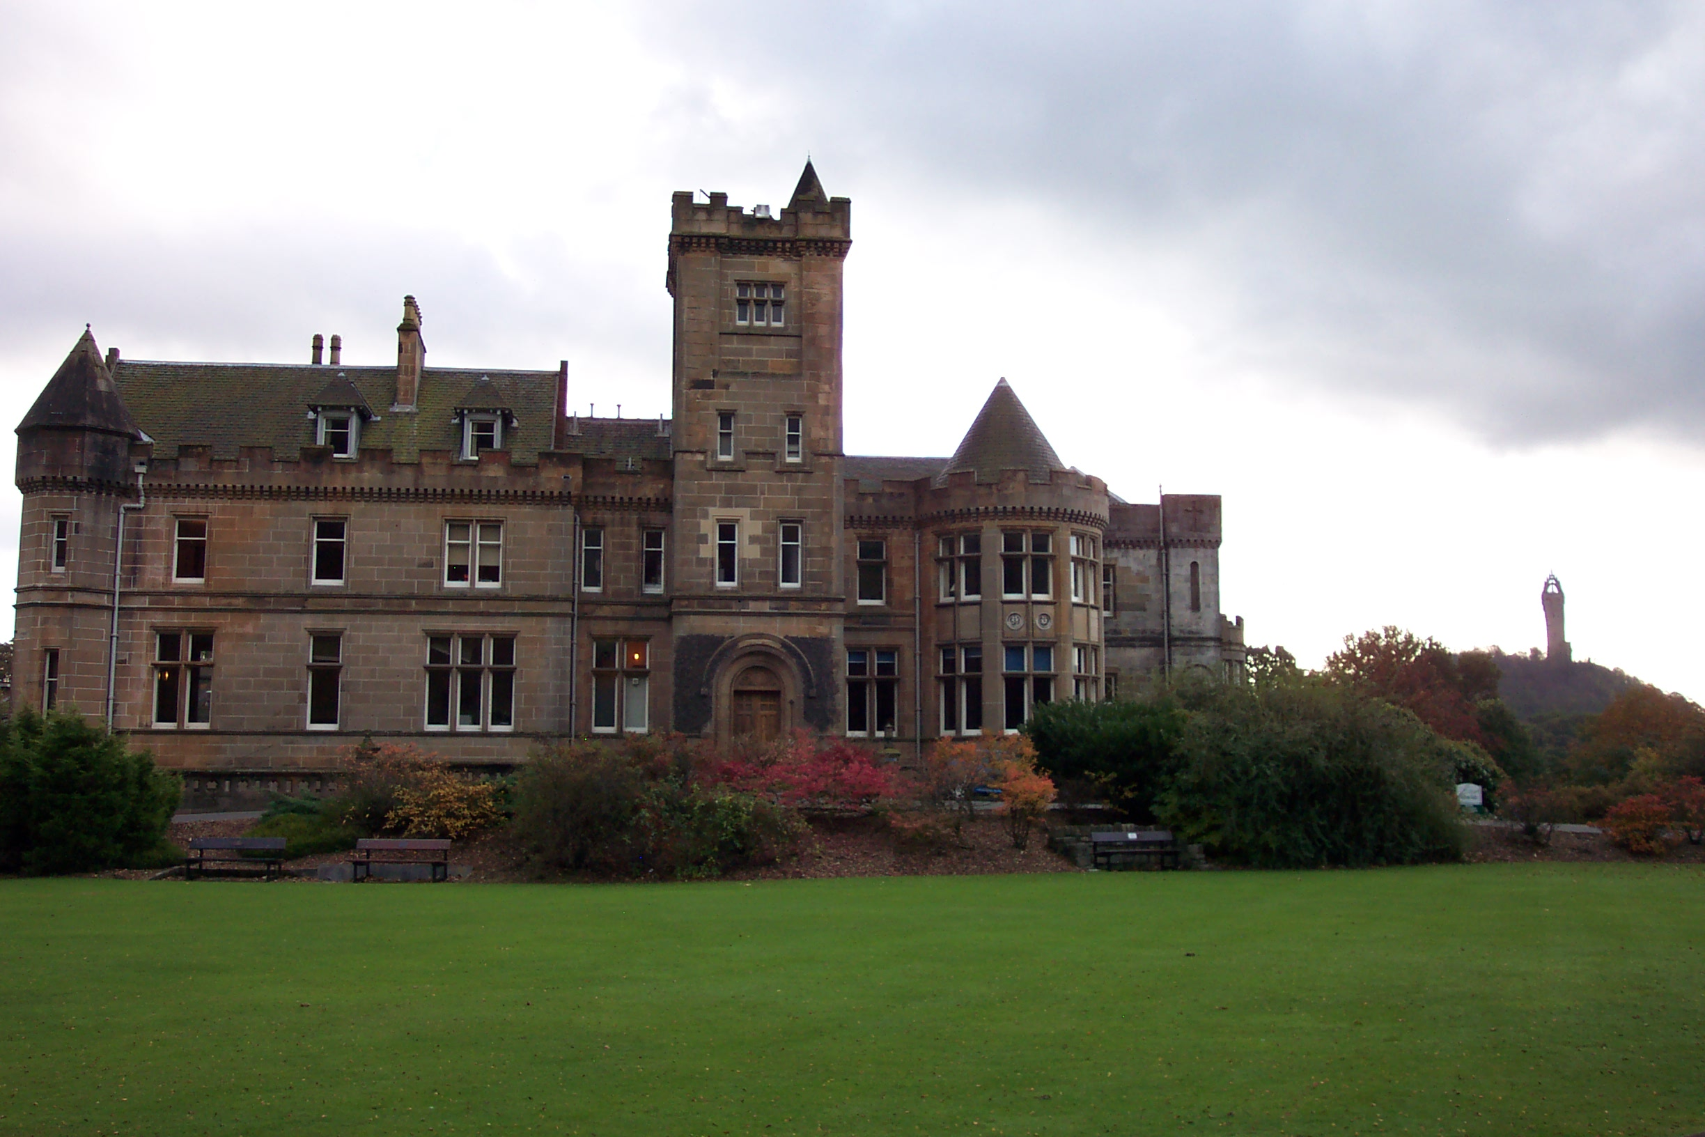
Robert & James Haldane of Airthrey, Stirling, Scotland
James Haldane
1768-1851

Slide 5
The Tabernacle Church, est. 1799 - Circus At Edinburgh, Scotland
The Independent church at Edinburgh was a converted circus. The speaker’s stand in the center ring with 3000 seats surrounding it. Most Sundays it was filled to capacity.

Slide 6
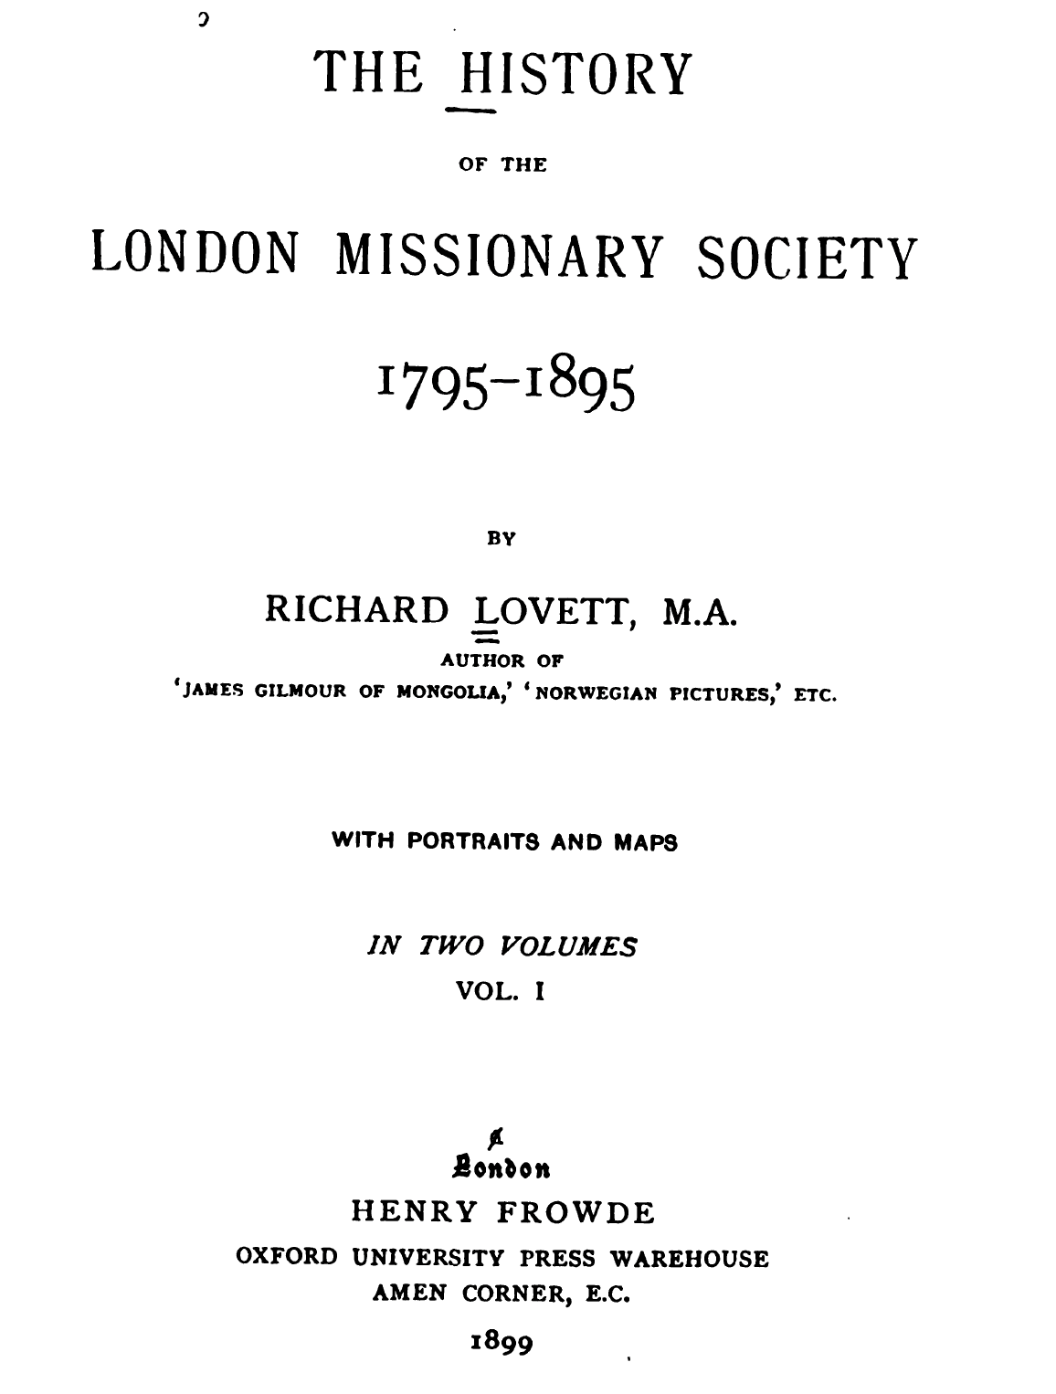
Missionary Societies
1792 – Baptist M.S.
1792 – General M.S. of Dublin, Ireland
1795 – London M.S., England
1796 – Mar. - Edinburgh M.S., later Scottish M.S.
1796 – (Fall) The Society for Propagating Christian Knowledge
1797 – Dec. - The Society for Propagating The Gospel At Home

Slide 7
Letter To Presbytery Dec. 1, 1798
Memoir of Greville Ewing, J. J. Matheson, 1843, p. 177

Slide 8
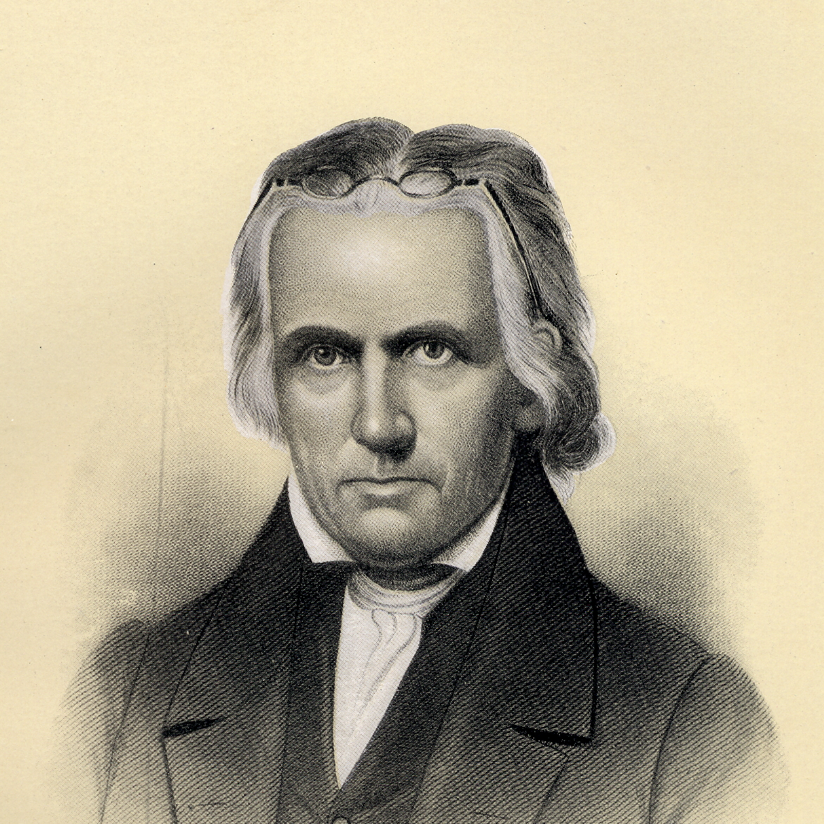
Evangelical Society of Ulster, Ireland
“When Campbell came to Ahorey, the times were troublous, what with the (Irish) Rebellion in 1798, a large measure of spiritual apathy, and much desecration of the Lord's day. It was no wonder that serious-minded men began to take a hard look at things and try to make some efforts towards the promotion of spiritual life. This took the form of the establishing in Armagh city of the Ulster Evangelical Society on October 10, 1798.”
-Thomas Campbell’s Ministry At Ahorey, Alfred Russell Scott, Restoration Quarterly, v.29, #4, 4th Qtr., 1987, p.231.
Thomas Campbell, Secretary

Slide 9
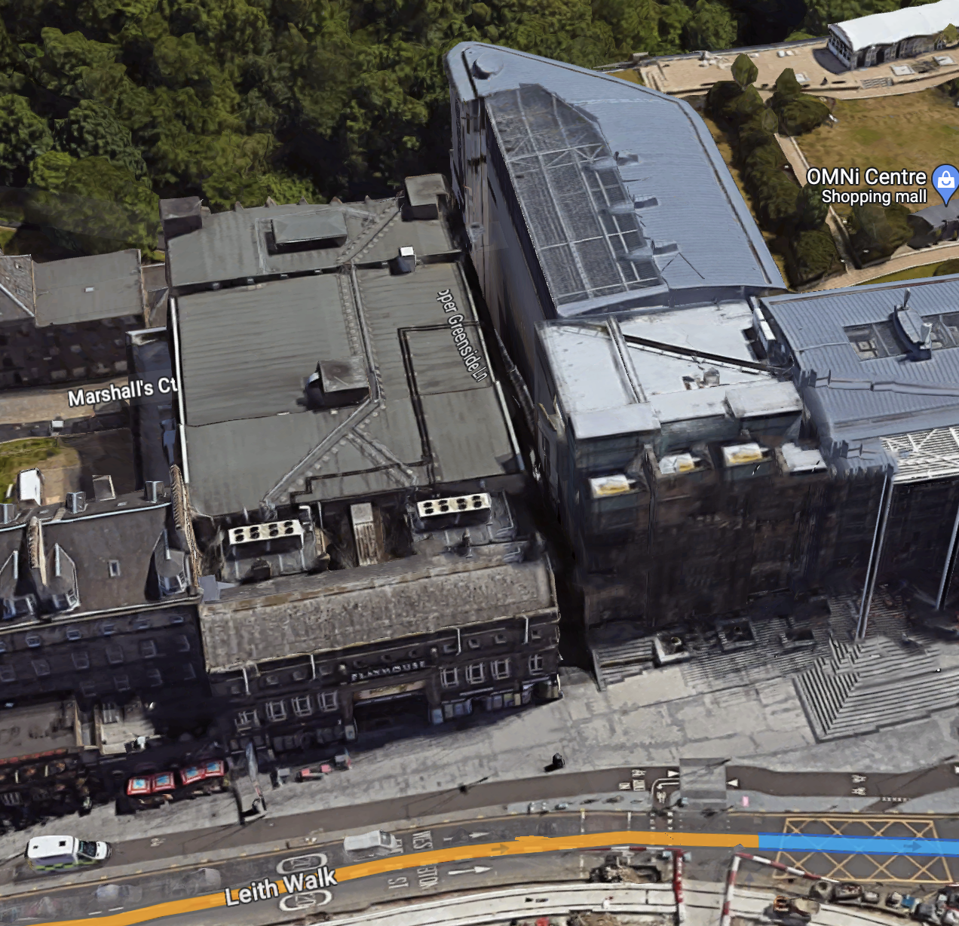
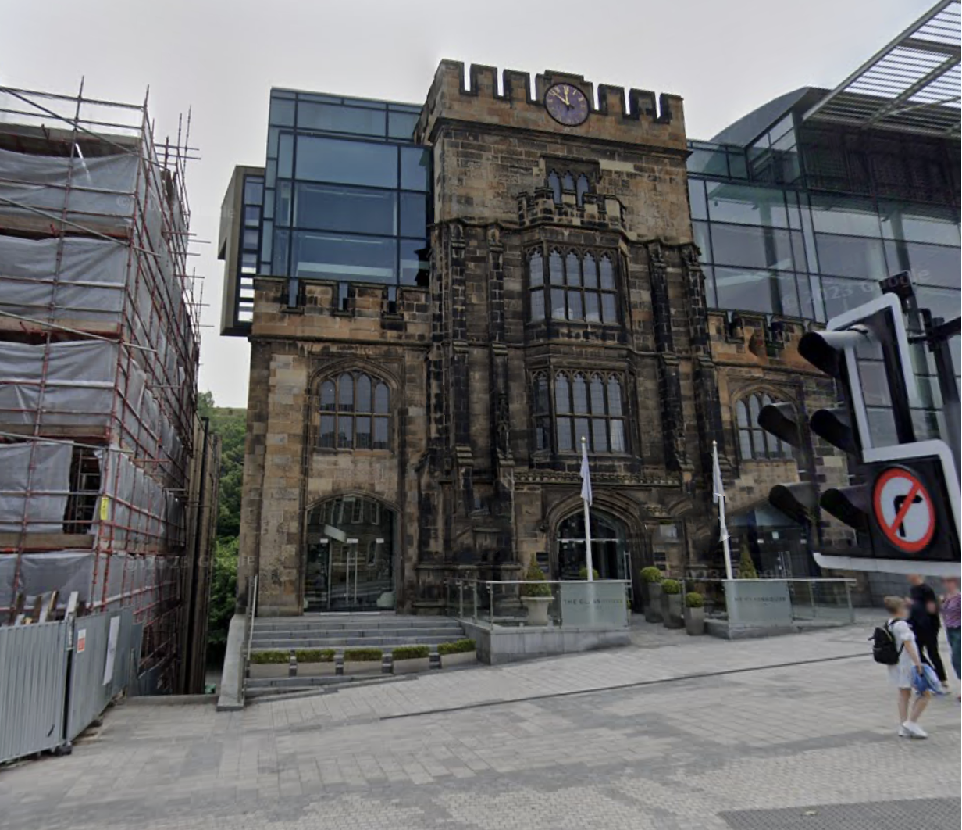
Society For Propagating The Gospel At Home Becomes A New Church
Lady Glenorchy’s
Circus Tabernacle
Calton Hill
Lady Glenorchy’s
Circus Tabernacle
https://www.google.com

Slide 10
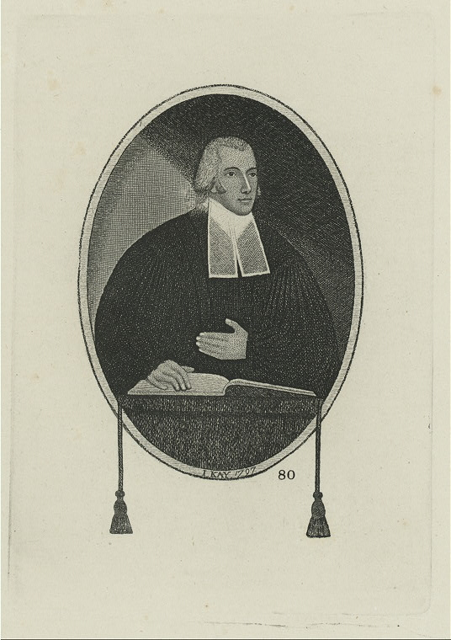
Greville Ewing – Chief Architect Of The Congregational Movement – Jan. 1799
310 organize on the Scriptures alone
Congregational (self-governed)
Independent
Weekly gathering for worship
Evangelistic in nature
Weekly observance of Lord’s Supper
James Haldane: first ordained minister
Greville Ewing

Slide 11
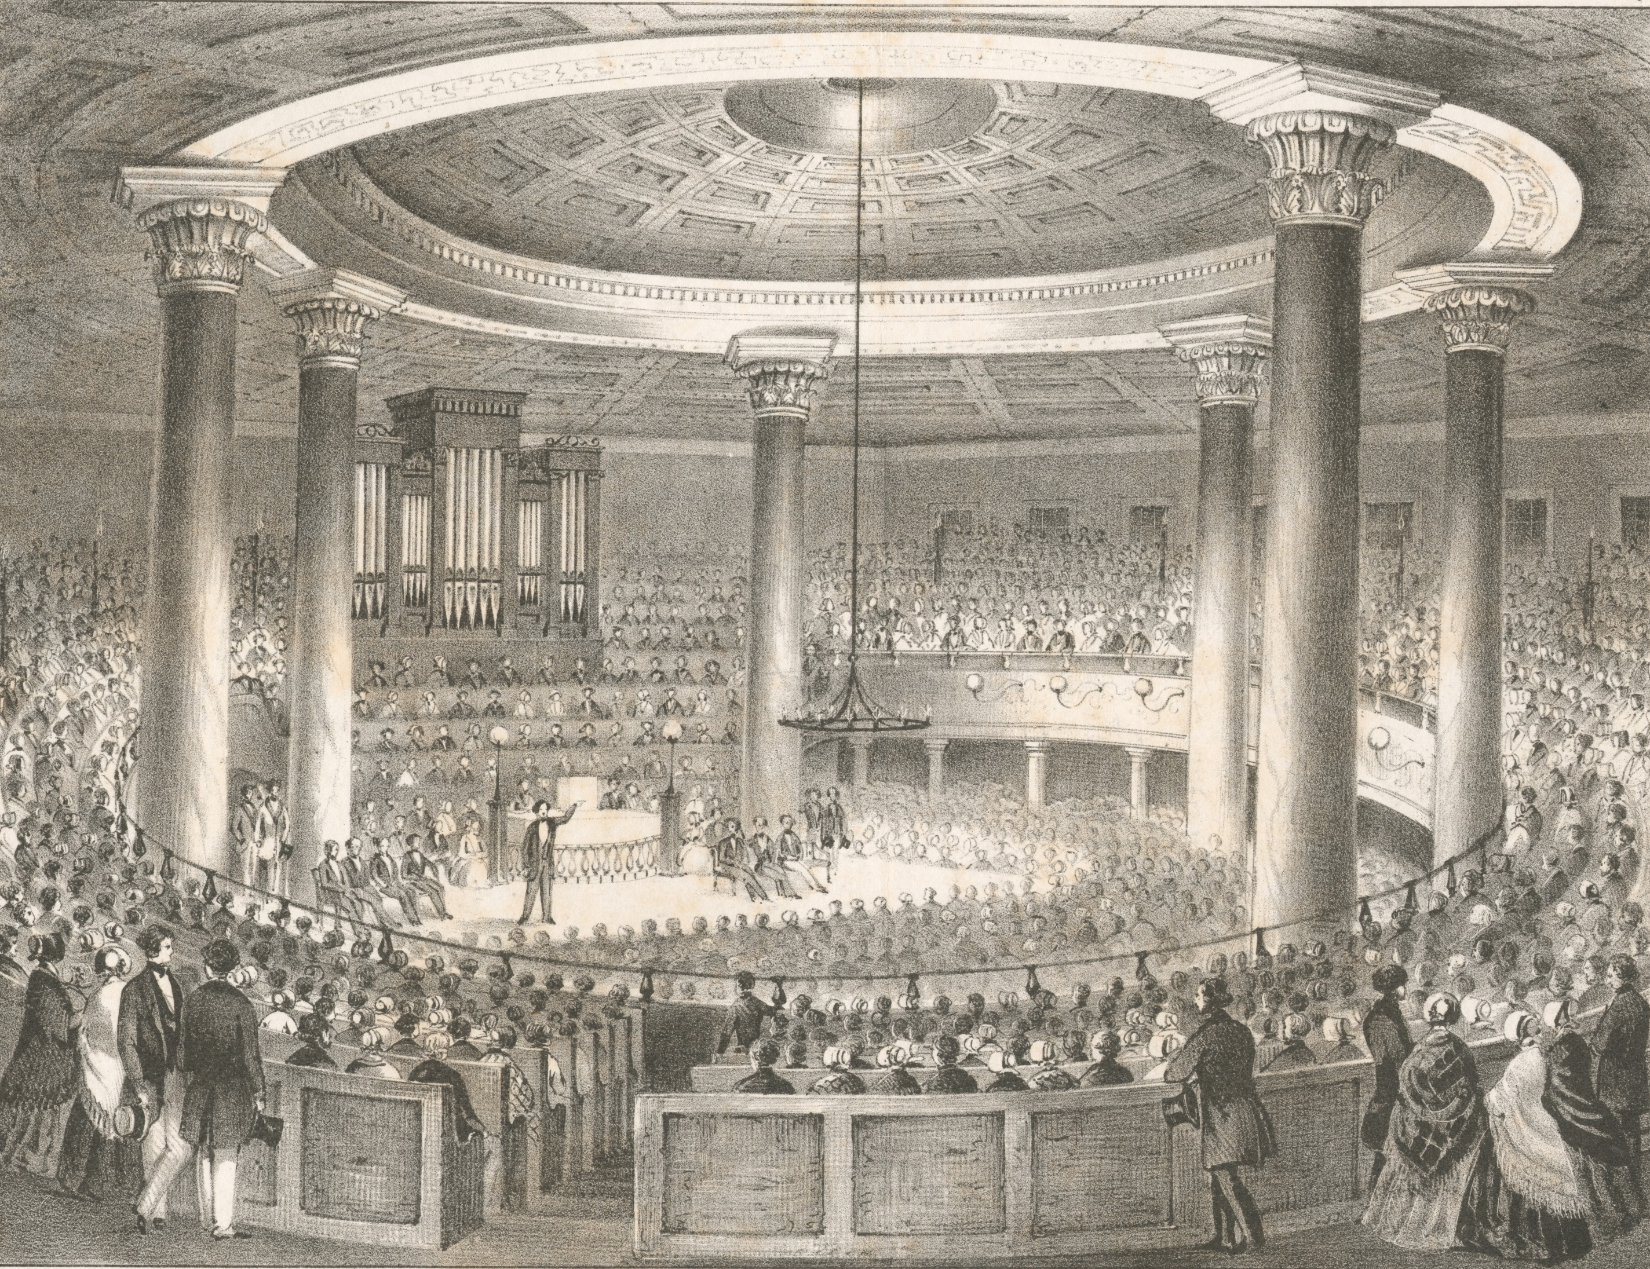
June, 1799 – G.E. to Glasgow
June 2 – G.E.’s last sermon at Edinburgh circus.
Robert Haldane arranges meeting place at Jamaica Street in Glasgow
July 28 – G.E. preaches to 3000
Theological School
https://en.wikipedia.org/wiki/Broadway_United_Church_of_Christ

Slide 12
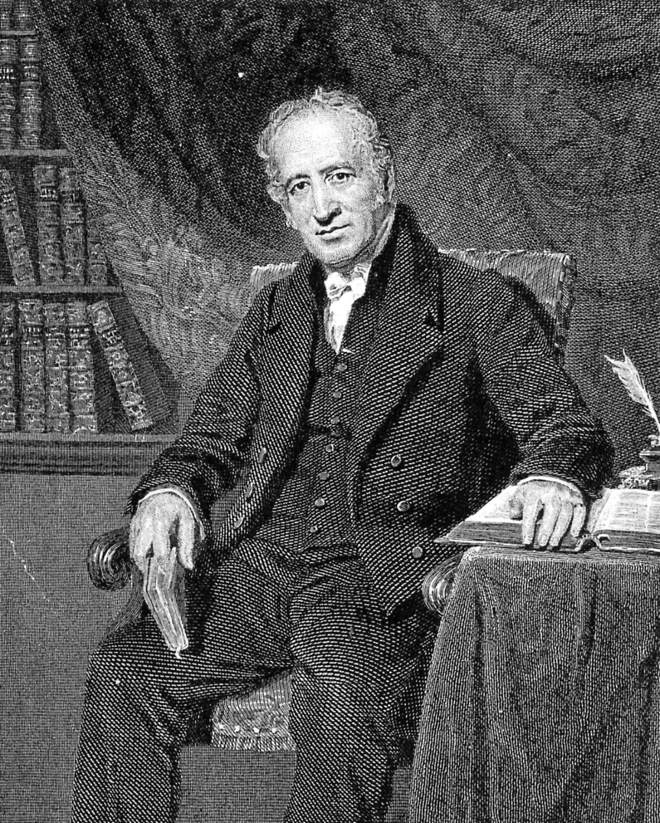
A new church was planted in Glasgow – Summer 1799
“His mindset in starting the church was, ‘Without issuing any thing in the form of creed, confession of faith, formula, or church rules, he exhibited the Bible, as the only rule of faith and practice, to which reference should be made, for government in every duty. He never contemplated making men Independents, but as being made Christians, by the washing of regeneration, and renewing of the Holy Spirit.’” - Memoir of Greville Ewing, J. J. Matheson, 1843, p. 230
Greville Ewing

Slide 13
By the end of 1804, there were 24 congregational churches throughout Scotland.
https://en.wikipedia.org/wiki/Broadway_United_Church_of_Christ

Slide 14
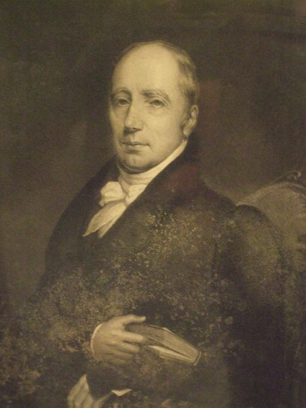
The Writings
1804 – "Reasons for separating from the Church of Scotland, in a Series of Letters, chiefly addressed to his Christian Friends in that Establishment.”
1805 – “A Vindication of Presbyterian Church Government”
https://ordinaryphilosophy.com/tag/william-innes/
William Innes - Dundee
Greville Ewing

Slide 15
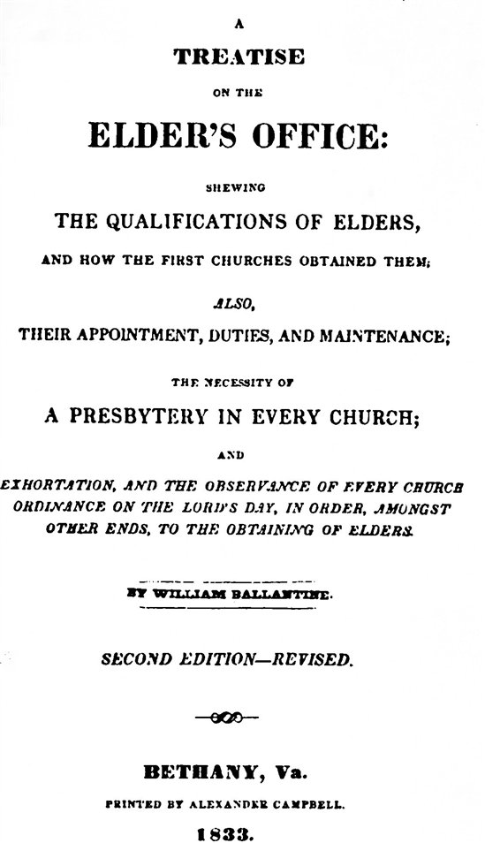
The Writings
1805 – William Ballentine: “Treatise of the Elder’s Office,”
1805 – “Views of the Social Worship of the First Churches” by James A. Haldane
Ballentine insisted that the Bible teaches there should be a multiplicity of elders in each congregation. And, that these should come from among members who volunteered, members who had no “formal education,” to participate in worship. This practice was called, “mutual exhortation.”
James Haldane

Slide 16
Divisions Arise 1807-1809
1807 – “An Attempt Towards a Statement of the Doctrine of Scripture On Some Disputed Points, Respecting The Constitution, Government, Worship, and Discipline of the Church of Christ.”
Greville Ewing

Slide 17
Divisions Arise 1807-1809
Non-ordained members conducting worship at Edinburgh
April – 1808 James Haldane determines he can no longer sprinkle babies & is himself immersed
Robert Haldane charges for seats in tabernacles to support the work.
April 1809 – Greville Ewing formally separates from the Haldane movement
James Haldane 1768-1851
Greville Ewing

Slide 18
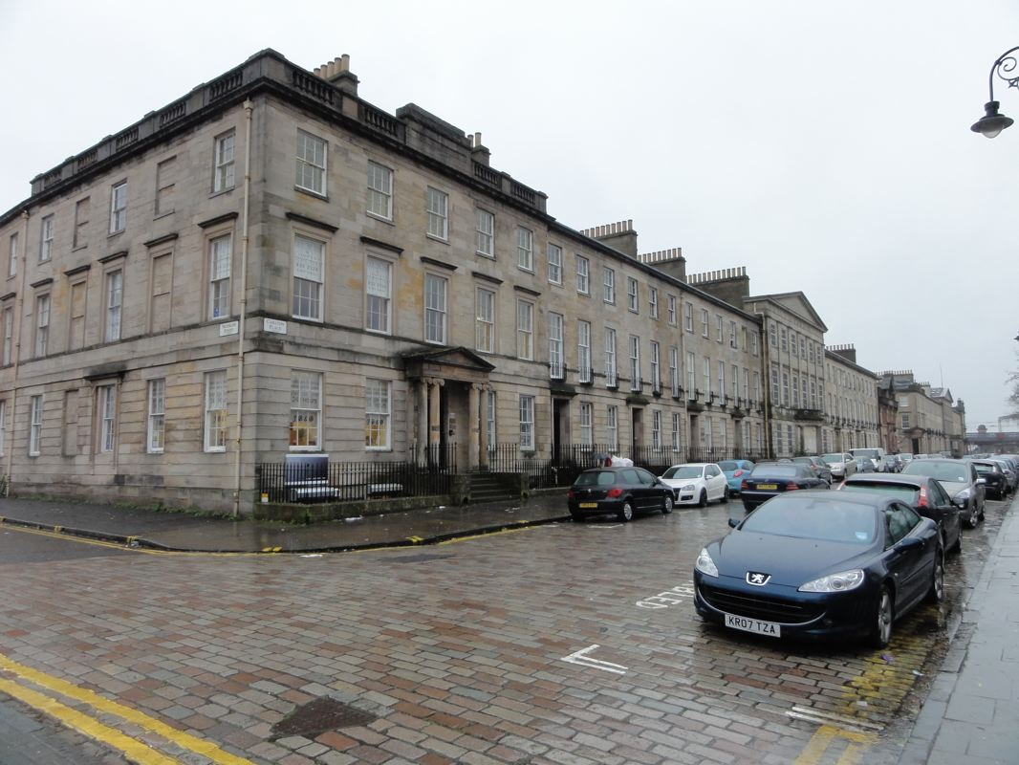
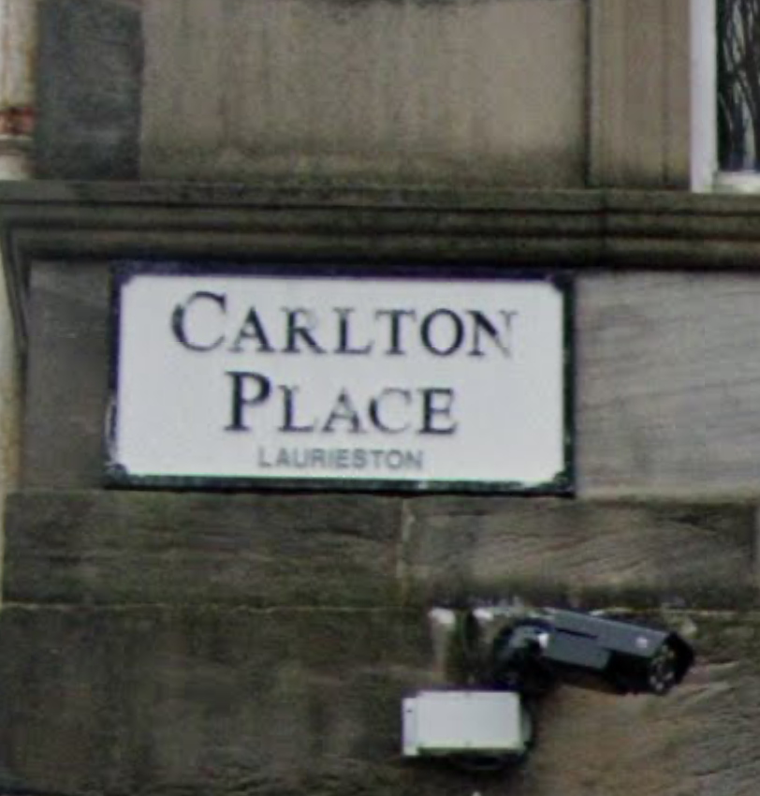
A Welcome Home At Carlton Place
Memoir of Greville Ewing, J. J. Matheson, 1843, p. 283

Slide 19
A Welcome Home At Carlton Place
Memoir of Greville Ewing, J. J. Matheson, 1843, p. 283

Slide 20
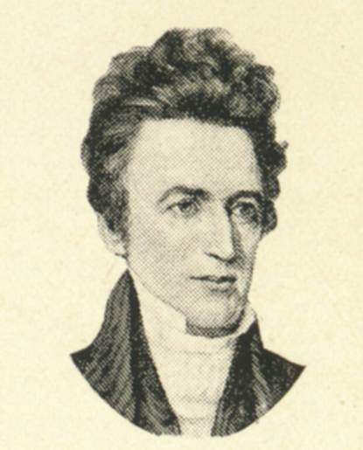
A Welcome Home At Carlton Place
Alexander Campbell
November 1808
Memoir of Greville Ewing, J. J. Matheson, 1843, p. 283
Greville Ewing

Slide 21
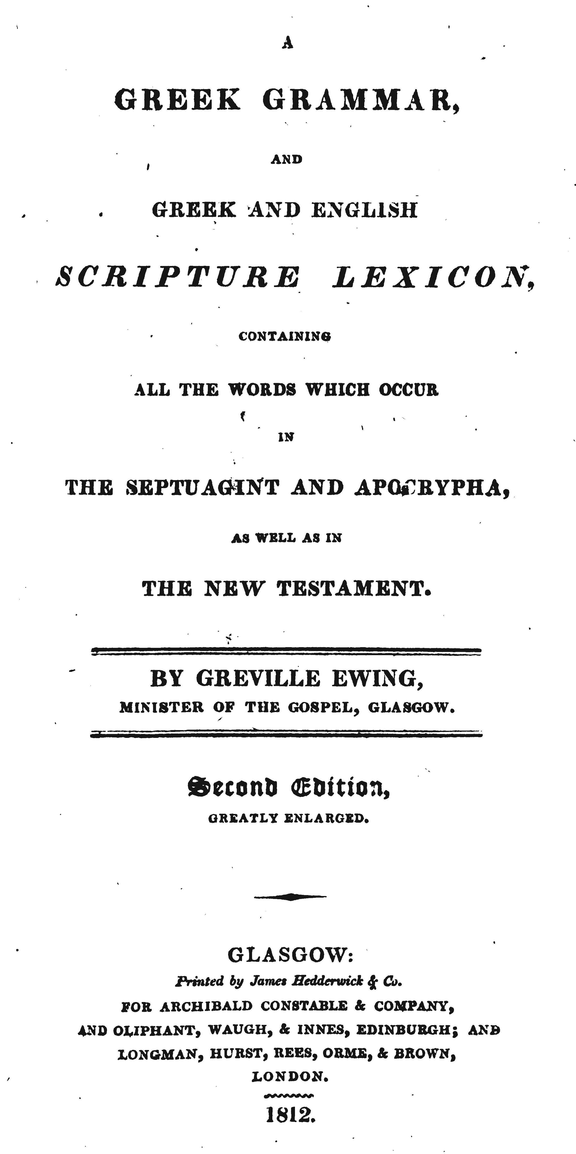
Publications of Greville Ewing
28 volumes, tracts, sermons, papers
1801 – The Rudiments of the Greek Language shortly illustrated; and a Compendious Lexicon. 2nd ed. 1812, 3rd ed. 1827

Slide 22
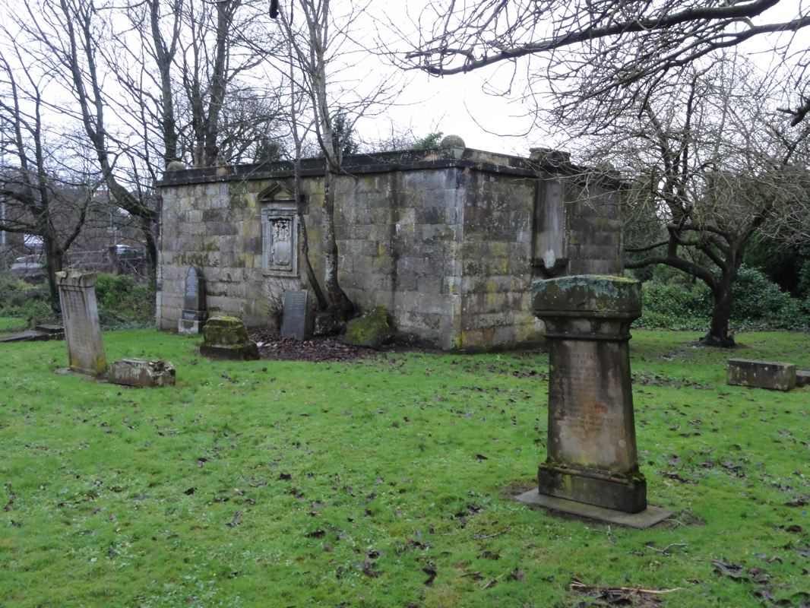
Greville Ewing died August 2, 1841
Greville Ewing
Maxwell Enclosure – Eastwood Cemetery Pollokshaws, Glasgow, Scotland

Slide 23
See This And More: TheRestorationMovement.com

