Slide 1
Is Restoration Relevant Today?
2 Corinthians 13:9-11

Slide 2
Is Restoration Relevant Today?
katarti÷zw katartizoœ - to complete thoroughly, i.e. repair (literally or figuratively) or adjust: — fit, frame, mend, (make) perfect(-ly join together), prepare, restore.
-Key Dictionary Of The Greek N.T.

Slide 3
Is Restoration Relevant Today?
It Is Our Prayer - v.9
It Is Our Pledge - v.10
It Is Our Proposal - v.11

Slide 4
The Prayer Of restoration - v.9
Solomon’s Prayer For Restoration - 2 Chronicles 6
Nehemiahs’ Prayer For Restoration - Nehemiah 1:3-11
Paul’s Prayer For Restoration - Ephesians 3:14-19

Slide 5
The Pledge Of Restoration - v.10
“As For Me And My House” - Joshua 24:15
“Teaching Them To Observe All Things I Have Commanded You” - Jesus, Matthew 28:20
“And what you have heard from me in the presence of many witnesses entrust to faithful men who will be able to teach others also.” - Paul, 2 Timothy 2:2
“We will speak where the Bible speaks, and remains silent where the Bible is silent.” - Thomas Campbell - 1809

Slide 6
The Proposal Of Restoration - v.11
Barton W. Stone - 1801
John Smith - 1832
John T. Johnson - 1836
N.B. Hardeman - 1923

Slide 7
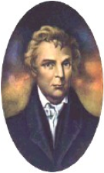
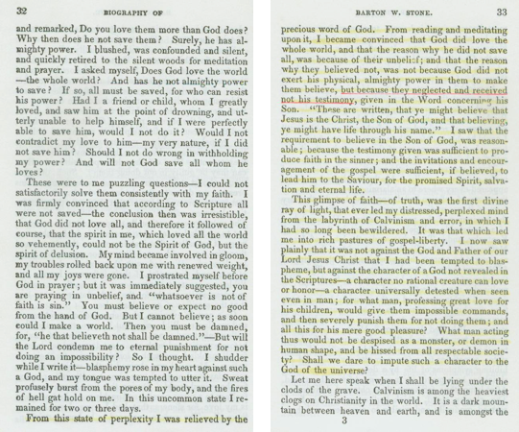
B.W. Stone’s Battle With Calvinism

Slide 8
B.W. Stone’s Battle With Calvinism

Slide 9
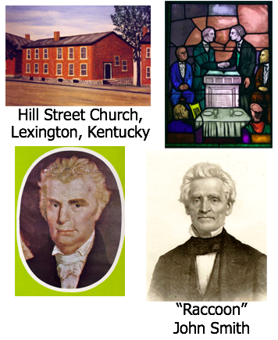
Unity Meeting Lexington, Ky, Jan.1, 1832
“Let us, then my brethren, be no longer Campbellites or Stoneites, New Lights or Old Lights, or any other kind of lights, but let us come to the Bible, and to the Bible alone, as the only book in the world that can give us all the light we need.” — John Smith
B.W. Stone

Slide 10
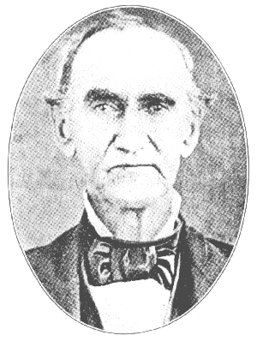
John T. Johnson 1836
"The spirit of proselytism, which regards exclusively the interests of one denomination, and is concerned in bringing men to Heaven, in one way or not at all, and which disregards the feelings and interests of other churches, is a principle of war." - Dr. Beecher, Presbyterian, -Christian Messenger, December 1835, Vol. 9, #12 p.281,2,
From Gospel Advocate, 1836 J.T. Johnson responds: “We are curious enough to pause here a moment and ask for information, how many denominations were in the times of the apostles, and for two centuries afterward? We have read in the Acts of Apostles of a sect called or named Christians, at Antioch— a sect everywhere spoken against. And if any one was suffering as such (as a Christian), he was exhorted not to be ashamed. For my life, I can find no record of the Presbyterian denomination. If Dr. Beecher could only be convinced that there was no such denomination ever recognized by the Savior and his apostles, it would be an easy task for him to prove, from the sacred record, that there is not even a plausible ground for his sister denominations of Episcopalians, Methodists, etc.

Slide 11
John T. Johnson 1836
“But the clause quoted induces us to ask, how many ways are there to Heaven? Did the Saviour teach more than one way? But are there not ways? If there be more than one way, it is very important that Christians should be made acquainted with them, that the people may make choice of the one which suits their tastes. Just before the Saviour left the world, he commissioned his ambassadors to proclaim one way. Peter followed his instructions in the first discourse he delivered after the commission. Now, we have been simple enough to believe that there is but one gospel, and but one way to Heaven. The terms of pardon are too plain to be mistaken.
“If we are wrong, it is because we are warring against the requirements of the Saviour, not because this warfare strikes at the very existence of the different denominations; for we are free to confess that it does. And for this very reason all parties ought to give this subject a patient, full, fair and candid examination. Who have returned to the pure, unadulterated, apostolic doctrine, or word of God, is the great, the interesting, the momentous question? If none have, then let us teach each other and return together. Let us meet upon the true, the only foundation. 'Thou art the Christ, the Son of the living God.' Love him, obey him, be buried with him, rise with him. Then let us run the race together, assisting each other to win the prize.

Slide 12
John T. Johnson 1836
Dr. Beecher: 'With trumpet-tongue the providence of God is calling upon Christians of every denomination, to cease from their limited views and selfish ends, and to unite in the conflict which is to achieve the subjugation of the world to Christ!'
J.T. Johnson: The doctor has not been roused to obedience by the trumpet-tongued providence of God! He is still a Presbyterian— and that is just what the Lord never warranted him to be. He must abandon— yea, I say abandon— it is a harsh-sounding word to a man of delicate nerves, but so it is. He must abandon the Presbyterian creed and cause, before he can get upon that foundation laid by the Christian's King, and before he can or will unite in the conflict which is to achieve the subjugation of the world to Christ. Yes, my friend, the mischiefs of the spirit of Presbyterianism have been great. You have felt them long enough to speak from knowledge, and from the heart. And you are a most competent witness that it has been 'endured long enough to afford experimental evidence of its wickedness and folly.' Come out of her, doctor. Some of them have been striving to force you out. Come out of your own accord, and place yourself upon that rock against which the gates of hell shall not prevail.

Slide 13
John T. Johnson 1836
“Yes, doctor, it is a matter of fact, and of painful regret, that the Protestant Churches 'have been contending whether a small remnant of men should go to heaven precisely in this or in some other way, while the world has been perishing around them.' There is but one remedy for all this evil; and he who is blind to it, or can not see it, must be the slave of a party, or of a human system. Come back to the Bible. We repeat with you, doctor, that 'it is time to cease from this limited enterprise. Jesus Christ has need of our harmonious exertion, and the world has need of it. Never can the world be emancipated until those who love our Lord, and the souls of men, are released by voluntary suffrage from the divisions, toils and irritations of a war establishment.' It would have sounded much better if the doctor had added, 'a war establishment of human origin.'”

Slide 14
John T. Johnson 1836
Dr. Beecher: “And may God grant that this generation pass not away before a delegation from all Christian denominations shall assemble to attend the funeral of bigotry and heresy, and to lay them so deep in the same grave, that they shall not rise until the trumpet of the arch-angel shall call them to judgment to answer for their crimes, and to receive the punishment of their deeds.”
J.T. Johnson: “Brother Stone gives in his adhesion to the sentiments of the extract by a most cordial assent, and says amen! to the concluding prayer. Not so fast, brother Stone. I see the doctor has emphasized Christian denomination. You, like some of the rest of us, may not be included in the doctor's estimate of what is a Christian denomination. Now, it is very certain that if you and I belong to a Christian congregation, that the doctor does not. The congregations are too unlike to be the same. The Presbyterian Church is not the Church of our Lord Jesus Christ. He never founded such a Church, and never "has given the slightest intimation that he will acknowledge it as such.....In the meantime I would, as the doctor's best friend, beseech him to leave the ranks of 'bigotry and heresy' before 'the trumpet of the arch-angel shall call' him to judgment to answer for remaining in such ranks with a full knowledge of what he himself so justly condemns.”

Slide 15
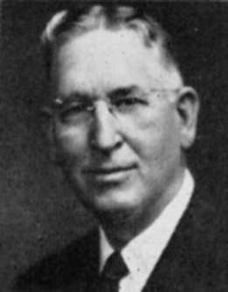
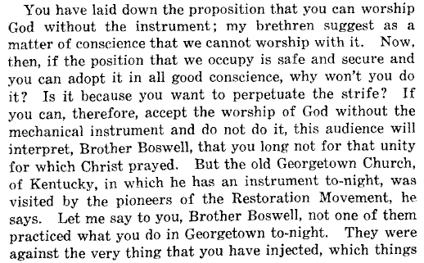
1923 Hardeman/Boswell Debate

Slide 16
1923 Hardeman/Boswell Debate
-Hardeman’s Second Speech, May 31, 1923,
page 61,62

Slide 17
The Proposal Of Restoration Is Still The Same Today:
Aim For Restoration!!!

