Slide 1
E. S. Wiley’s Plantation School

Slide 2
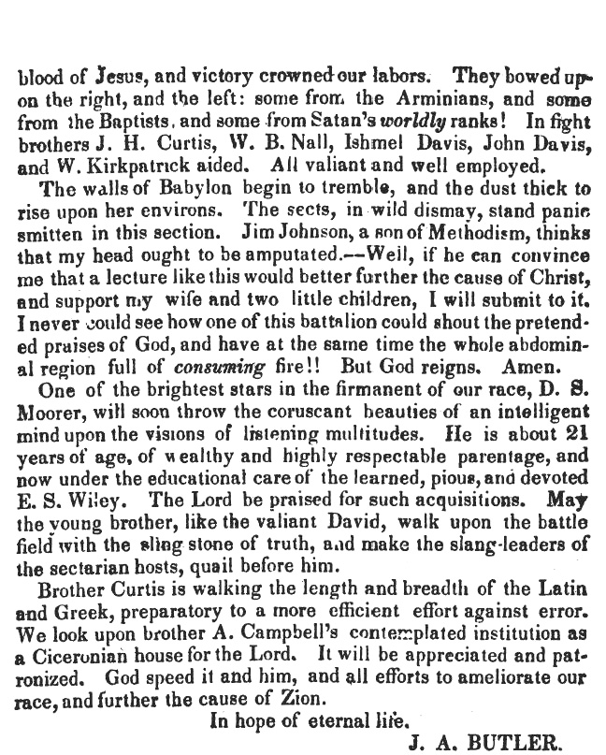
(H.D., November 1840, pp. 357-358).

Slide 3
Braggs Store, Lowndes County, Alabama, Dec. 15, 1839: The good cause is advancing rapidly… I have been evangelizing this year, say not more than nine months, during which upwards of 20 have been immersed. Brother Butler has immersed as many more, besides other accessions. Brother J. M. Barnes reached this place two days ago. He intends settling permanently in this county. Thank the Lord for our increasing strength. James H. Curtis. (M.H., February 1840, p.91)

Slide 4
By 1840, Barnes had returned to Alabama and was conducting a Bible School at "old Brother Wylie's" in Lowndes County.
He had formerly worked in Chambers County and had returned to South Carolina.
William C. Kirkpatrick, the oldest brother of J. W. Henry's grandmother, was one of the pupils to attend this school.
Henry said that he had heard "many reminiscences of his Uncle William, but Grandmother Payne stuck to it to the last that 'Jeems' A. Butler, as she pronounced it, was the greatest of all preachers, living or dead.

Slide 5
William C. Kirkpatrick was the eldest brother of Sarah Kirkpatrick Payne. He attended the Bible School conducted at "Brother Wylie's in Lowndes County," by John M. Barnes, who has already been mentioned.

Slide 6
Henry describes him thus: Intellectual, tall and sinewy, .... He would rise at four o'clock on Sunday morning, walk from twenty to thirty miles to an appointment, preach from eleven to one or two o'clock, and never dampen his collar.
He wrote many articles on church history and similar topics for our current religious journals.
He went to Tennessee as a teacher and an evangelist in 1847, through the influence of John M. Barnes, but later returmed to Montgomery county, Alabama.

Slide 7
By 1840, Barnes had returned to Alabama and was conducting a Bible School at "old Brother Wylie's" in Lowndes County. William C. Kirkpatrick, the oldest brother of J. W. Henry's grandmother, was one of the pupils to attend this school. Henry said that he had heard "many reminiscences of his Uncle William, but Grandmother Payne stuck to it to the last that 'Jeems' A. Butler, as she pronounced it, was the greatest of all preachers, living or dead. In 1845, Barnes moved to Tennessee in order to earn a larger salary to support his increasing family. That year, when Wharton, Fanning, and Anderson were attempting to get the Christian Review launched, John M. Barnes was requested to represent Middle Tennessee on its editorial staff. The following year he organized a school which he called Berea Academy.
(M. H., New Series, III, No. 4 (April 1839), 187, 189, 190, 1~ibid., New Series, III, No. 5 (May 1839), 285-86. 108J. w. Henry, op. cit., p. 1, col. 4. 109Millennial Harbinger, New Series, VII, No. 12 (December 1843)' 574. 49 industrial Bible School, located on the Nashville and Huntsville road, forty miles from Nashville).

Slide 8
Before I close this note, already too long, permit me to speak a word in reference to Bro. John M. Barnes. He is engaged in a flourishing school in Maury Co., and from the manner his patrons universally express their approbation of his labors, I can say that Middle Tennessee ought to encourage his school liberally. He is a skillful instructor, is possessed of brilliant talent-is assisted by his highly accomplished Lady and does business with an energy and activity worthy of this best of employment& Brethren, send him your sons, and he will make them ornament& to the State, the church and the world. He educates for both worlds. Your Bro. in the Hope,
Nashville, Dec. 28, 1843. W. S. Speer. (Christian Review, January 1844, p14)

Slide 9
Barnes was a much-loved figure to his students. B.F. Manire would write:
In the summer of 1846, when in my eighteenth year, I made the good confession under the preaching of J. J. Trott and W. S. Speer, and was baptized by the hands of my revered teacher, John M. Barnes, to whose painstaking and skillful instructions; I am mainly indebted for whatever literary attainments I may have made, and to whose memory I now gladly pay this tribute of undying affection. (R.L. James, pp. 46-50).

Slide 10
"Elm Crag" & Tolbert Fanning
by L.C. Chisholm
My first acquaintance with Mr. Fanning was in 1842 at a big meeting he held in the little town of Russellville, Ala., at which time he had two hundred additions, I being one of the number.
In 1843 I went to his Elm Crag School, but remained only a short time. I was not pleased with Elm Crag as suited to my wants at the time, and set in with John M. Barnes, who was teaching at Old Lasea, Maury County, Tenn., and remained with him three years.

Slide 11
Highland Home
THE SCHOOL OF SOUTH ALABAMA

Slide 12
Justus McDuffie Barnes Was The Most Powerful Force To Work In South Alabama.
Just Out Of Bethany College, He Started Strata School On Sept. 8, 1858.

Slide 13
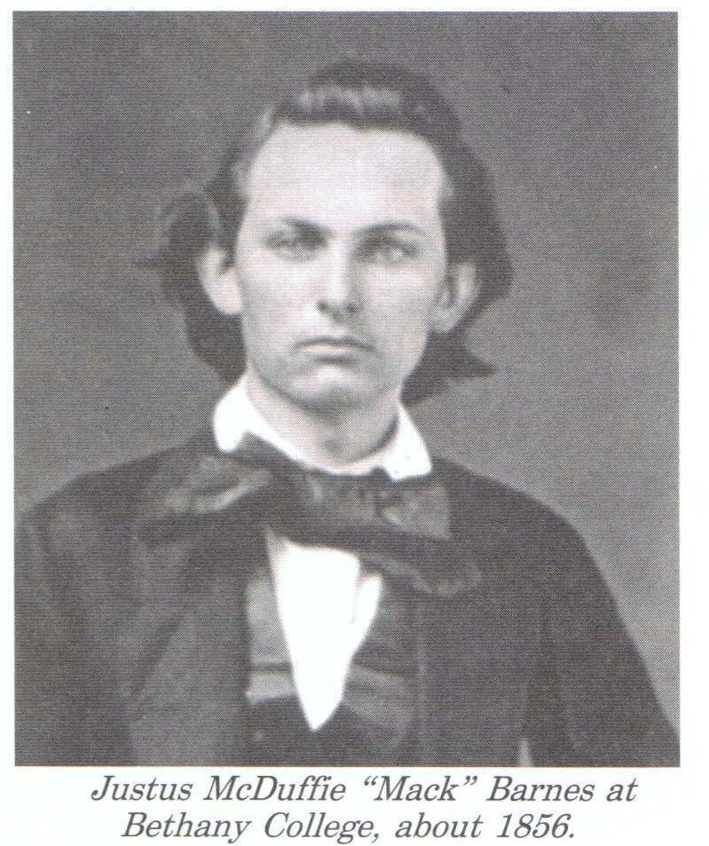
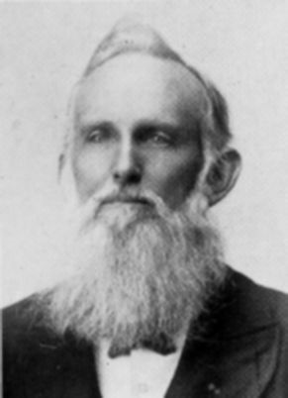

Slide 14
Justus McDuffie Barnes was well educated, having received his preparatory training from Felix Tankersley at Strata, Professor Mangum, a native of Ireland and graduate of the University of Dublin who taught at Rocky Mount, now Highland Home, and from George C. Freeman who taught near Pine Level. He attended Bethany college, Virginia, now West Virginia, 1854-56, and graduated with a degree of A. B. during the presidency of Alexander Campbell who founded the college.

Slide 15
He began teaching at Strata, in 1856, on his father’s plantation, with thirteen pupils, but his school quickly grew in favor and soon developed into the Strata high school with an enrollment of nearly two hundred students, of which his two brothers-in-law, Samuel Jordan and M. L. Kirkpatrick became joint proprietors. The location was changed to Highland Home, with a change of name in 1881 to Highland Home Institute, changing again in 1889 to Highland Home College which remains as a monument to the vision and labors of its founders. He resigned the presidency of this school in 1898 and removed his family to Montgomery where he established the Barnes school for boys, conducted for the past twelve years by his son, Ely Barnes.

Slide 16
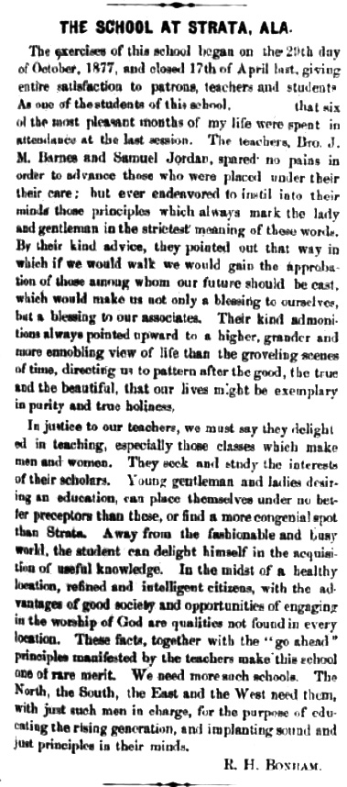

Slide 17
J. W. Henry studied in school under Justus M. Barnes and became closely associated with the family. His information regarding the early history of the Disciples of Christ in Alabama came from the written sources (where there were any) , and from his personal contacts with the "pioneers" and the children of the pioneers. For a number of years, he was in the insurance business which kept him traveling over the state almost constantly.

Slide 18
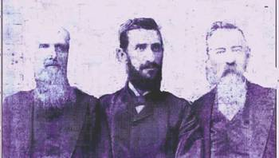

Slide 19
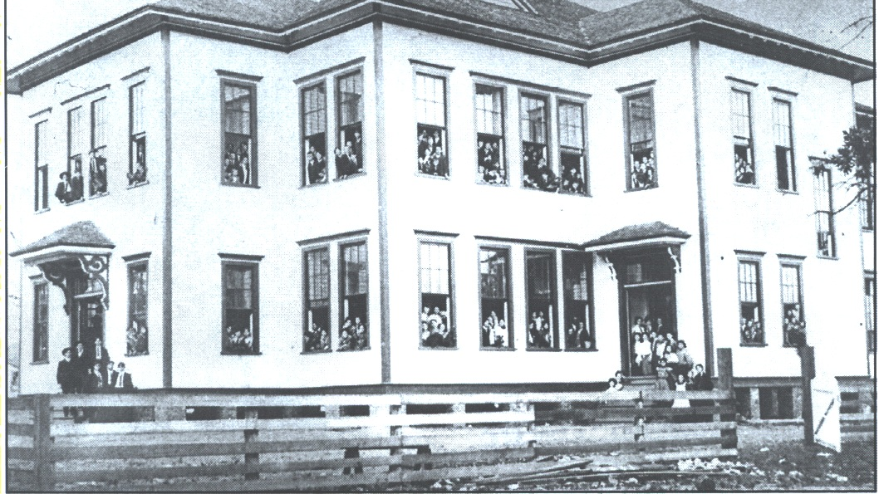

Slide 20
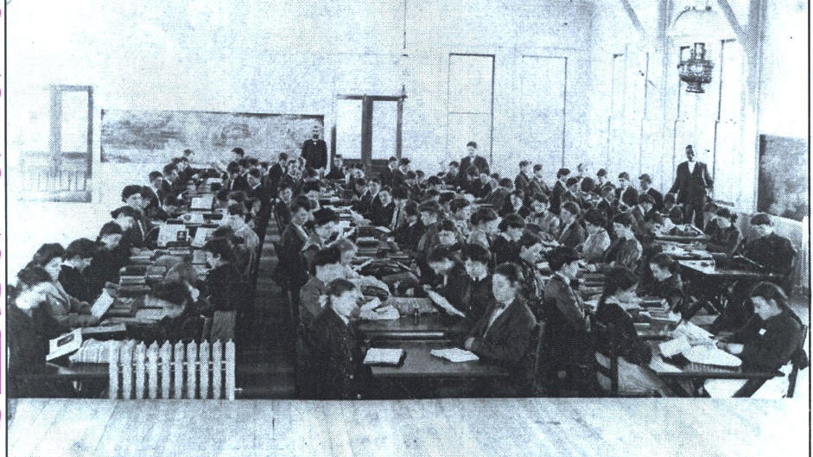

Slide 21
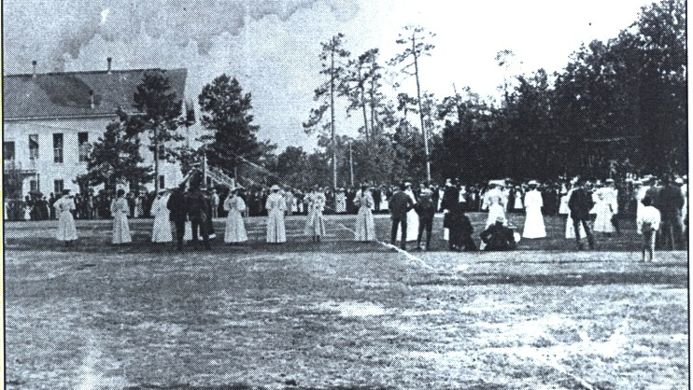

Slide 22
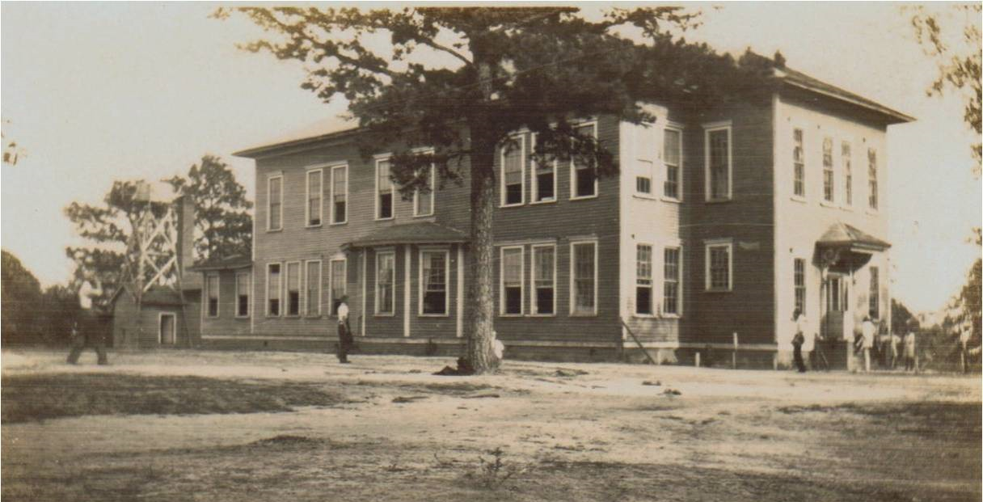

Slide 23
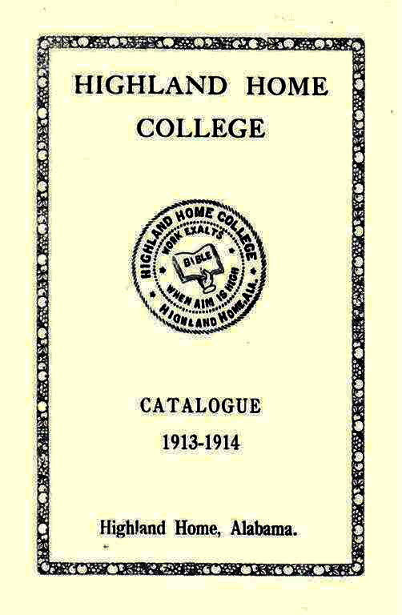

Slide 24
In 1881 He Moved The School To Highland Home.
The School Continued Until 1916.
The School Was Taught By Barnes, Samuel Jordan,
And M.L. Kirkpatrick.
( Both Men Were His Brothers-in- law).

Slide 28
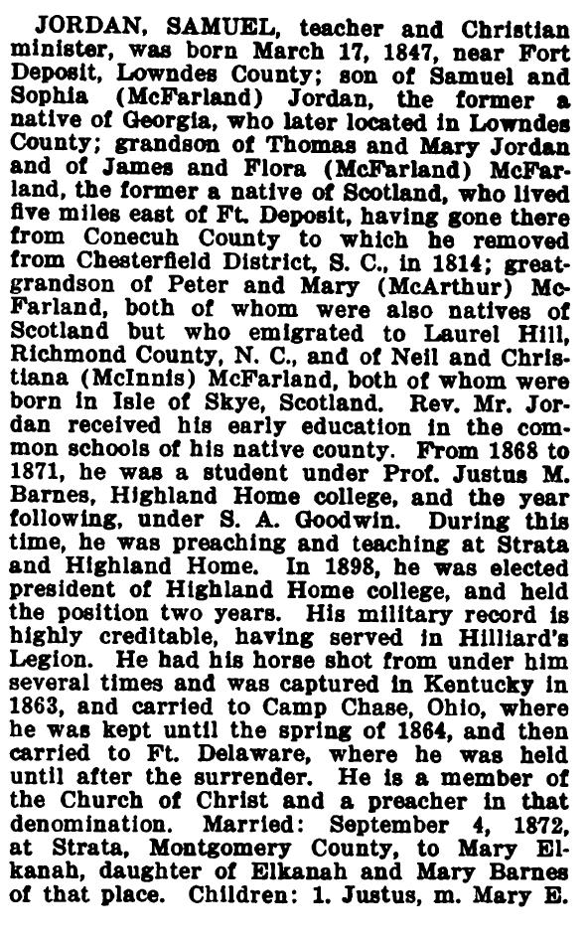
(Thomas McAdory Owen, Alabama and Dictionary of Alabama Biography, vol. III, S.J. Clarke Publishing Company, Chicago, 1921, pp. 949-950)

Slide 29
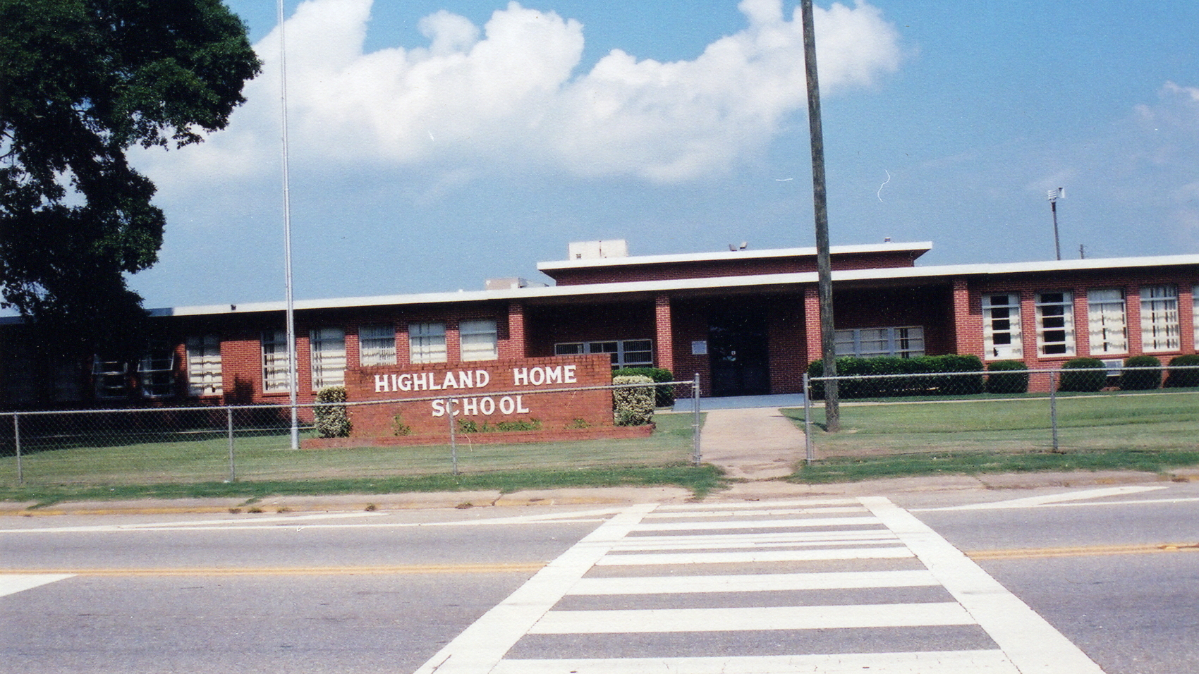

Slide 30
Lawrence County Movement

Slide 31
MOUNTAIN HOME

Slide 32
MOUNTAIN HOME SCHOOL
Mountain Home, eight miles north of Moulton, was a notable place at an early date. On October 2, 1837, when Martin Van Buren was president, a certain tract containing 40 ¼ acres, located the Southwest ¼ of the Southwest ¼ of Section 22, Township 5, Range 7, Lawrence County, Alabama, was staked out by and deeded to Alexander G. Austin by the United States Government. On this 40 1/2 acres of land stood Mountain Home's first school. Beautiful, ever-flowing Mountain Home Springs are within a stone’s throw of this land.

Slide 33
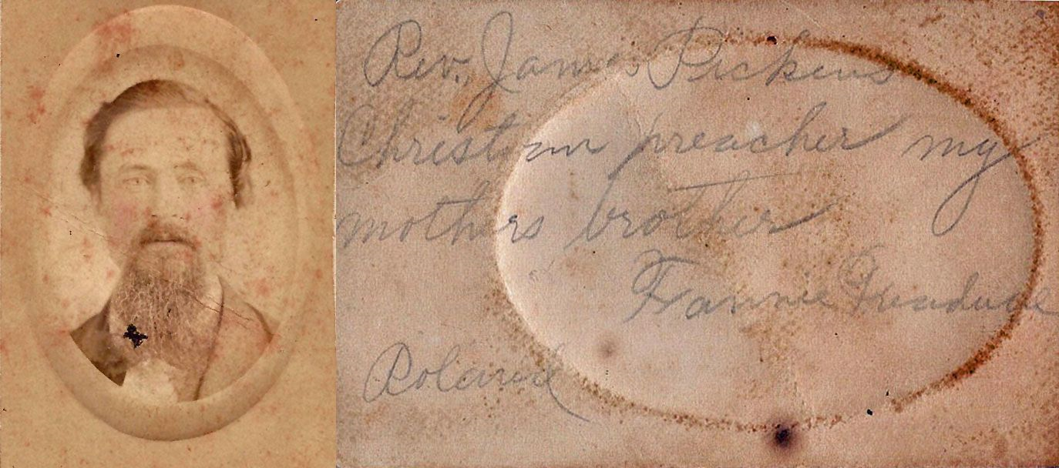

Slide 34
By an Act approved February 6, 1869, four years after the War Between the States, the Legislature of Alabama authorized a normal class at Mountain Home with no appropriations listed. There was a school at Mountain Home all during the decade 1870 to 1880 offering work on the Elementary and Secondary levels with possibly some college courses. James M. Pickens, a minister in the Church of Christ and a teacher, was principal and owner of the school plant. Andrew Pickens, Miss Gertrude Pickens and Miss Lou Williams also taught at that time. James Pickens planned to print a newspaper at Mountain Home and had the printing press installed but on February 3, 1881 was fatally shot before he was able to print the first paper. T. B. Larimore, founder of Mars Hill School in Lauderdale County, Alabama, taught with Mr. Pickens, getting the idea of Mars Hill from Mountain Home Academy. After Mr. Pickens death, there was no school for a while. Posey Spraggin was a teacher for a short time.

Slide 35
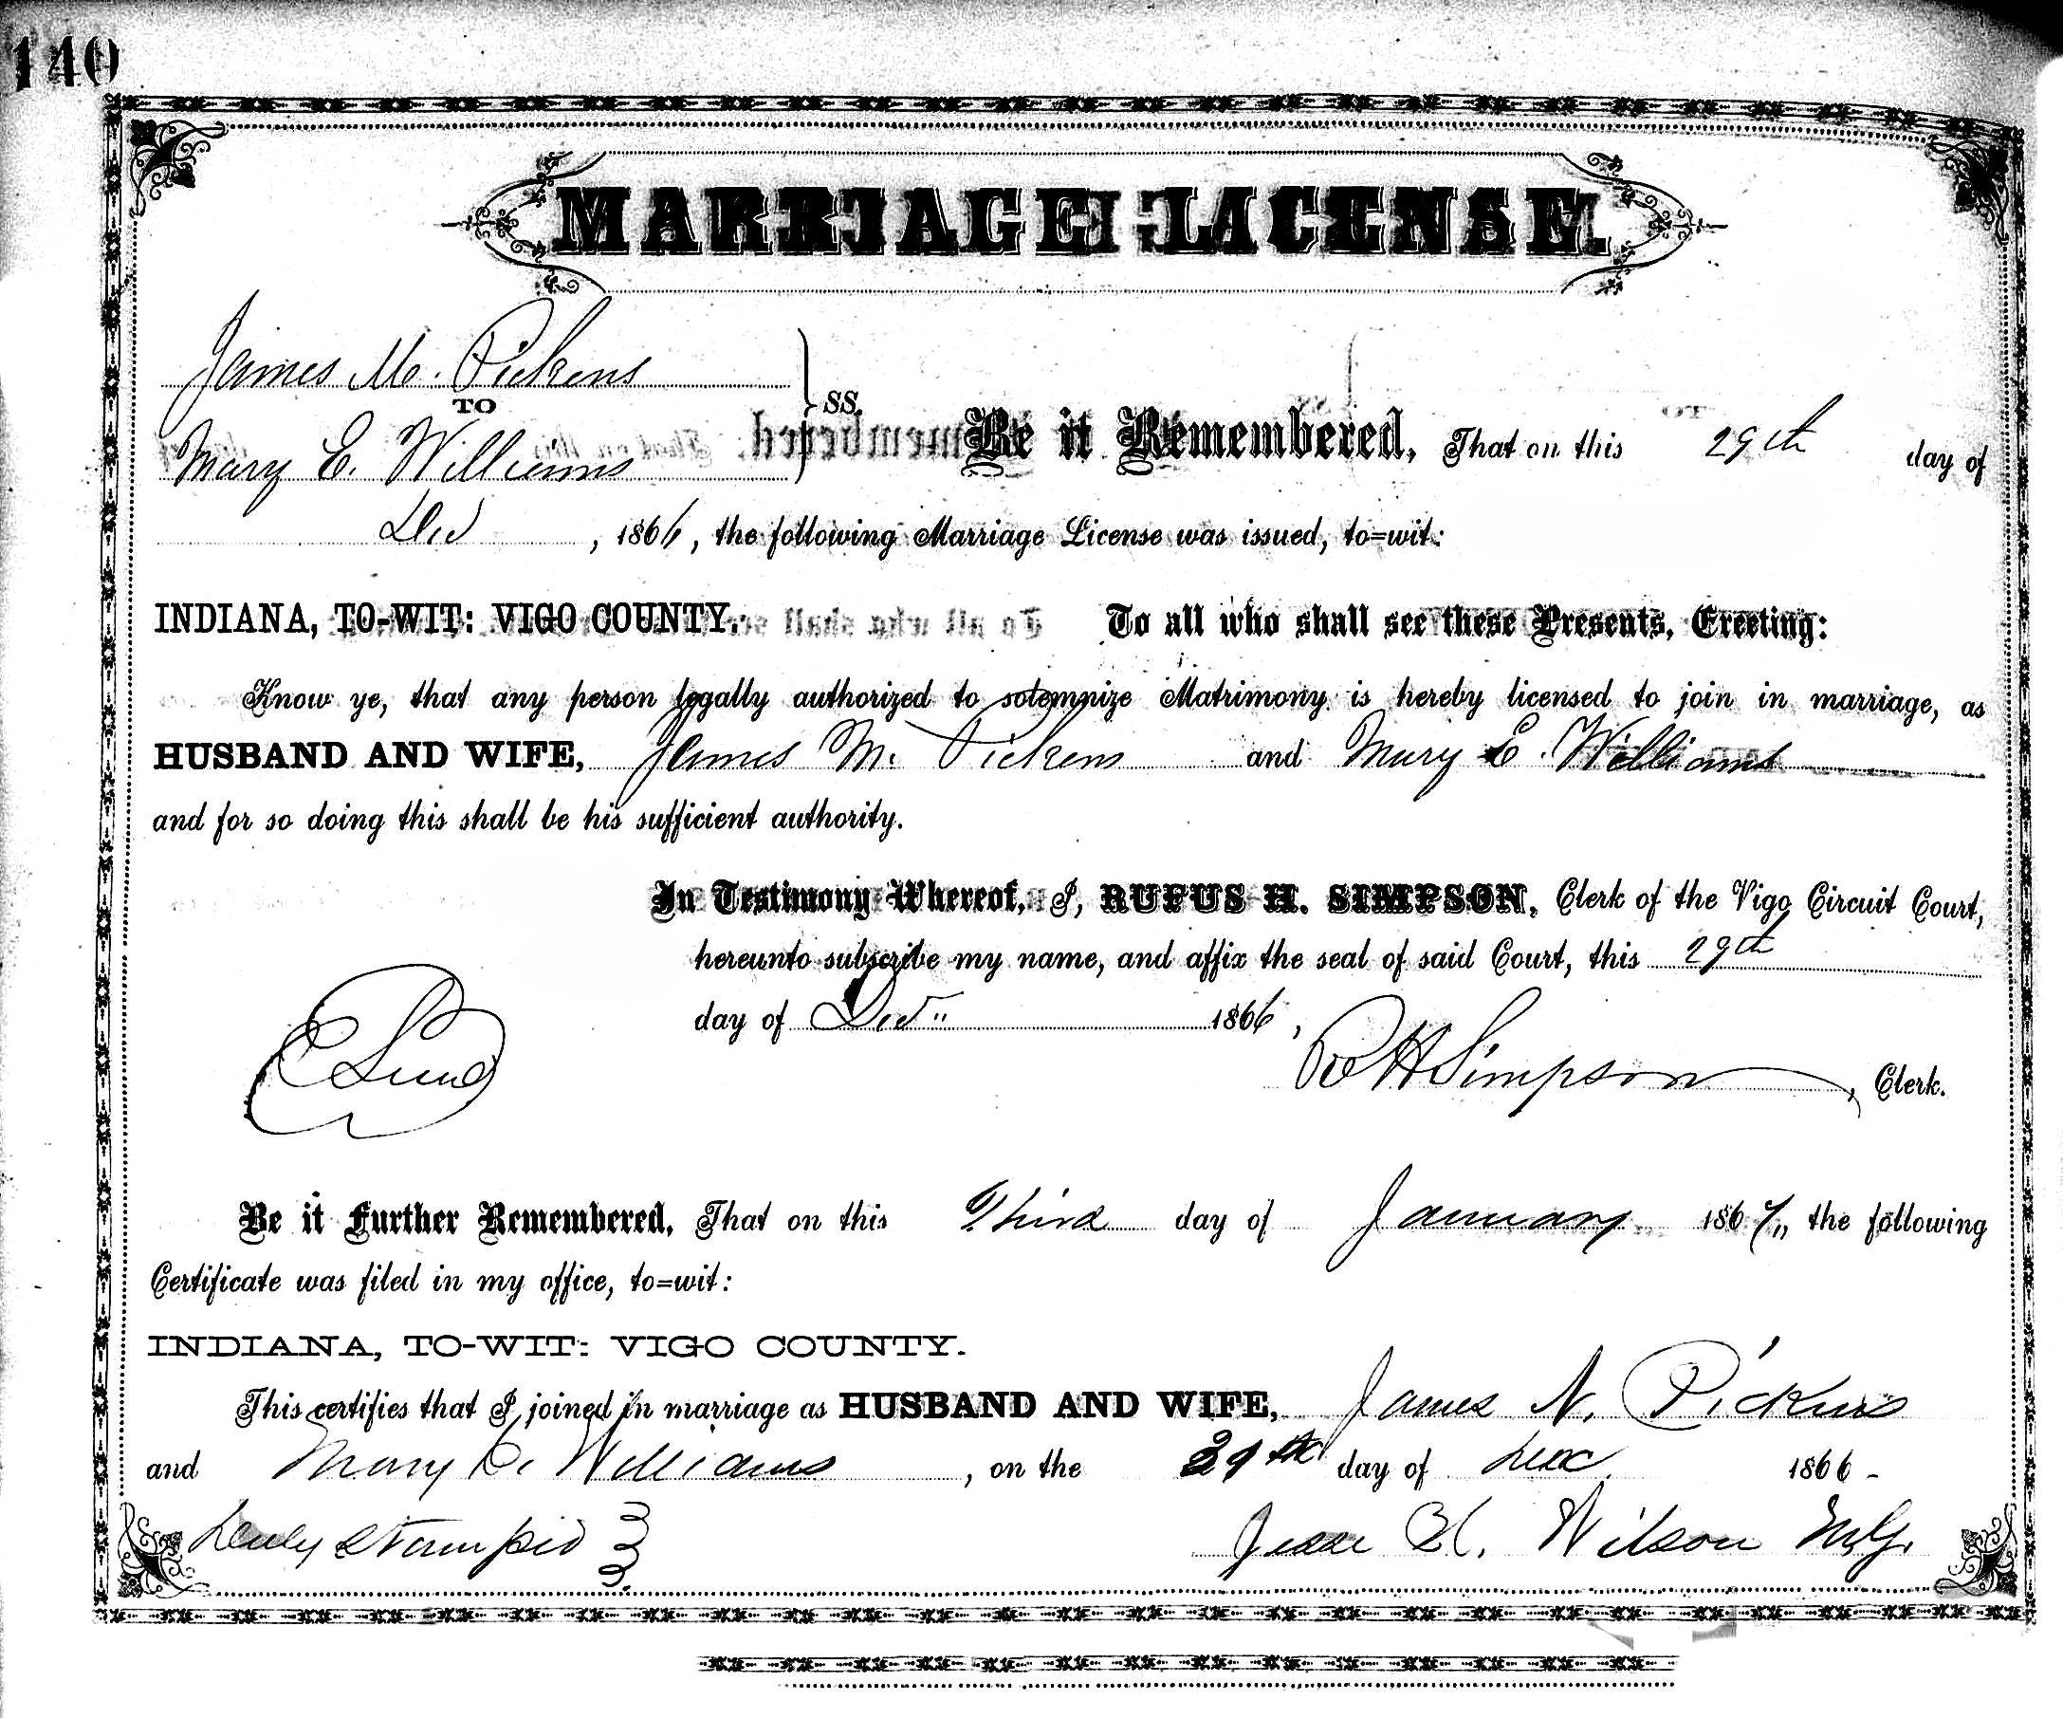

Slide 36
The large, well-adapted and commodious Boarding House is still standing and is the residence of the Riley Hill family. The dining room was in the basement and the kitchen was in a separate building behind the main dormitory. Discipline in the dining room was such that the person in charge did not speak for the young ladies to obey but merely scraped a foot on the stone floor to give directions to table manners, rising, and marching out. "One scrape" meant one thing, "two scrapes" meant something else, and so on.

Slide 37
On July 9, 1889, Mrs. Mary W. Pickens, widow of James M. Pickens, sold to Isaac Hollingsworth and his wife, Mary Hollingsworth, 325 acres of land with all the buildings, tenements, and appurtenances for the price of $1,150. The Mountain Home School plant was included in the sale.

Slide 39
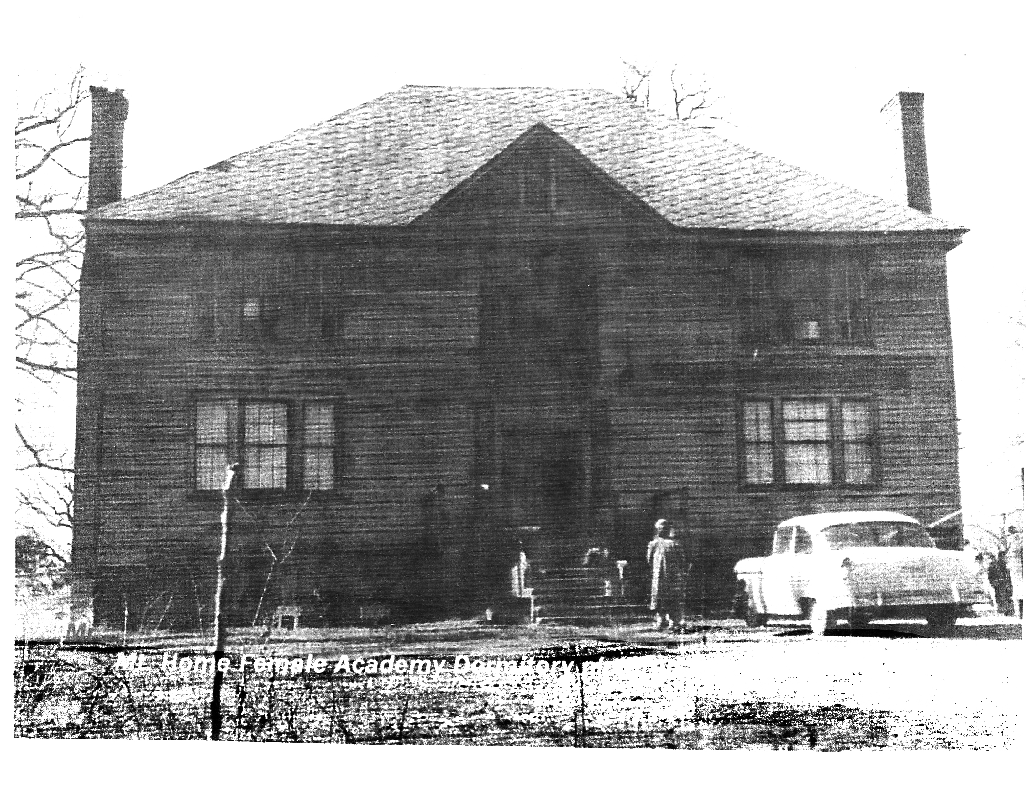
Home was consolidated with larger schools in 1952, closing the final chapter of the historic Mountain Home School.
(Excerpts from "Mountain Home School" Written by Ralph E. Graham, 1959).

Slide 40
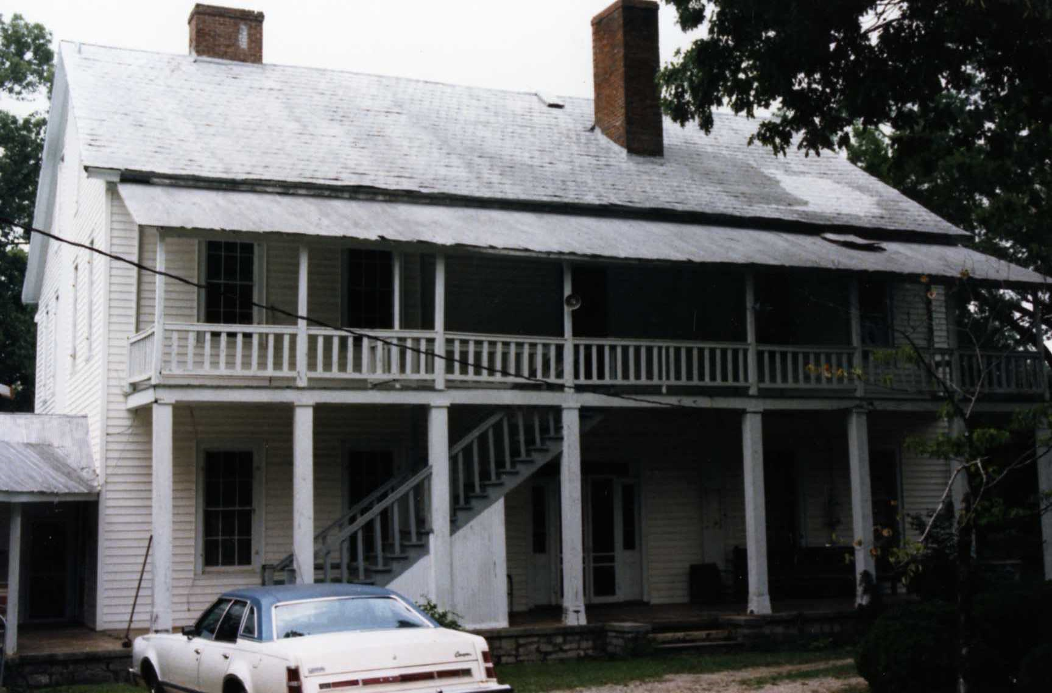

Slide 41
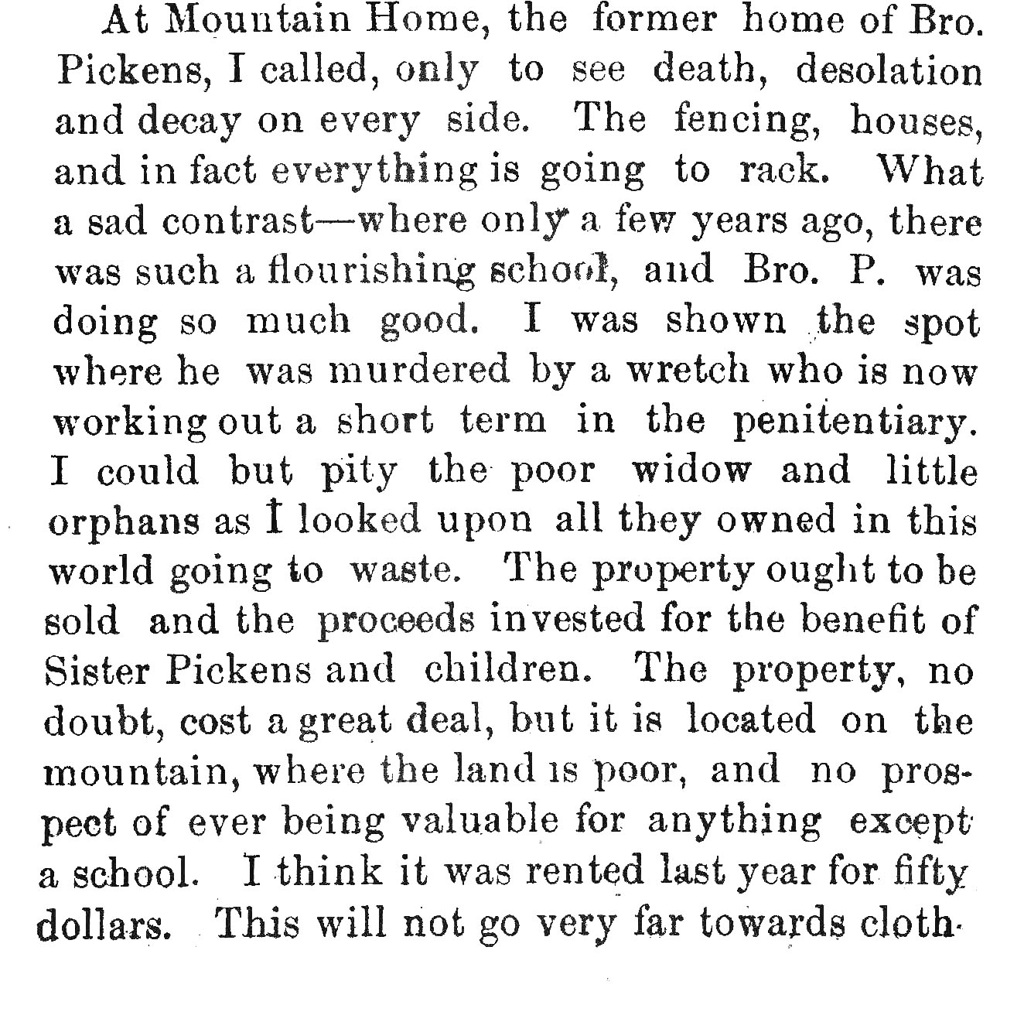

Slide 42
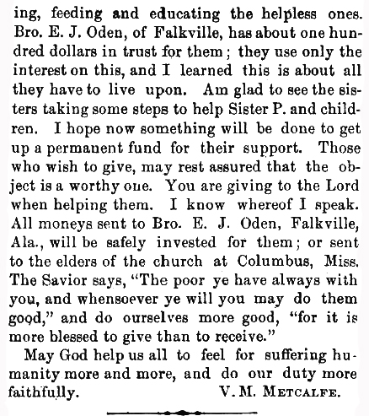

Slide 43
Crocket McDonald At Conference ,August 18, 1827.

Slide 44
3. James Madison Pickens Arrived In 1868.
a. Began Mountain Home College north of Moulton.
b. Larimore taught there for a year.
c. It was at Mountain Home that Larimore decided to start Mars Hill Bible College.

Slide 46
Pickens published a Journal at Mountain Home.
He also ran for Governor Of Alabama in 1880, On the Greenback ticket.
He died in a tradgic death in 1881. He was murdered, possibly over politics.
General Joe Wheeler volunteered to help in Letson’s defense.

Slide 47
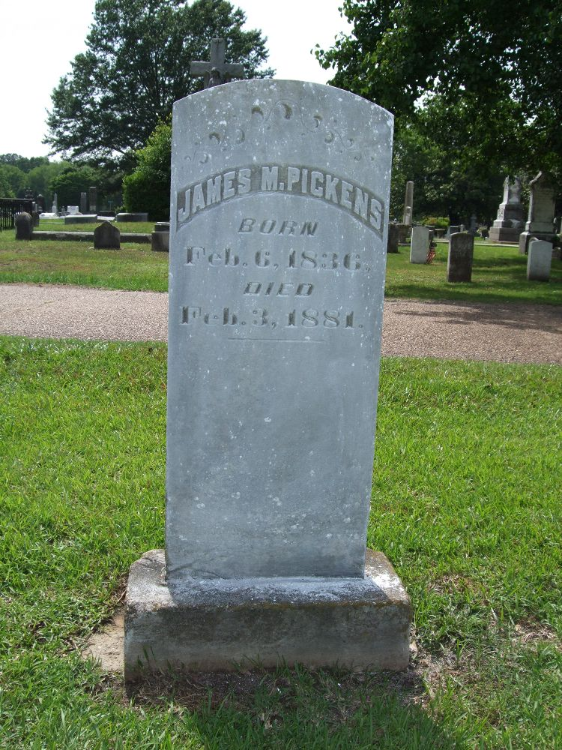
MOUNTAIN HOME COLLEGE

Slide 50
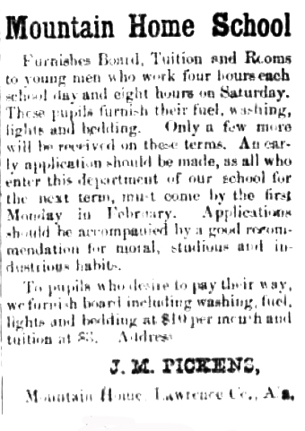
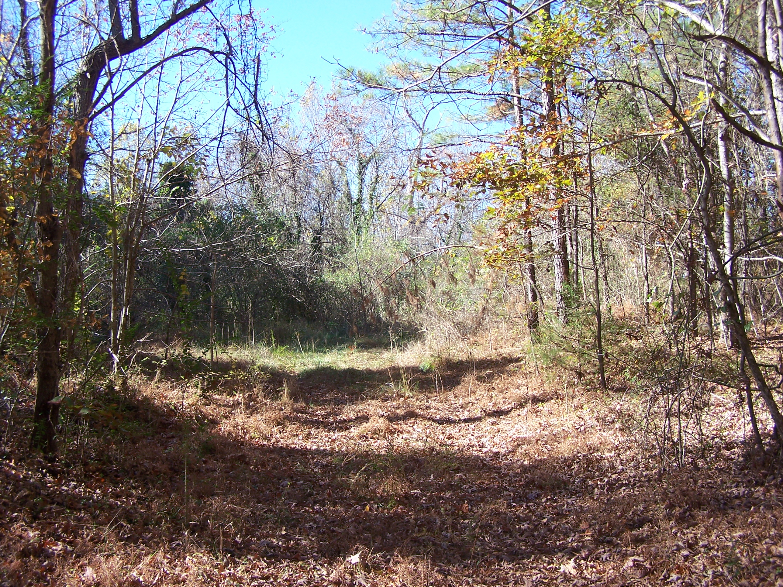

Slide 51
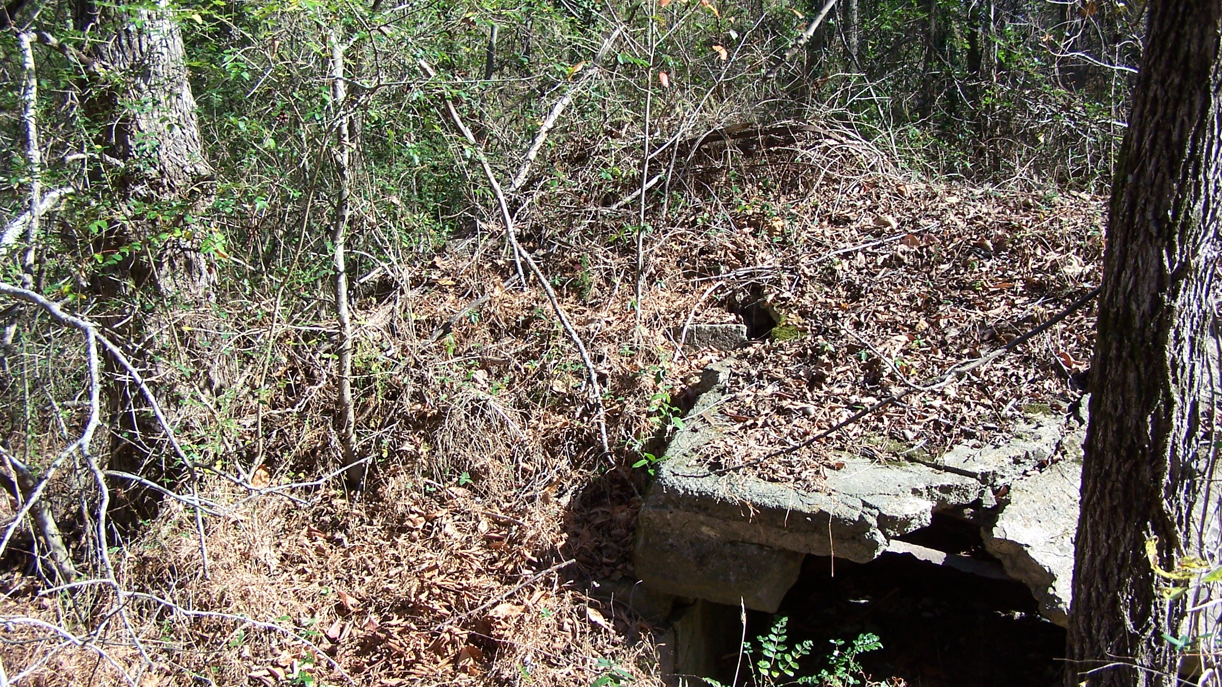

Slide 52
Mars Hill

Slide 53
Franklin College was established by Tolbert
Fanning In 1845 and it ended in 1866.

Slide 54
Two of the most outstanding graduates of Franklin College

Slide 56
Education
T.B. Larimore and John A. Thompson founded
Mars Hill College in 1870.

Slide 57
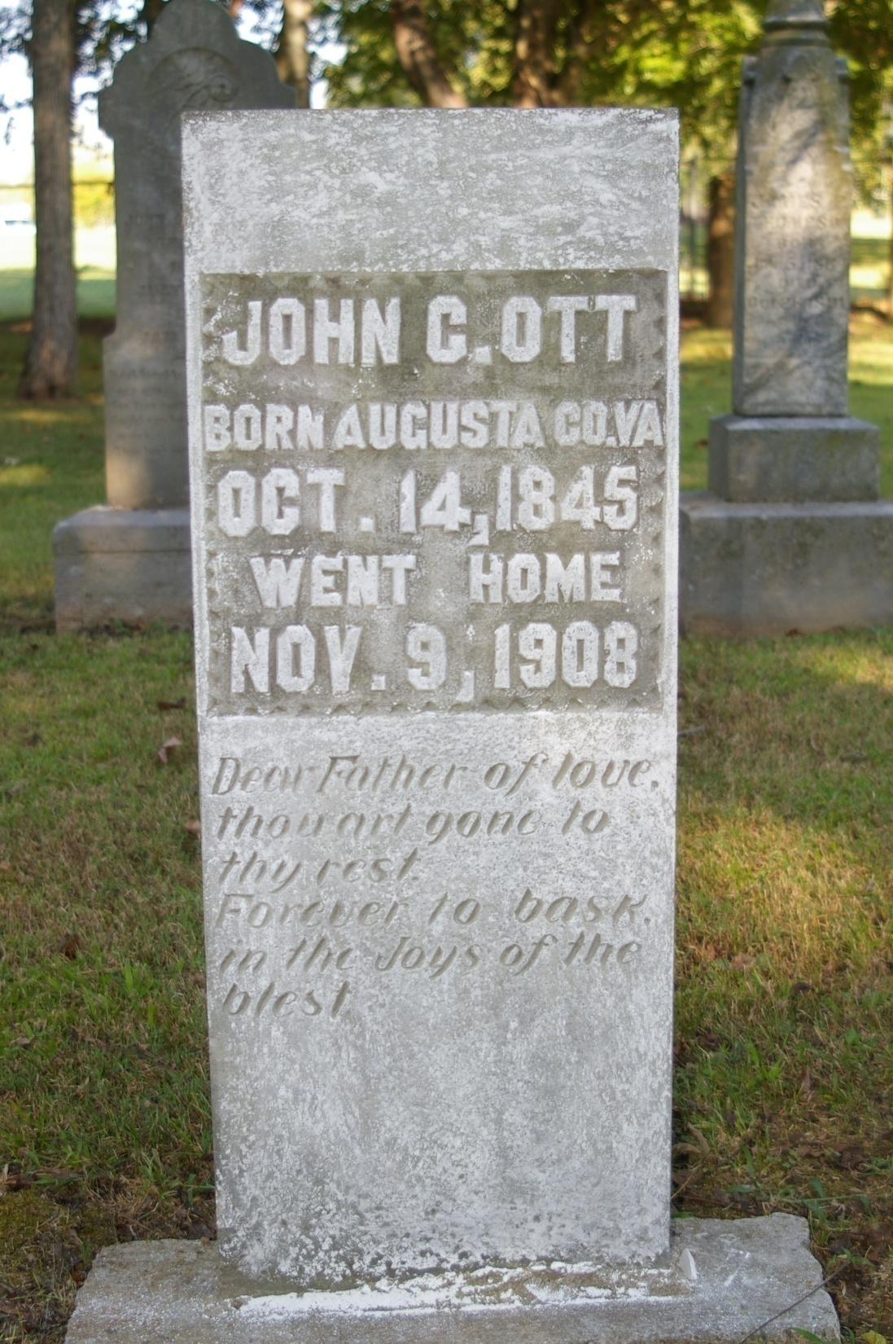

Slide 58
Education
The most famous of Larimore’s students
Mars Hill Students

Slide 59
Other Students at Mars Hill

Slide 60
Education

Slide 61
Education
Another One of Larimore’s Boys

Slide 62
Education

Slide 63
Education

Slide 64
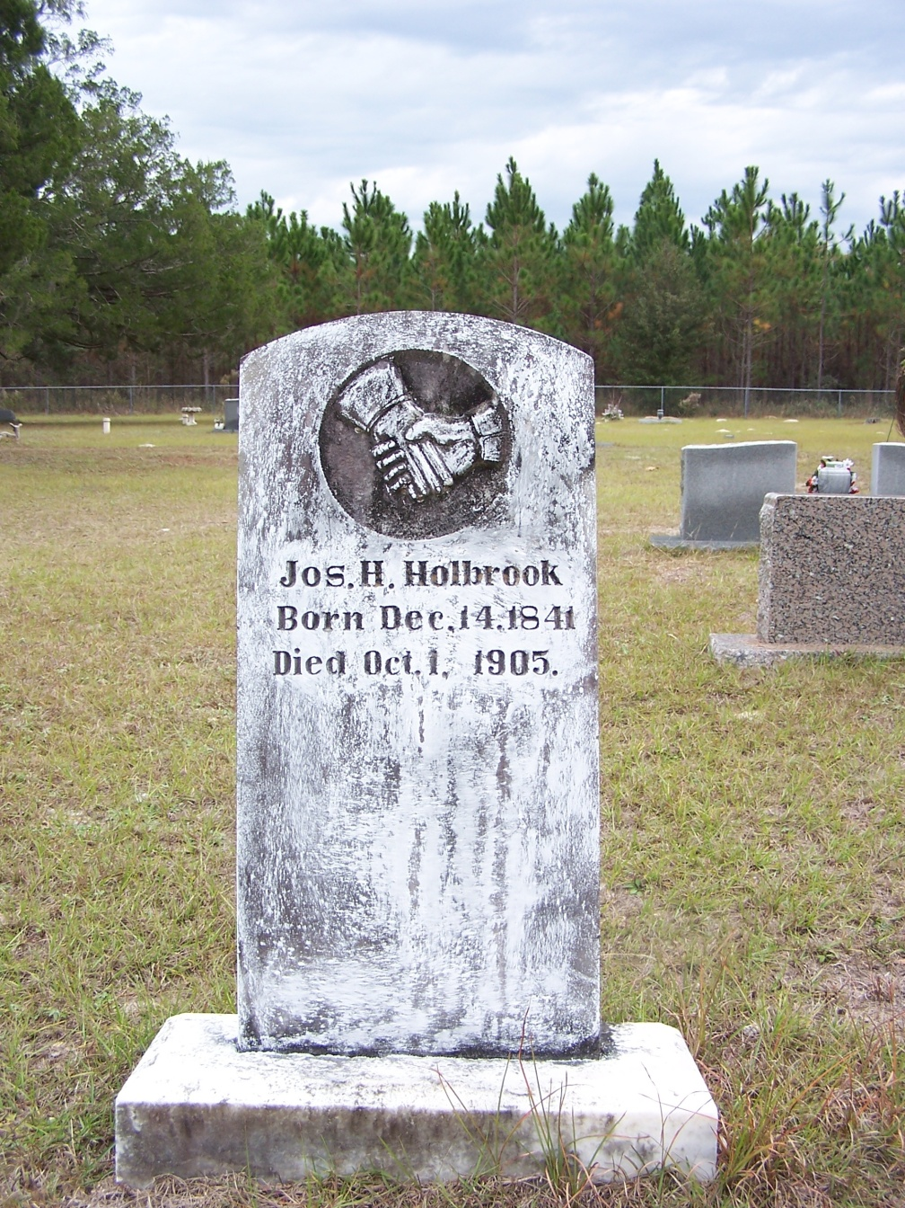
Education
Holbrook Was At Mars Hill For Two Years

Slide 65
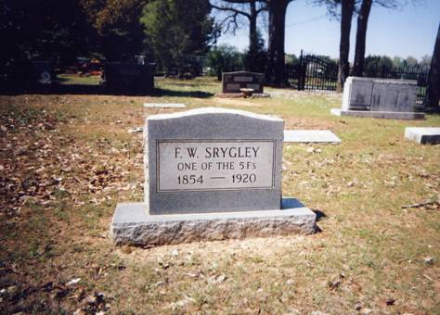
D. Larimore’s Boys

Slide 66
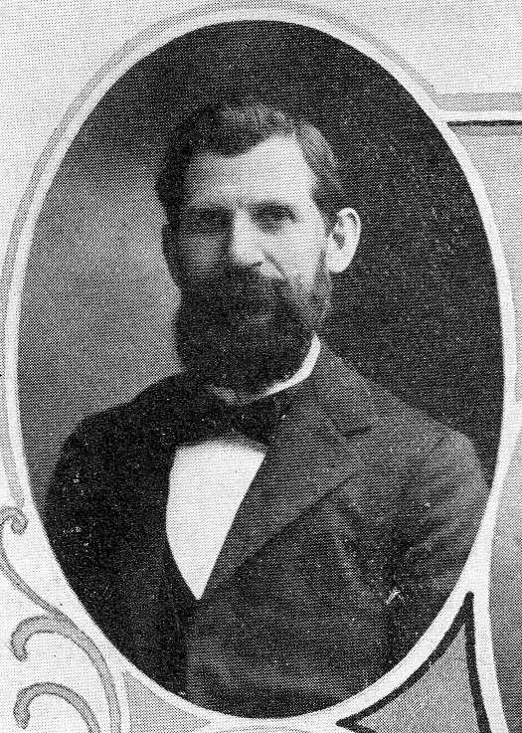

Slide 68
2. Theophilus Brown Larimore
conducted Mars Hill Bible College from 1871 until 1887.

Slide 70
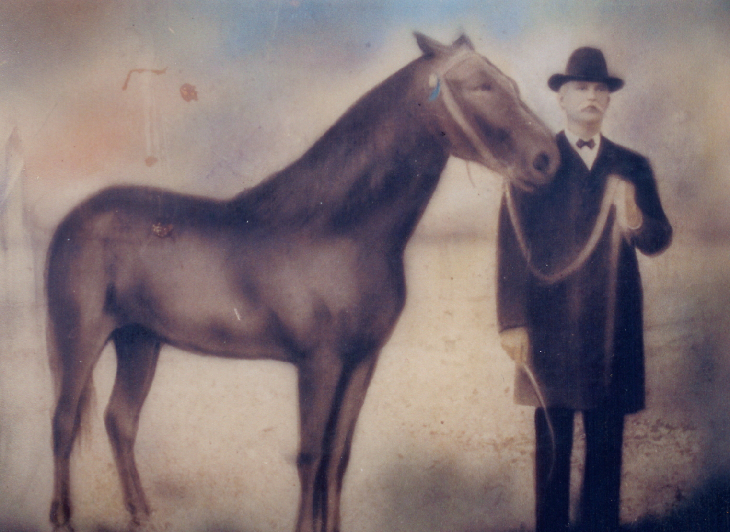

Slide 71
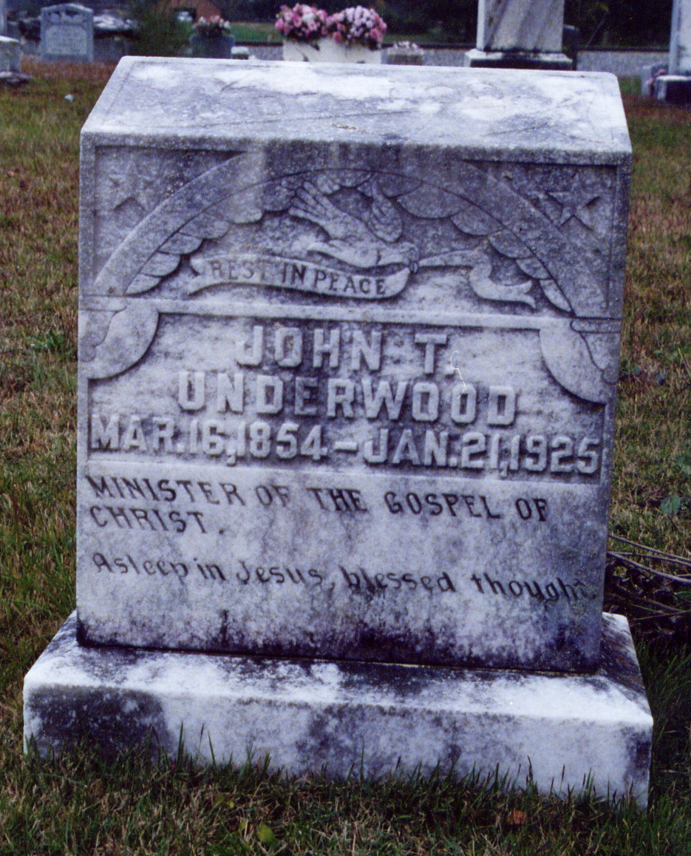
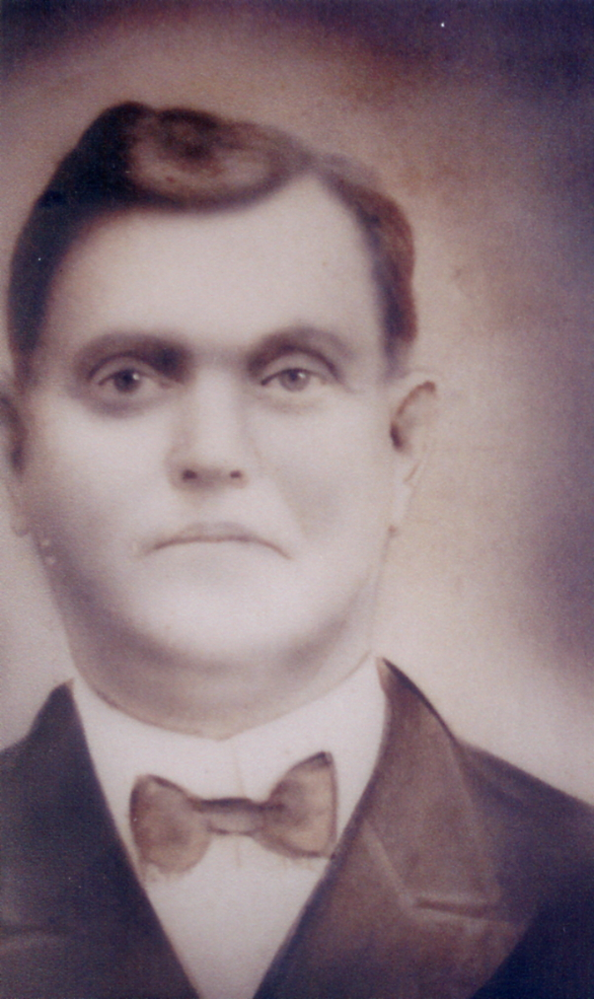

Slide 72
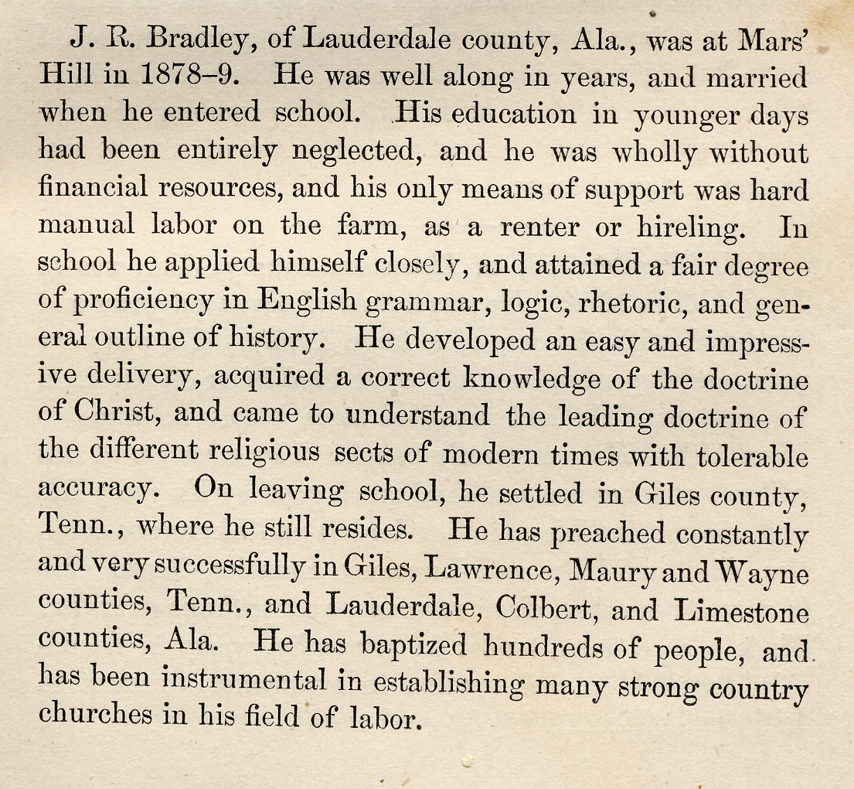

Slide 73
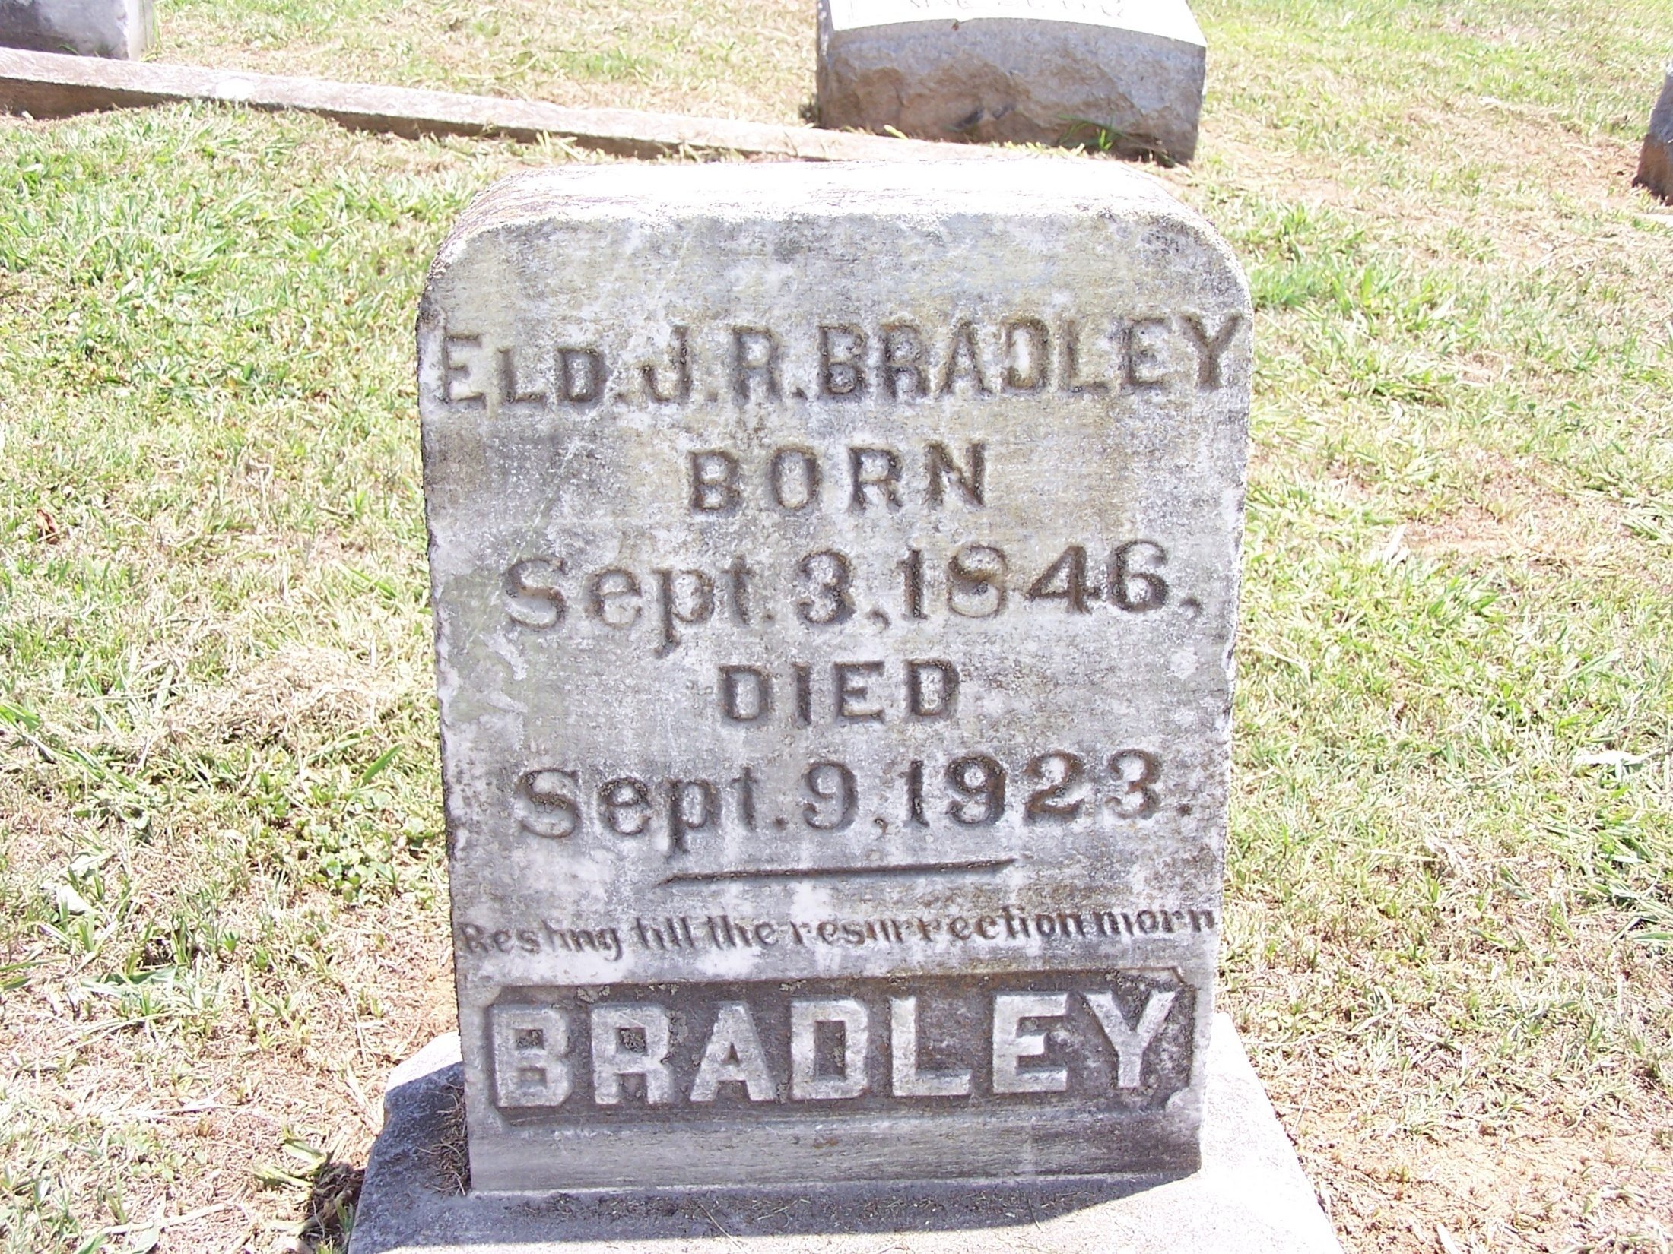

Slide 75
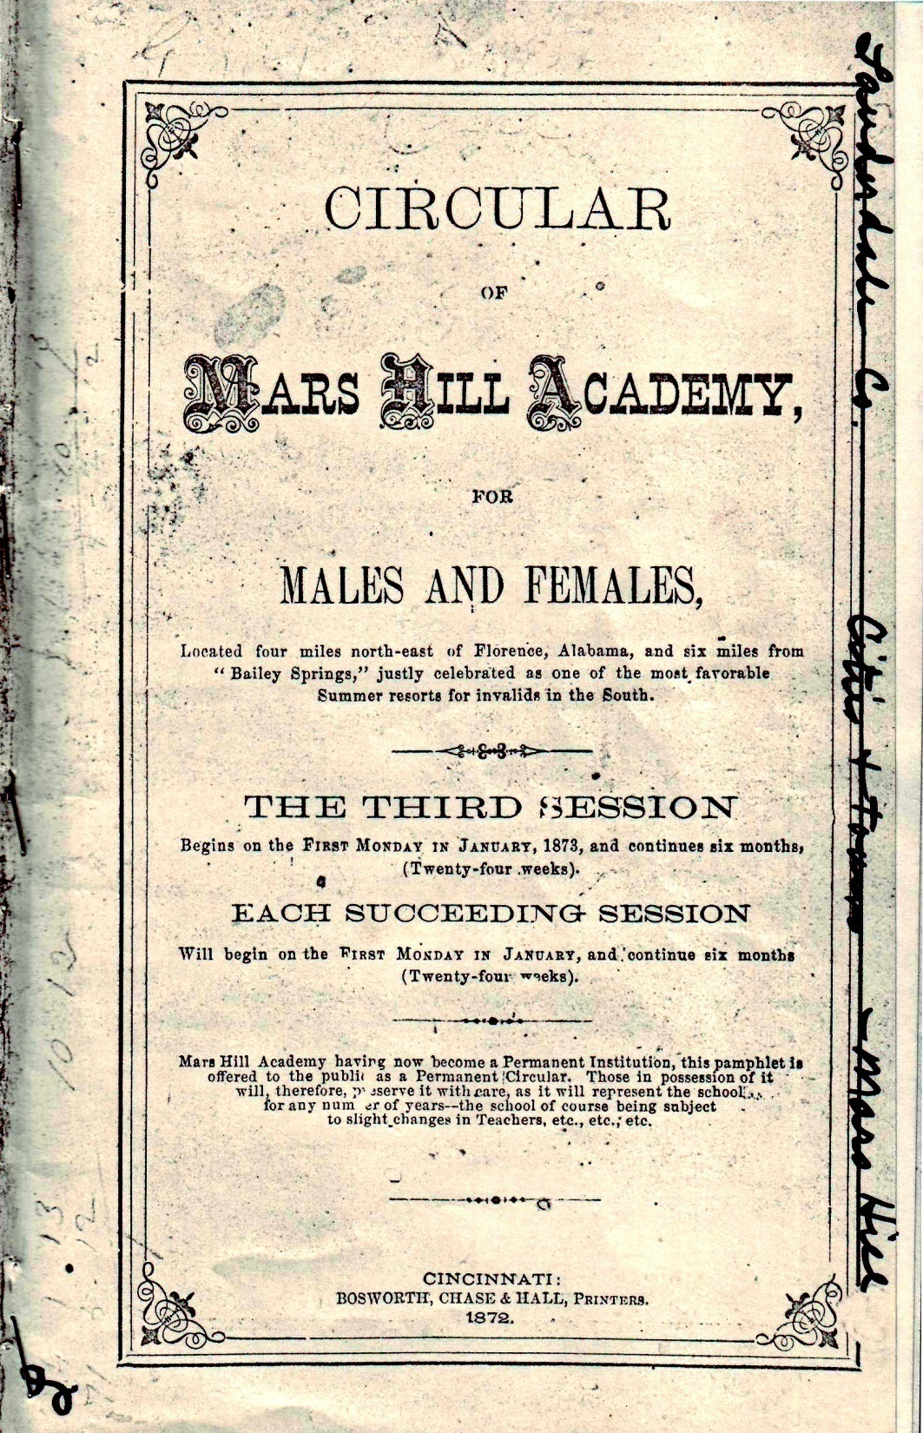
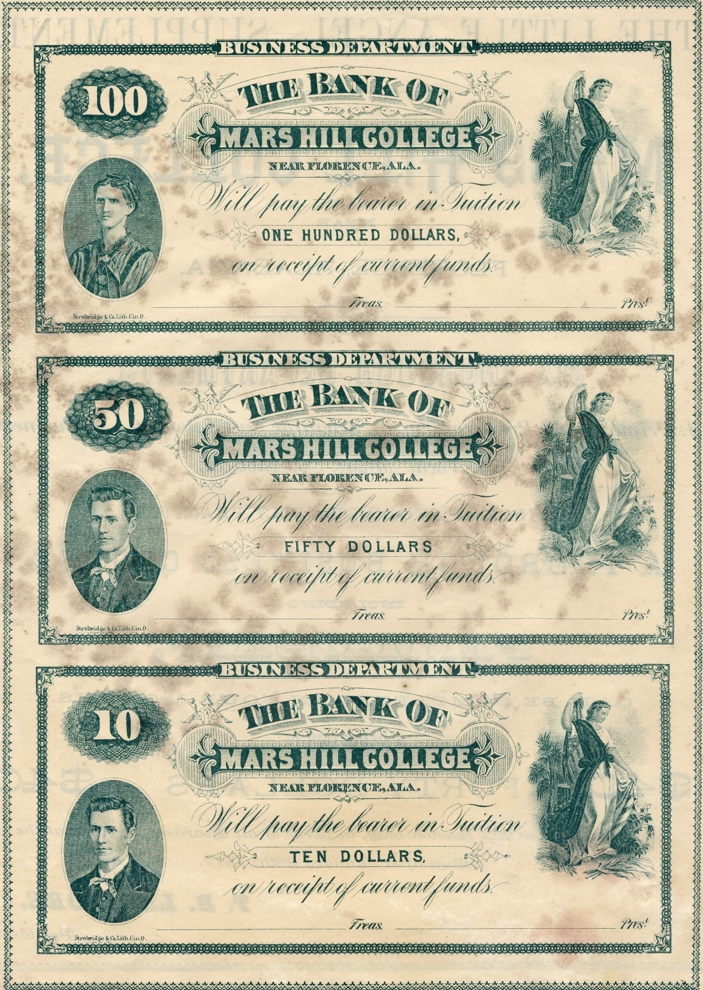

Slide 76
A. Alabama Christian College Of Berry,Alabama.
1. John T. Lewis And O.C. Dobbs.

Slide 78
B. Gus A. Dunn Served (1912-1914)
The First President Was
Gus Dunn Of Texas.
First Session– Oct.1,
1912.
First Five Months Held
In Church Building.

Slide 81
The Building Burned In 1933.
Two Of The School’s Most Well-known Students
Gus Nichols And Asa Plyler.

Slide 82
C. Hal P. McDonald President– 1916-1922.
1. Served Until The School Closed In 1922.
2. Introduced The Lectureship Concept To This School.
3. McDonald Was Eccentric In Some Ways.

