Slide 1
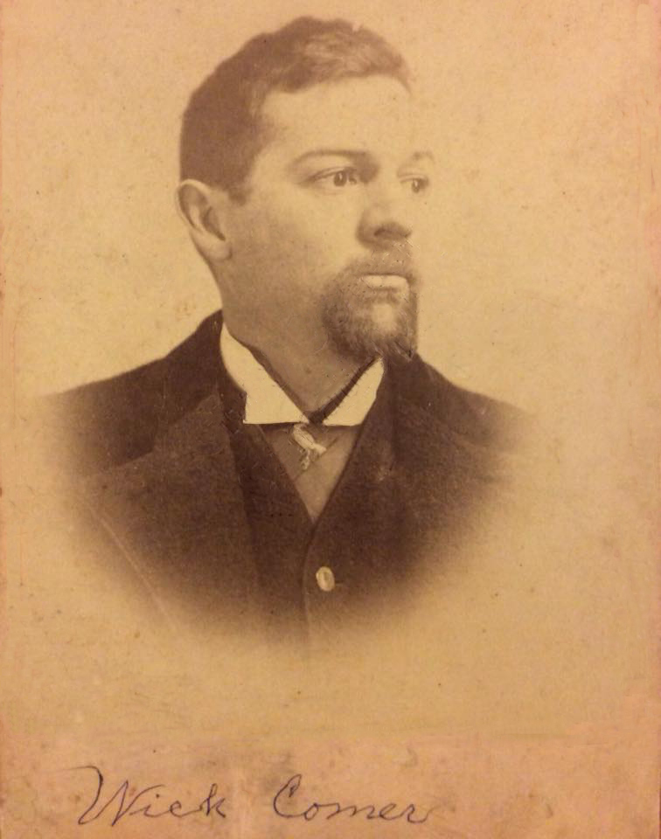
Robert Wycliffe Comer 1860-1944
“He Being Dead Yet Speaketh”
-Photos supplied by Chad Comer of Gamaliel, Ky

Slide 2
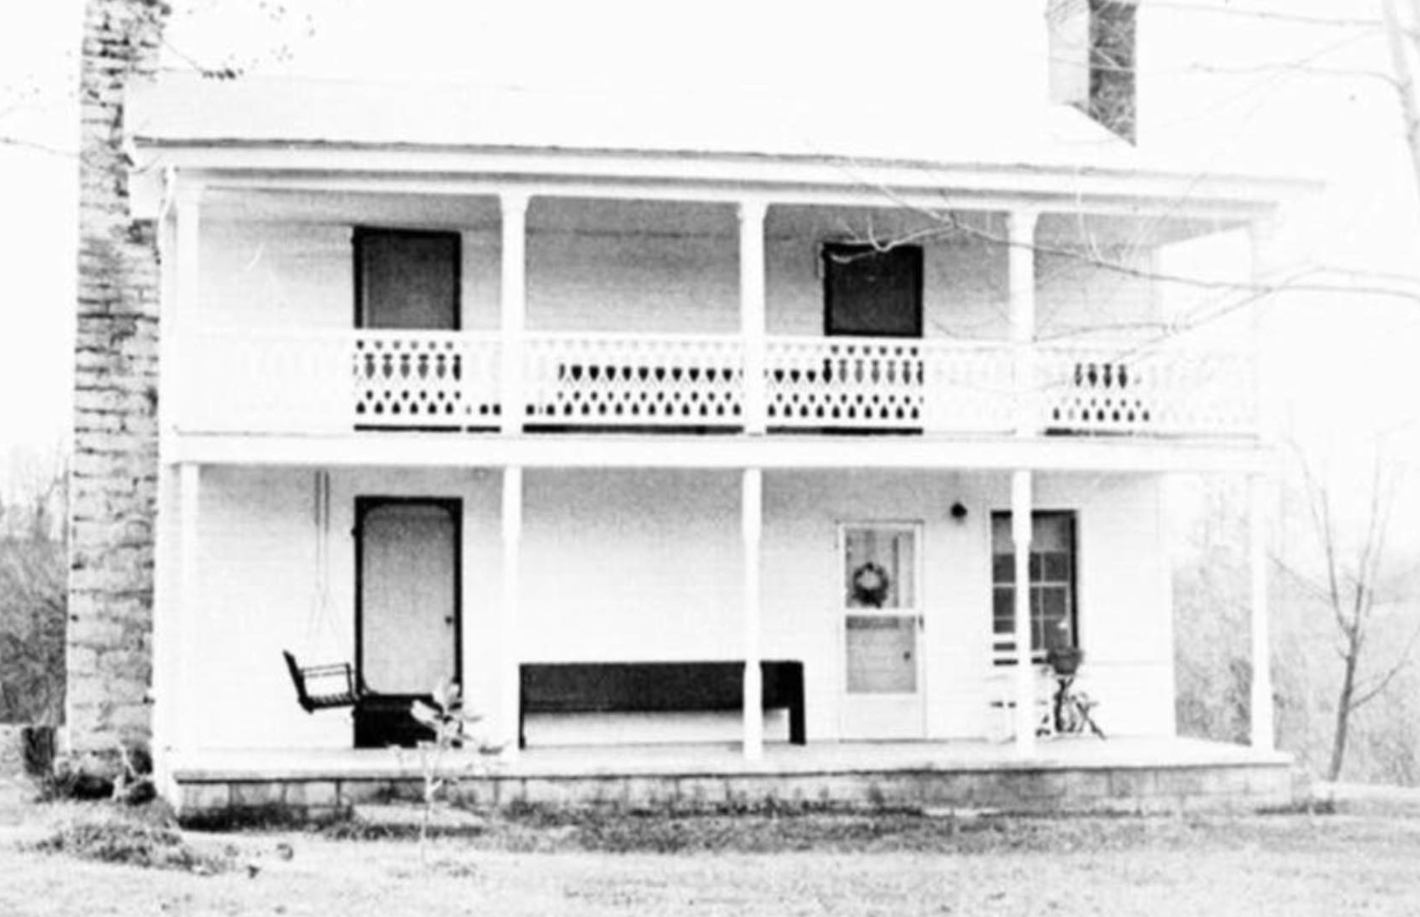
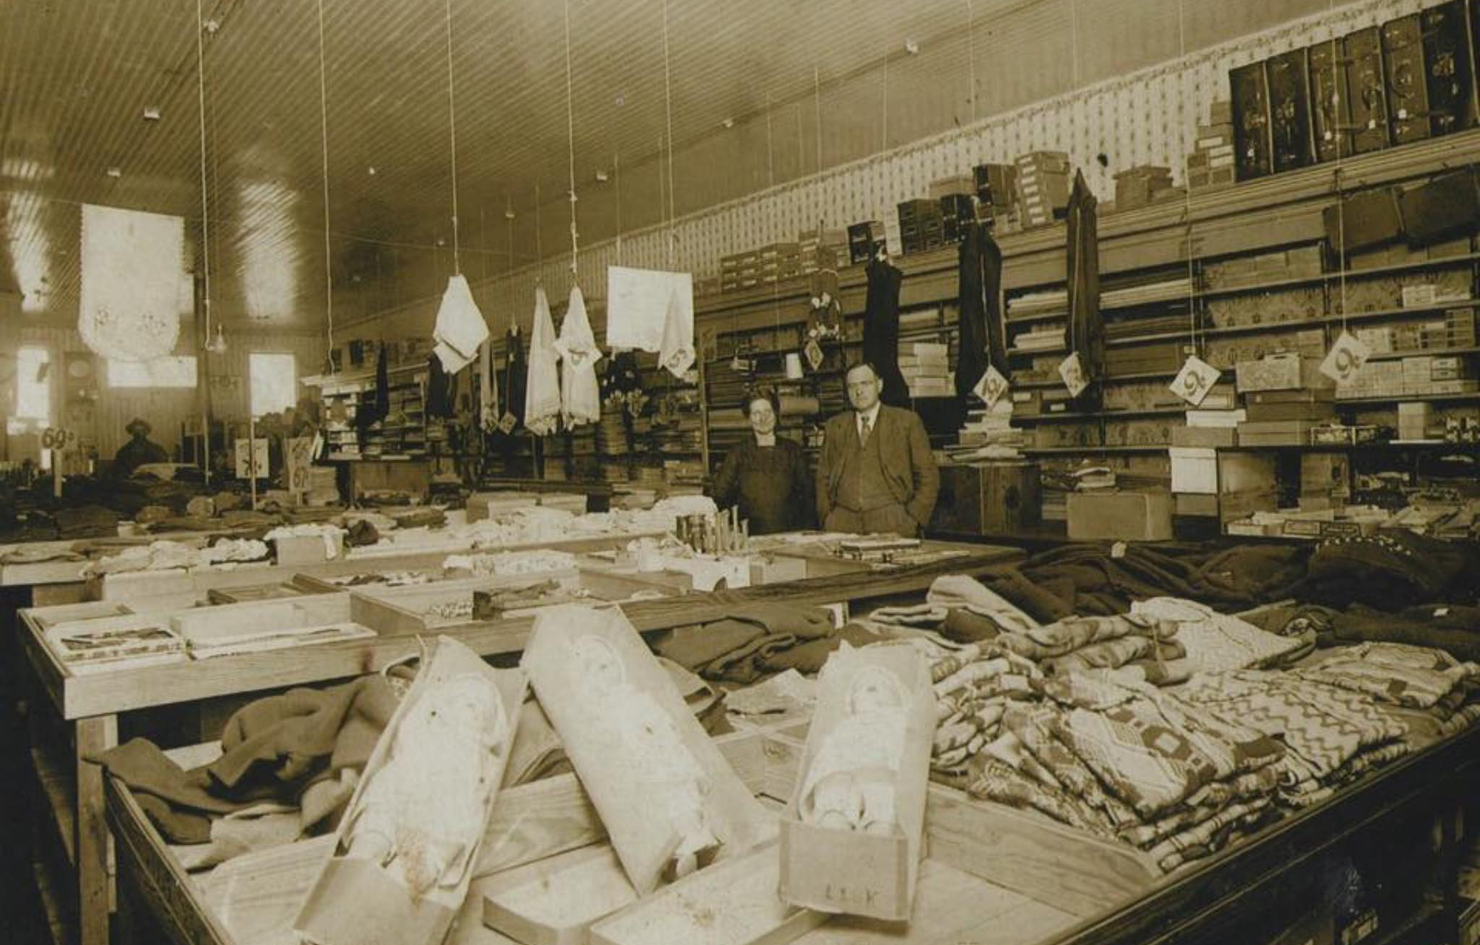
Wick Comer’s Gamaliel, Kentucky
Born and reared in the oldest house in Gamaliel, Kentucky – still stands today
Educated in local schools.
The family had a dry-goods business he worked in
Comer Brothers & Page Dry Goods

Slide 3
An Entrepreneur
1911 - With Harris, Davis & Co. traveling sales of dry-goods - had southern Ky route in.
Became a traveling banker – hundreds of thousands of dollars on his person often
Comer Brothers & Page Dry Goods
-Photos supplied by Chad Comer of Gamaliel, Ky

Slide 4
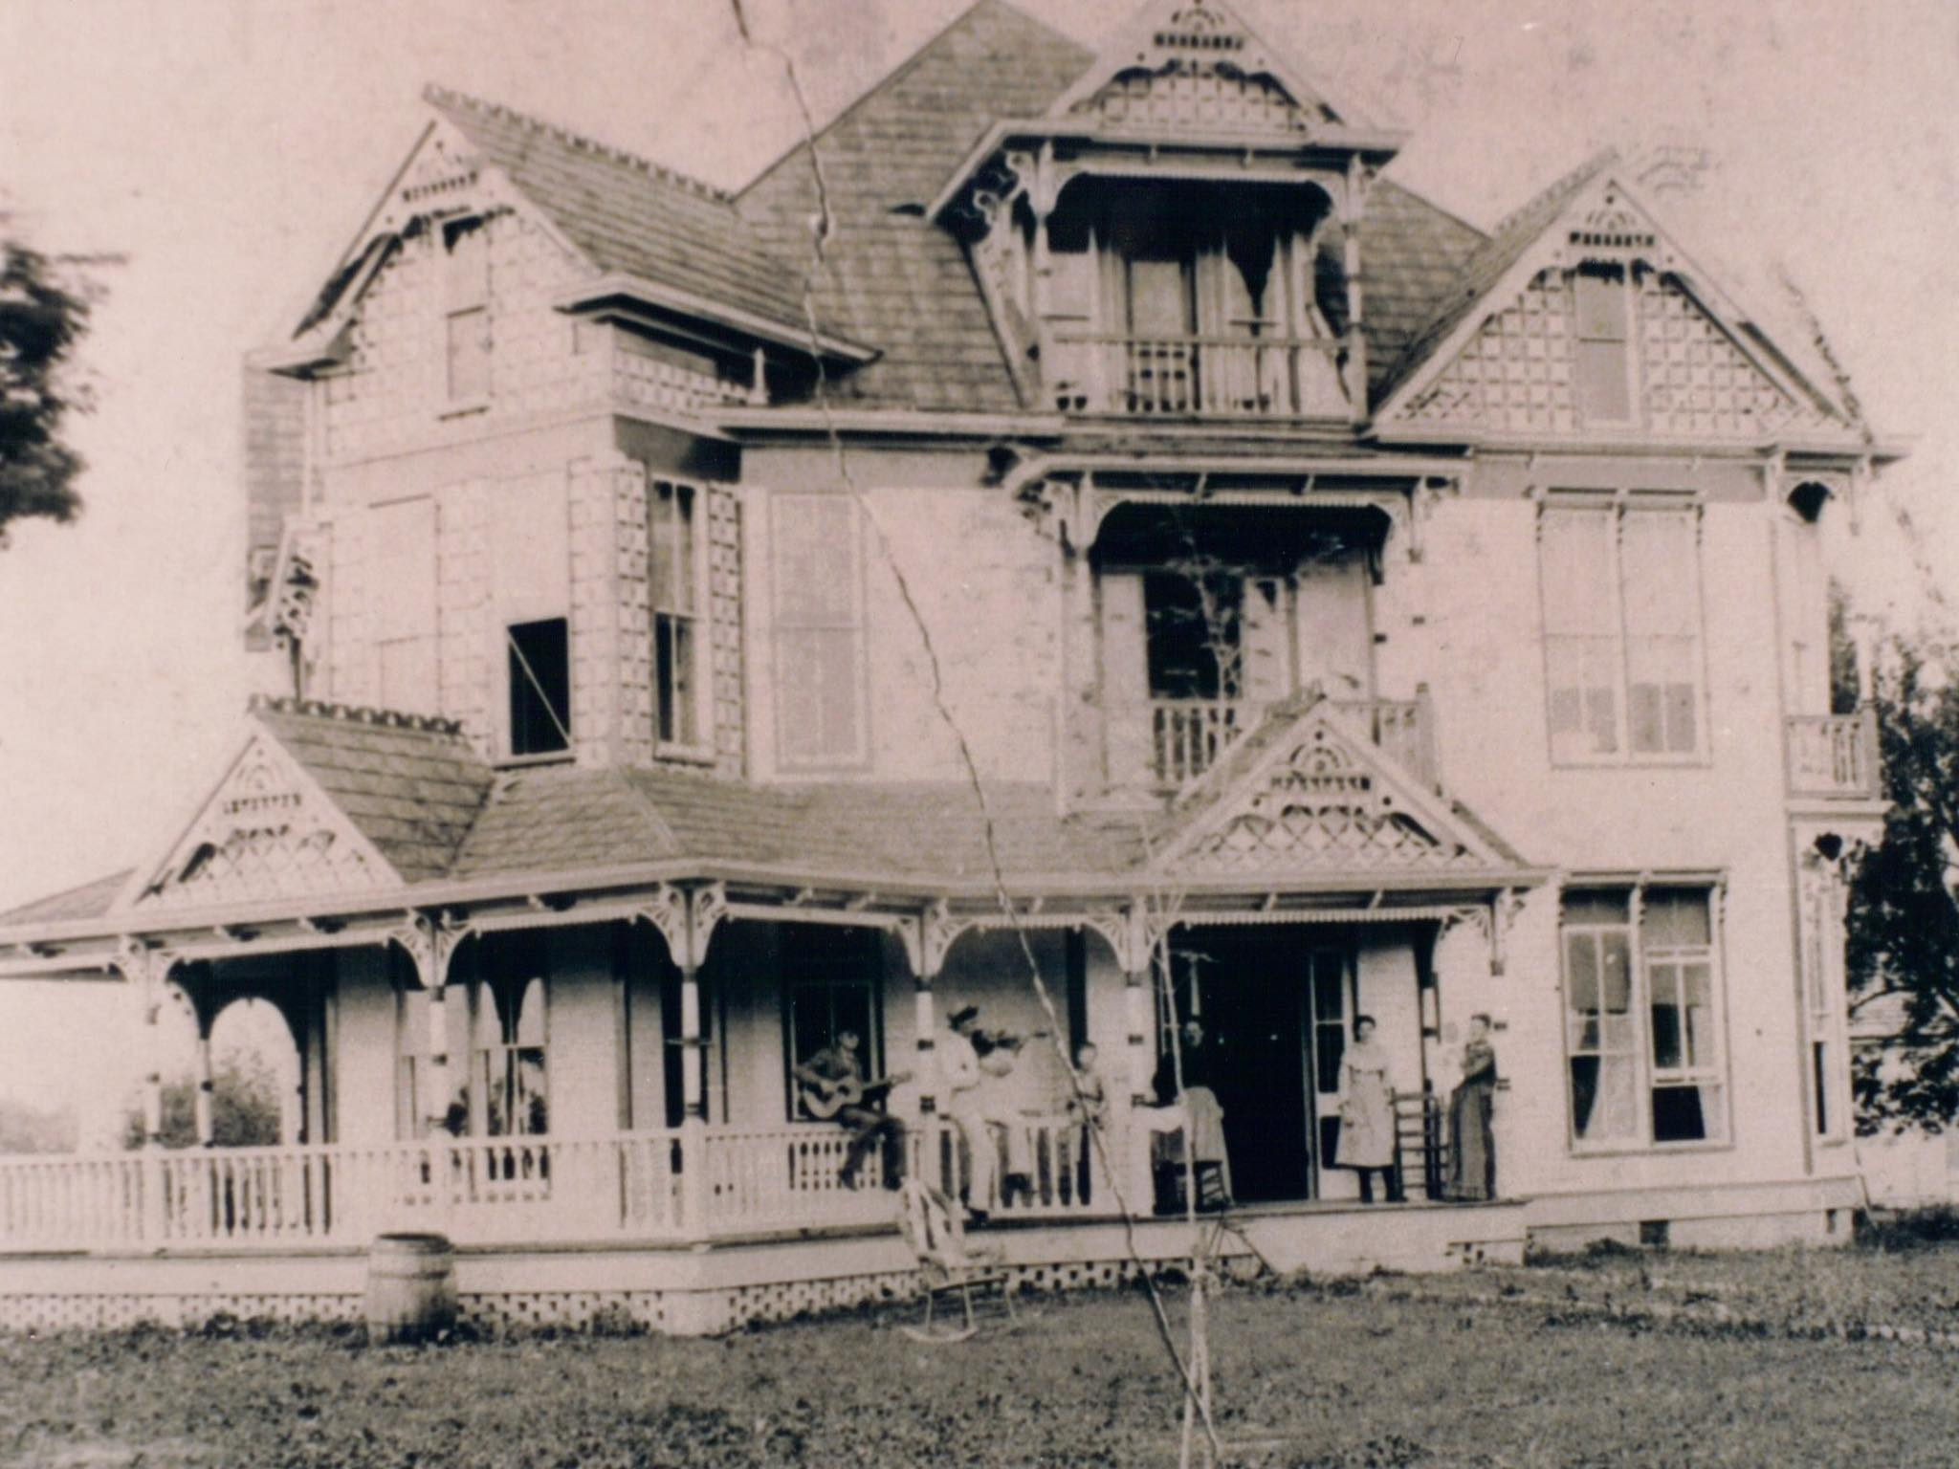
Based In Gamaliel
1912 he served as President of Real Estate Bank & Trust Company
1914 he served as President of the Bank of Davidson County, Nashville - when the bank merged with State Bank & Trust Company - served as V. P.
1914 he served as Vice-President of the Comer-McClellan Company - a large wholesale grocery
1914 opened Washington Manufacturing Co. as President
1925 became founding director of the new Liberty Bank & Trust Co.

Slide 5
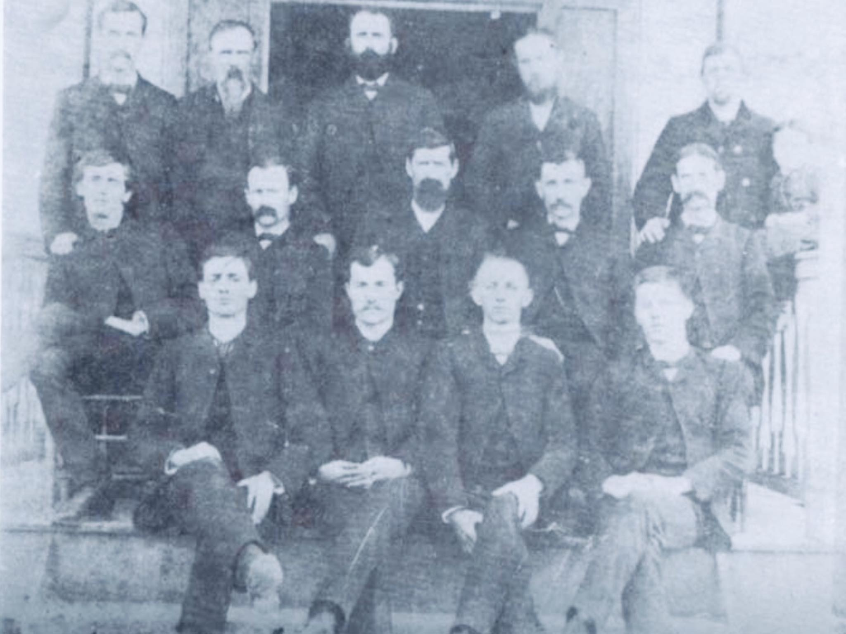
Gamaliel Chamber of Commerce Member
Wick with his daughter
-Photo supplied by Chad Comer of Gamaliel, Ky

Slide 6
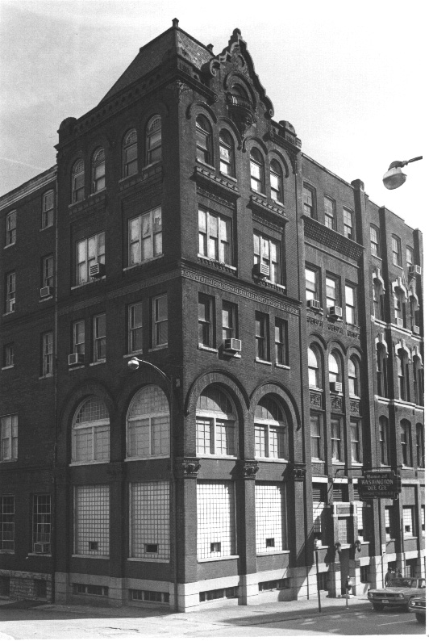
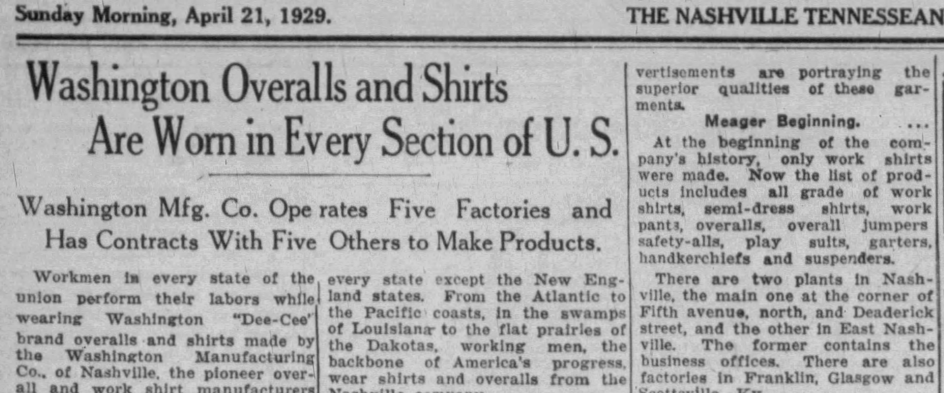
Washington Manufacturing Company
-Nashville Banner, Sunday, Apr. 21, 1929, p.87
Opened in 1914 -- Within 14 year

Slide 7
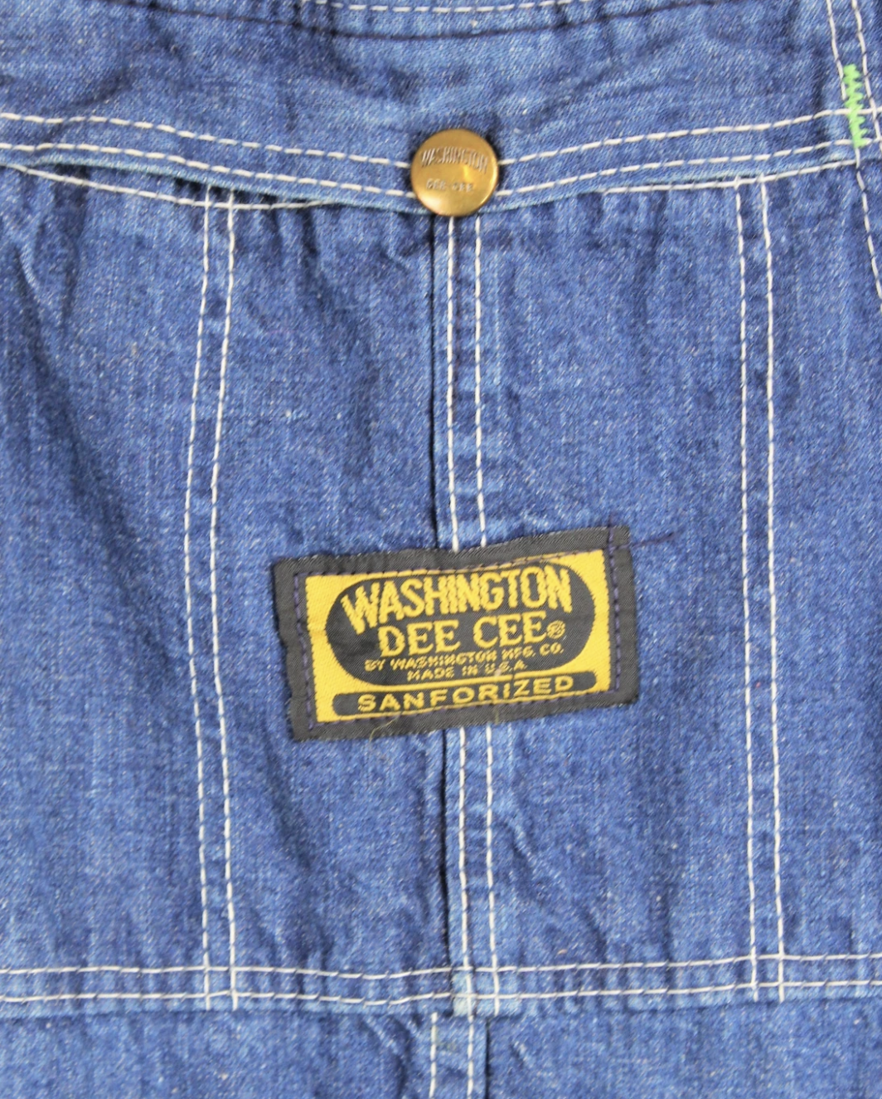
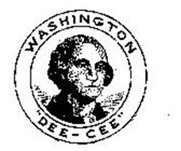
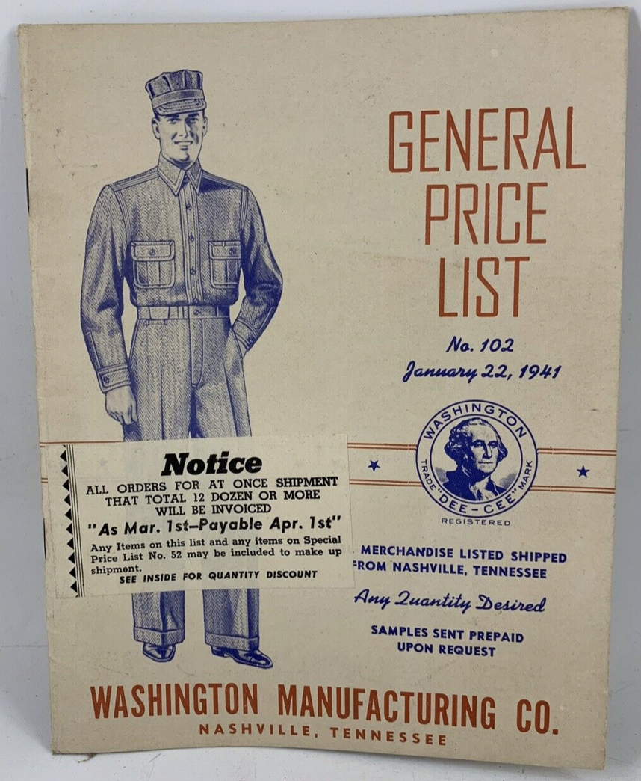
Washington Manufacturing Company 1914-1991
Initially, Dodd-Comer Manuf. Co.

Slide 8
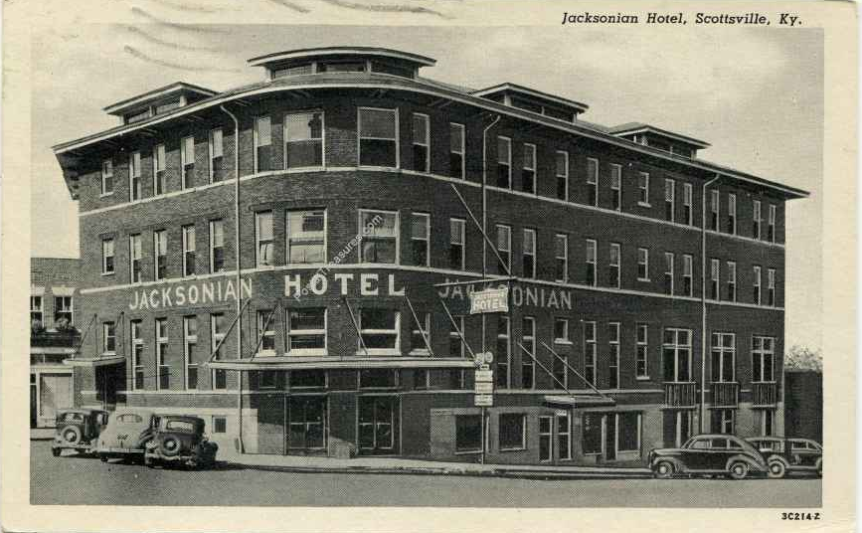
Jacksonville Hotel, Scottsville, Ky
Purchased by R. W. Comer in 1929
-The Franklin Favorite, 19 September, 1929, p.5

Slide 9
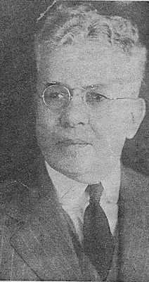
By 1930 – There were five factories. Two in Nashville; one in Franklin, Ky; Scottsville, Ky; & Glasgow, Ky
“He loved the church, and gave much of his time, means, and influence to the building up of that body of Christ bought with his own blood. He often had preachers, at the noon hour, come to his factory and engage in worship and in preaching to the employees. Just how much good came out of this, eternity will reveal.”
-T. Q. Martin, The Apostolic Times, September, 1944

Slide 10
The Great Depression Took Its Toll
By 1937 there were seven factories, adding one at Milan, Tn & Cookeville, TN. Yet, G. L. Comer had to close two factories in Nashville
-The Tennessean, May 3, 1937, p.12

Slide 11
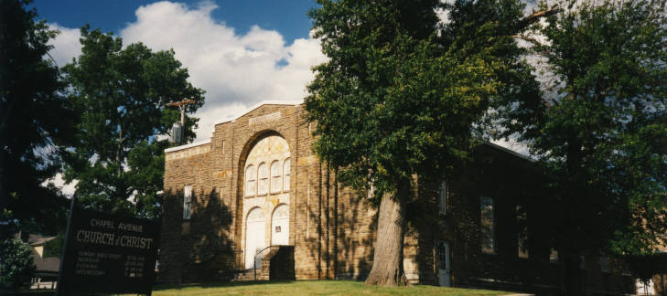
The Comers Were Founding Members of Chapel Avenue Church Of Christ Nashville, Tennessee 1930s-2001

Slide 12
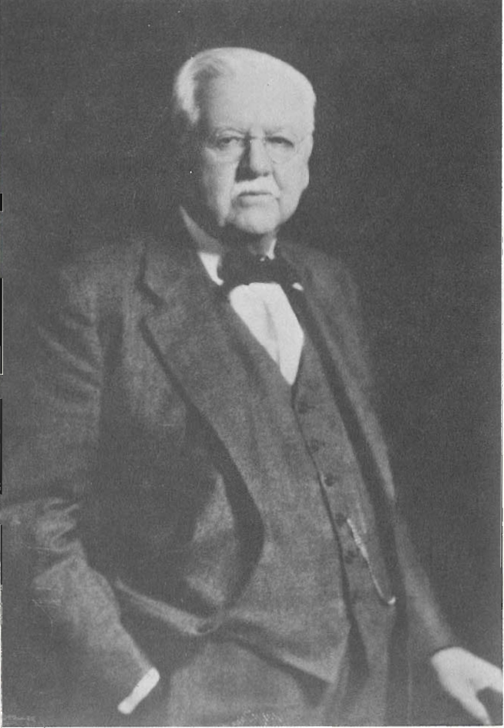
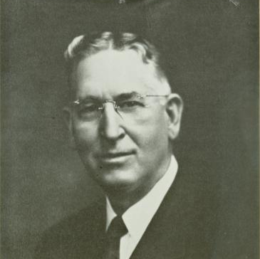
R. W. Comer & Freed-Hardeman College
1942 – Supported every Hardeman Tabernacle Series at the Ryman. Five volumes printed, supported by R. W. Comer. Purchase 1500 copies of the fifth volume of sermons for gifts to his employees.
1943 – gave the College a farm north of Henderson, TN to serve as a source for milk and dairy products.
1944 – Upon his death, Comer’s will provided $200,000 to endow the college to enter Southern Association of Colleges for accreditation
R. W. Comer
N.B. Hardeman

Slide 13
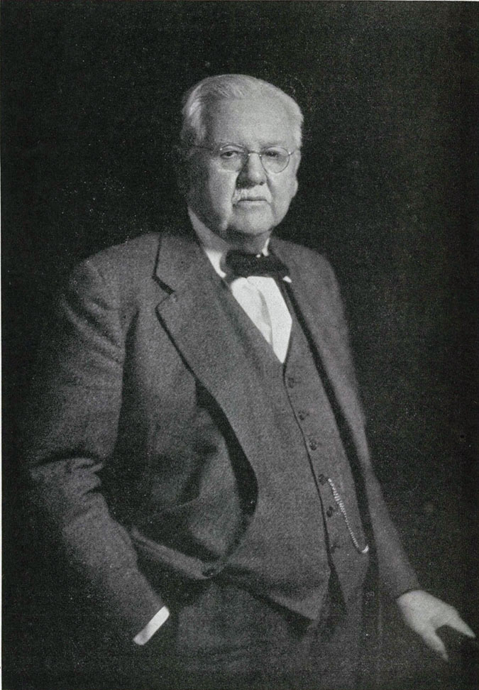
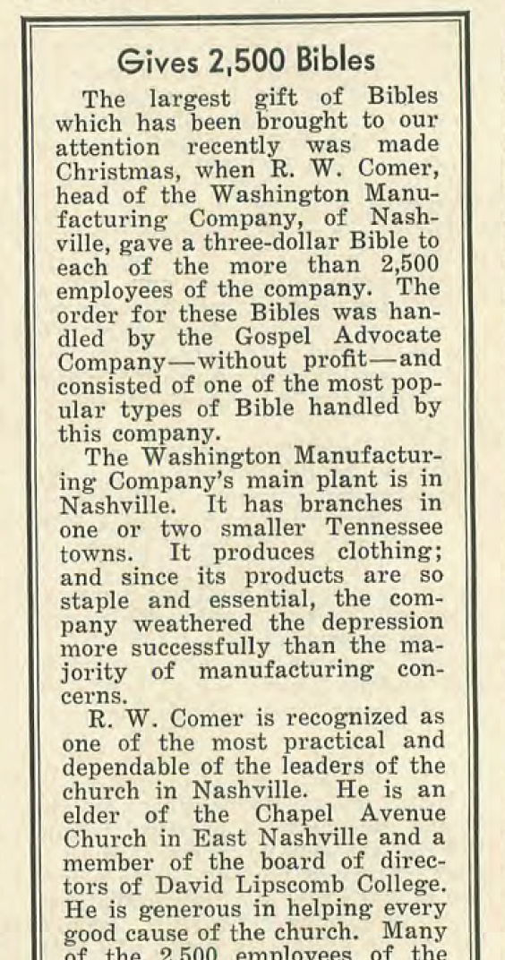
1936 R. W. Comer gave 2500 Christmas Presents: A copy of the Bible to every employee of Washington Manufacturing Company
-Gospel Advocate, January 14, 1937, p.44

Slide 14
“The Best Investment”
“How can we lay up treasure in heaven? We can’t take anything with us, but we can send it on.
“All we can save is what we put in the Lord's treasury
while we are living.
“Everything we do for ourselves alone dies with us. Everything we do for others religiously goes on into eternity.” —“The Best Investment” – Apostolic Times, September 1943

Slide 15
“True Happiness”
The greatest happiness that can come to anyone in this life is being a Christian, a follower of Christ, walking in his footsteps, doing as he did, speaking as he spoke, and being faithful to him as he was to his Father . . . If you are not a Christian, you need to learn your duty to God, hear his word, believe his truth, repent of your sins, confess your faith in the Christ, and be buried with him in baptism, and raised to walk in newness of life. God will then add you to his church—not to any man-made institution, and if we live faithfully, he will give us a crown of life. We can all agree and be one in faith and practice only when we are willing to limit ourselves to the teachings of the New Testament.” —“True Happiness” – Apostolic Times, January 1943

Slide 16
“Religion In Life”
“Just think of the many in darkness today because they know not the truth. When we have the opportunity to hear the gospel, and we neglect or excuse ourselves of the same, we will certainly be condemned at the judgment. It is a fact that many people are contributing their time and money to things that will never amount to anything religiously. Christ said, ‘Lay up for yourselves treasures in heaven;’ but when we give to institutions that are not mentioned in the Bible, it will amount to nothing religiously. It is certainly a great mistake when we do not follow the teaching of Christ, but follow the teaching of uninspired men. Any church whose name is not found in the New Testament is not the New Testament church.” —“Religion In Life ” – Apostolic Times, May 1943

Slide 17
“A Better Understanding”
“Do we all really know that the church of Christ is not a denomination, has no earthly head, has no man-made creeds, speaks where the Bible speaks, and is silent where the Bible is silent, calls Bible things by Bible names, was established in Jerusalem in the year 33? We all want to know what the church of Christ's plea is; and let us all decide with our Bibles in hand if the position in work and worship agrees with God's will, the Bible.” —The Apostolic Times, June 1944

Slide 18
“He was prominent in religious activities and an elder…”
-The Tennessean, August 6, 1944, page 34

Slide 19
“…I can announce to you that which, I am sure, but very few know—namely, that the last ten years of Brother Comer’s life were devoted most largely to the shaping up of his business matters and the fixing of things to be perpetuated after his departure. I doubt if any man among us has ever died leaving both his spiritual and business affairs in better shape. There will be no need for lawyers to help wind up his estate. That was all put in order according to his wish and will. There is a great trust fund set up that is to continue on down the line and it is to be used for the glory of God and the benefit of mankind. He not only provided for his own house, but also for all employees who proved loyal and faithful in the discharge of their respective duties. In case of sickness or disability, they will be cared for.”
-N. B. Hardeman, at R. W. Comer’s Funeral, (Comer, pages 9,10)
N.B. Hardeman

Slide 20
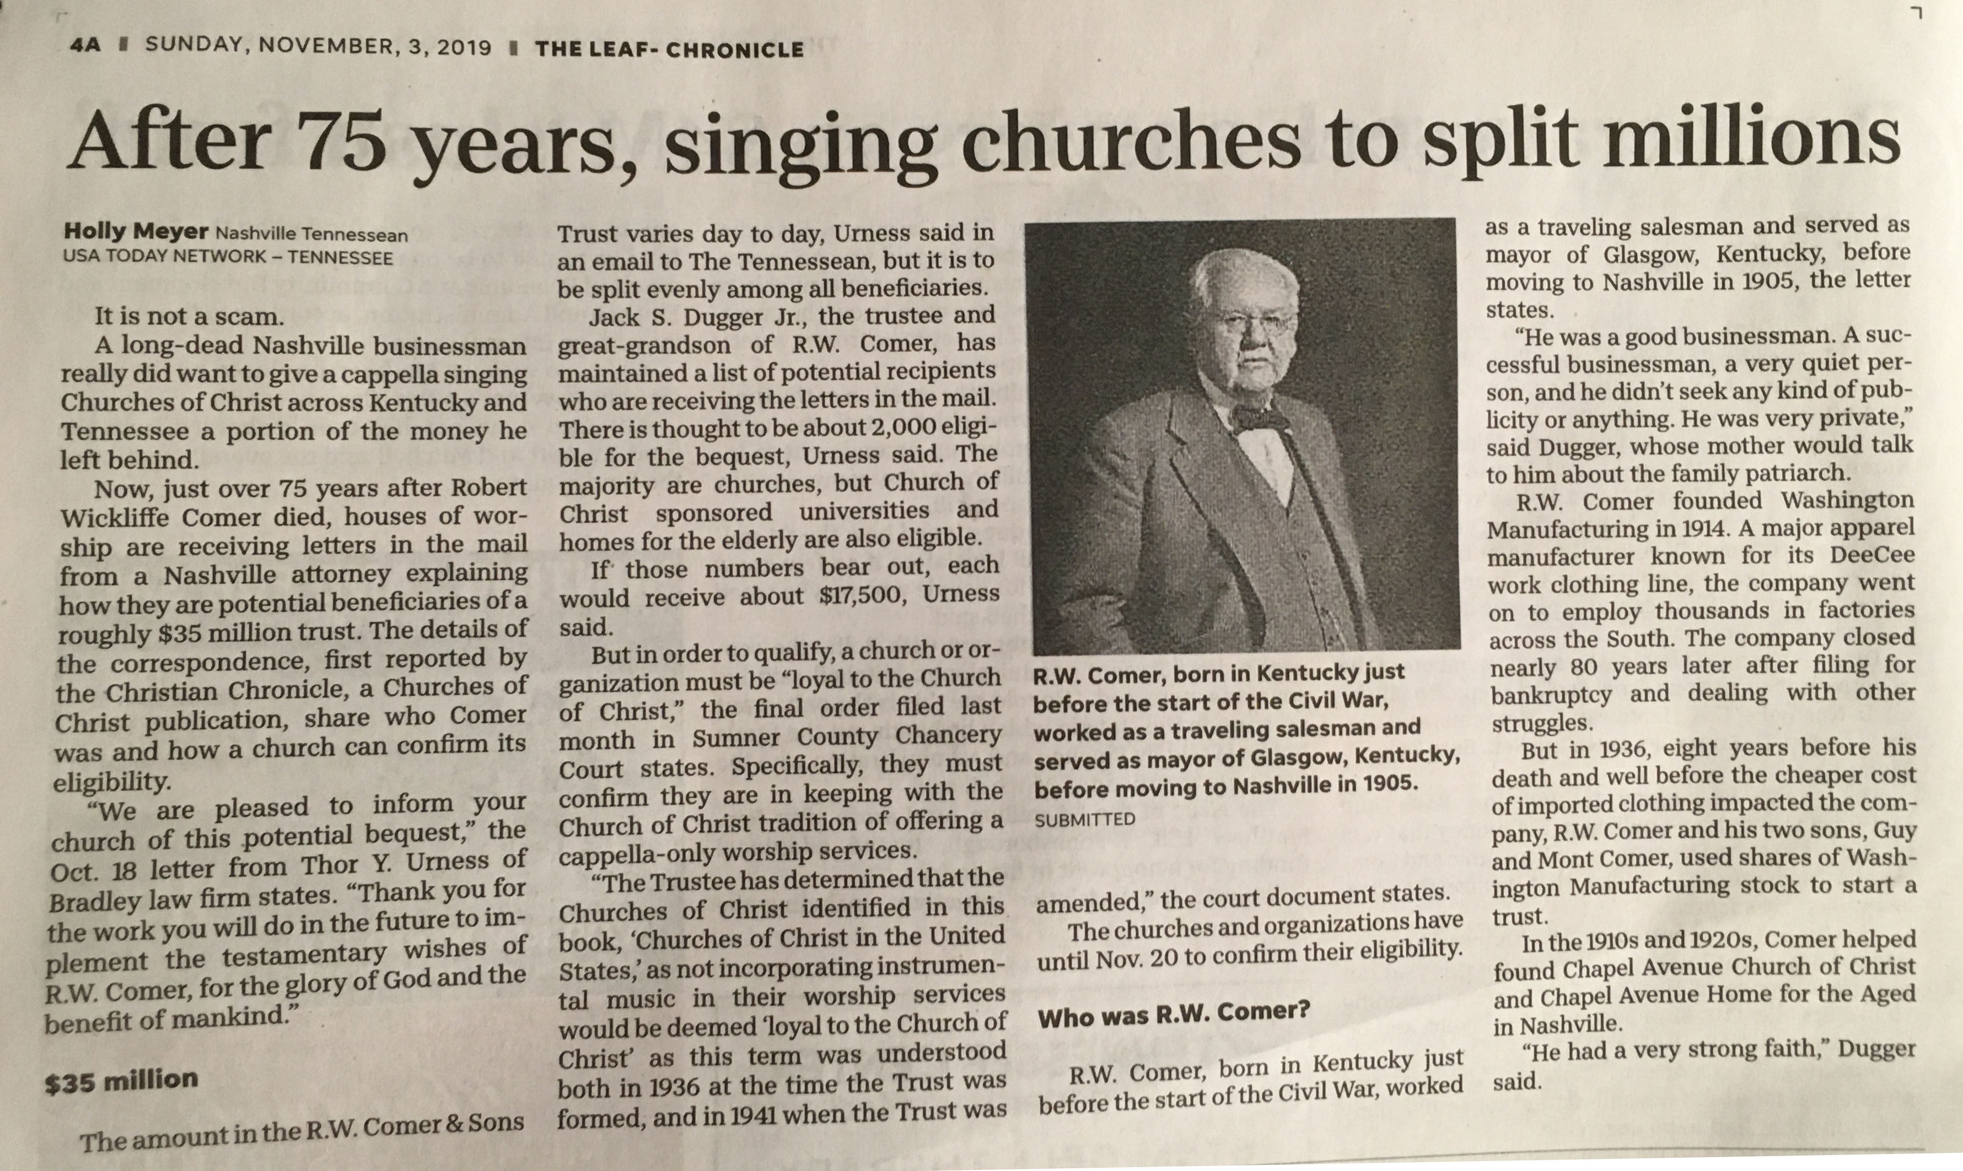
The Comer Trust
1935 – Roosevelt’s New Deal introduced Social Security – still new & untested
1944 – $35 million trust to help employees, family & finally the church

Slide 21
The Comer Trust
Two Criteria
Called Church of Christ
Non-Instrumental
Assumed 2000 churches in Ky & Tenn. could receive $17 to $20k

Slide 22
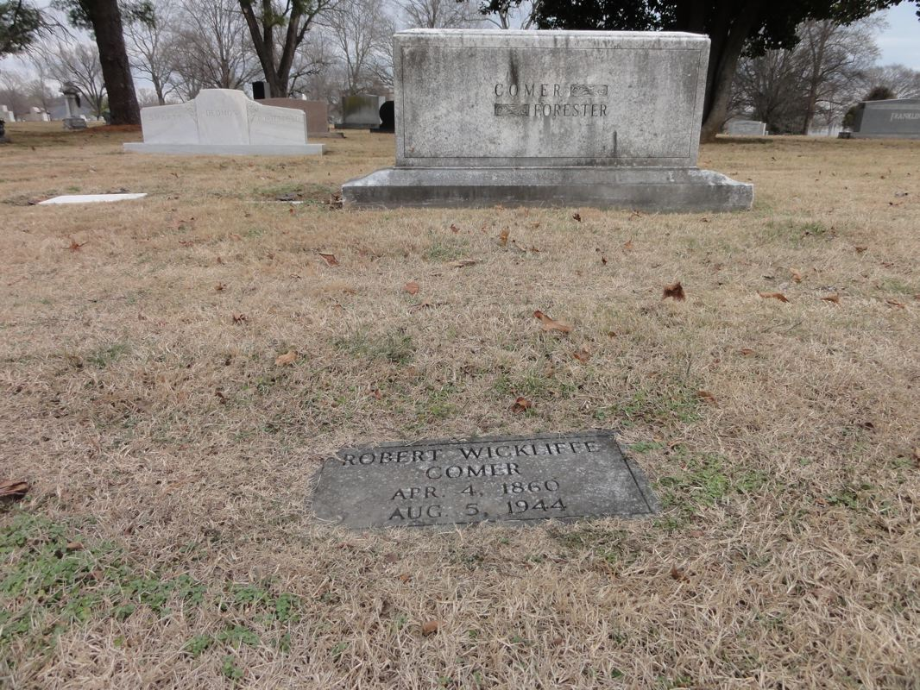
Robert Wycliffe Comer died in his 84th year August 5, 1944

