Slide 1
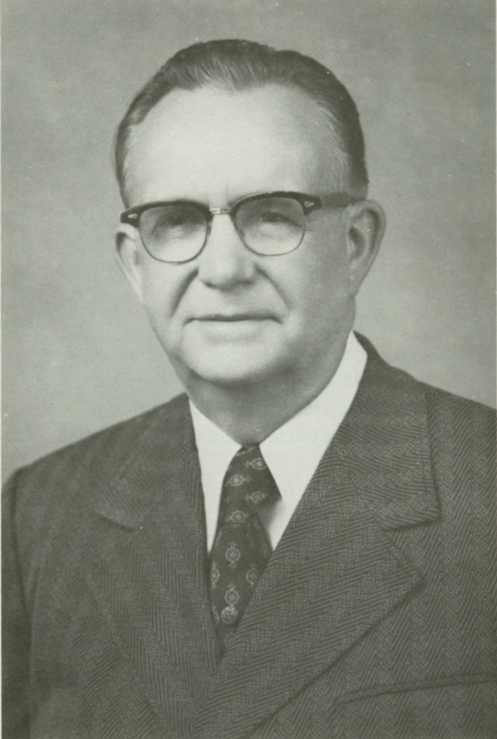
Rex Allwin Turner Sr.
1913-2001

Slide 2
Montgomery Bible College - 1949

Slide 3
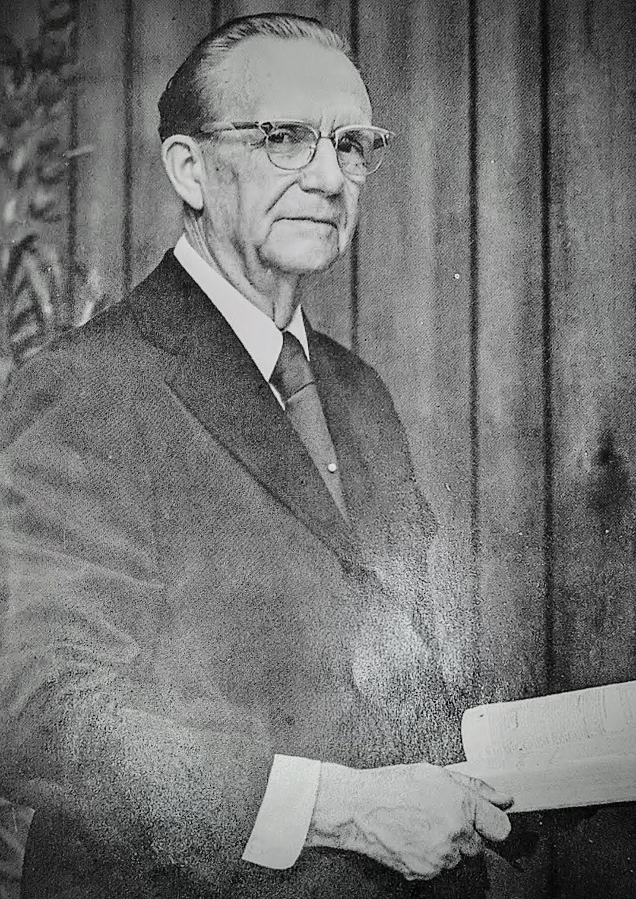
Rex A. Turner Sr.
As A Preacher

Slide 4
Learning To Preach Under Gus Nichols

Slide 5
Rex A. Turner Sr.
As An Educator

Slide 6
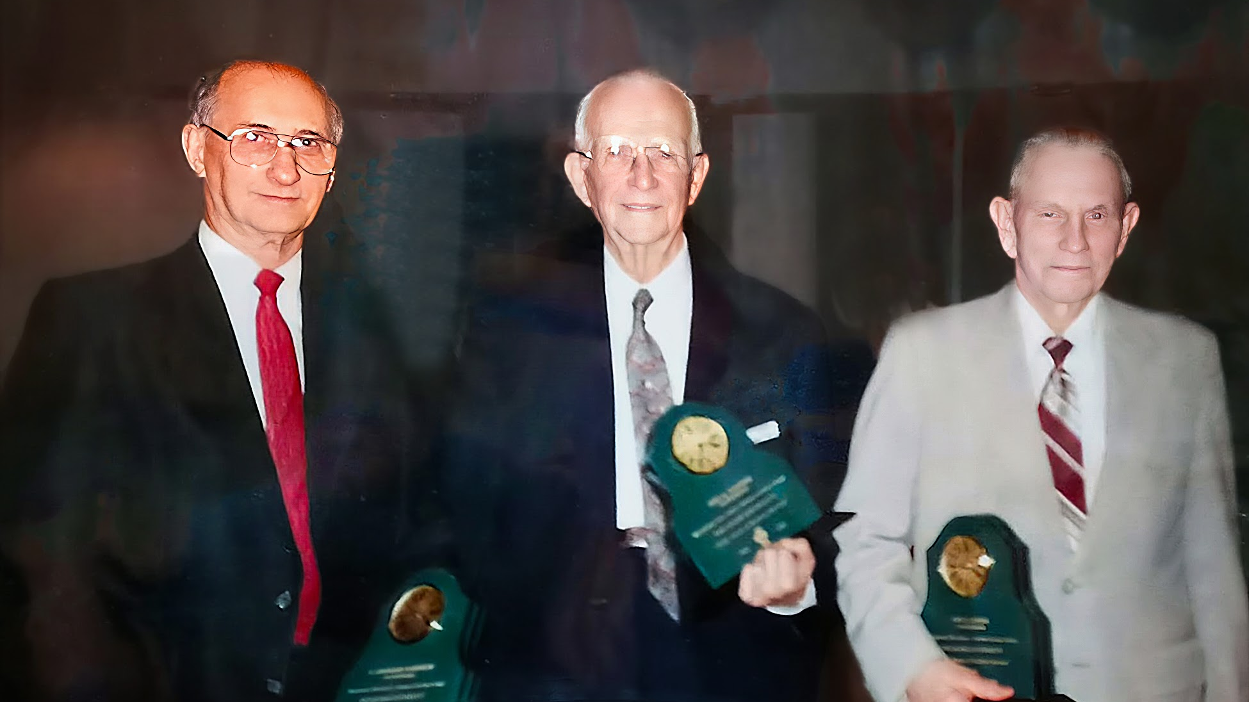
Leonard Johnson Rex Turner Joe Greer

Slide 7
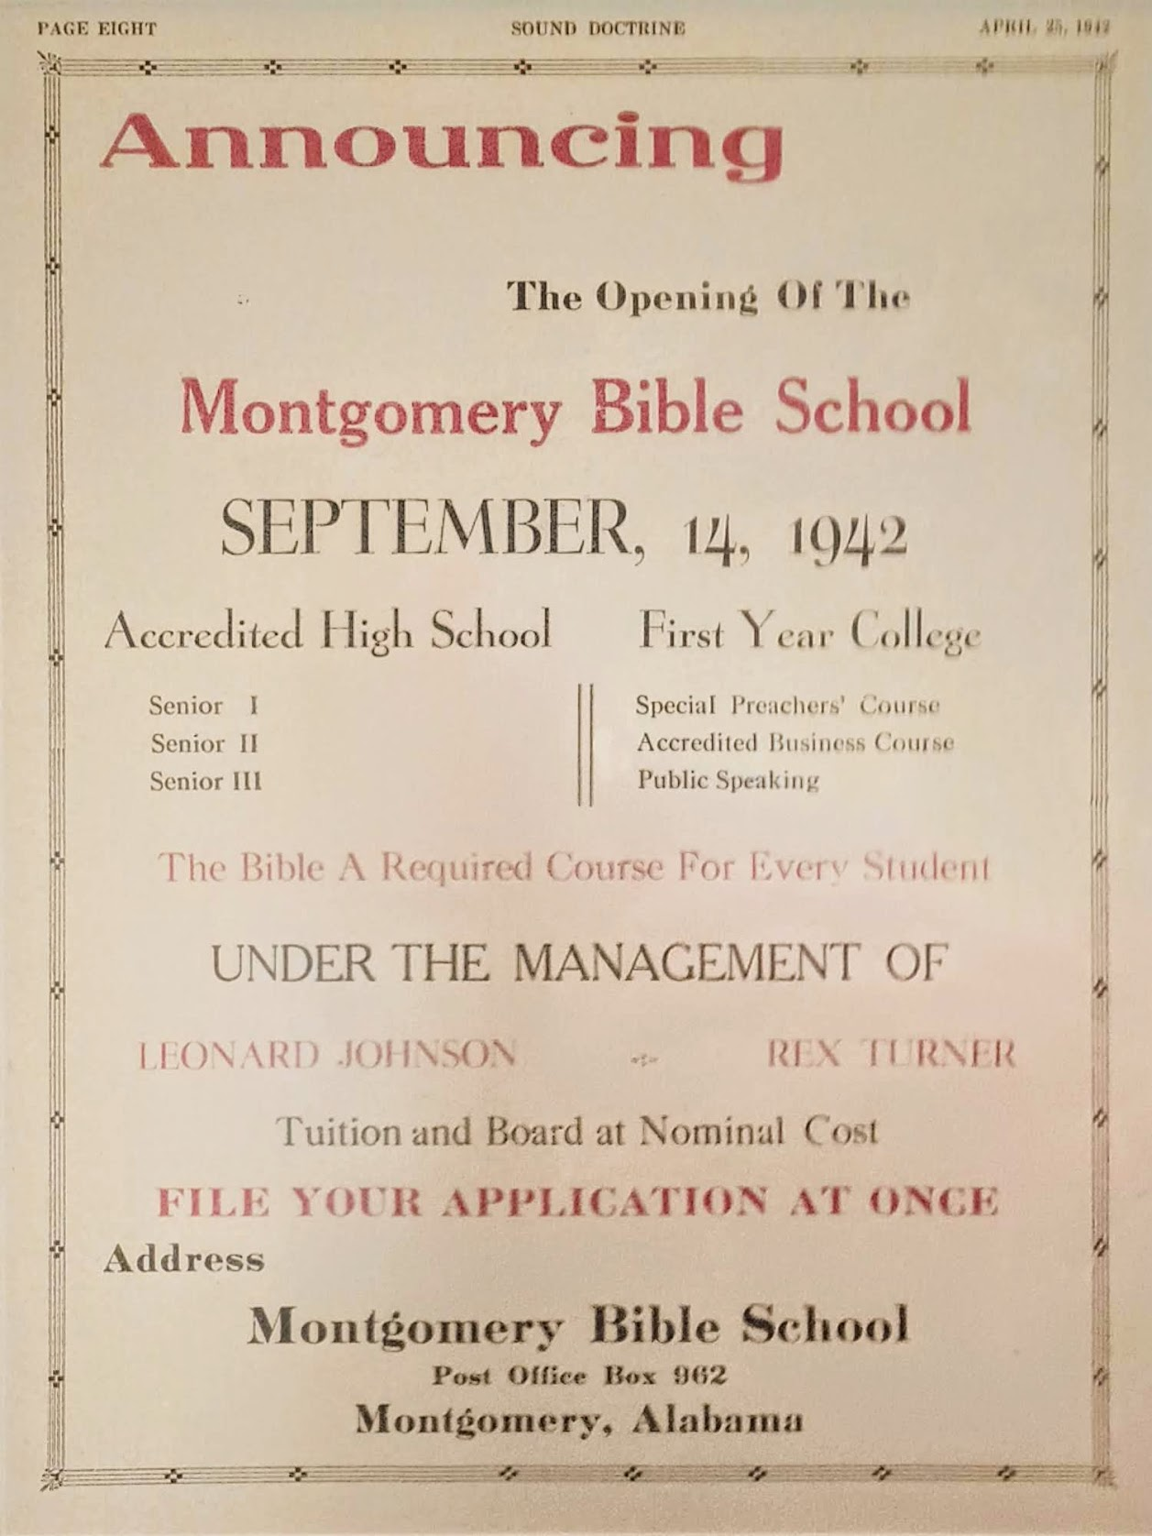
Montgomery Bible School

Slide 8
Ann Street Campus

Slide 10
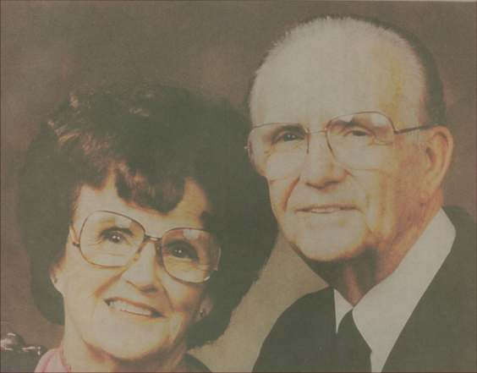
Rex & Opal Turner

Slide 11
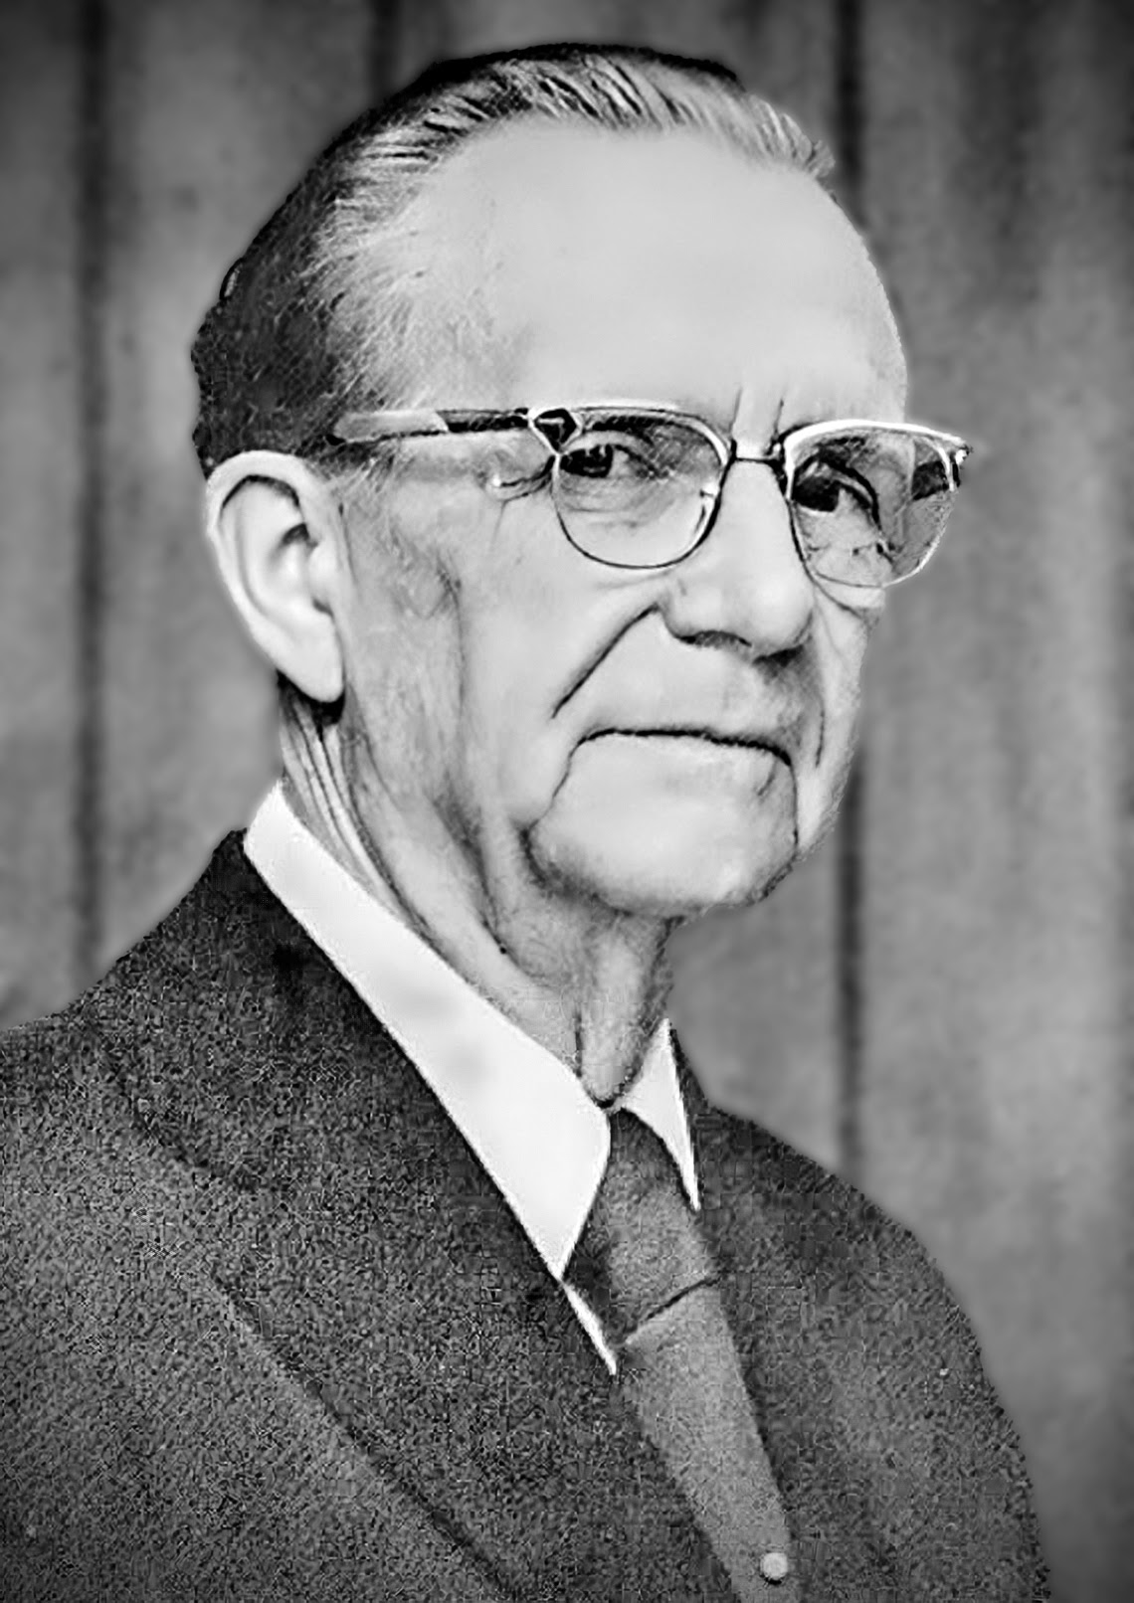
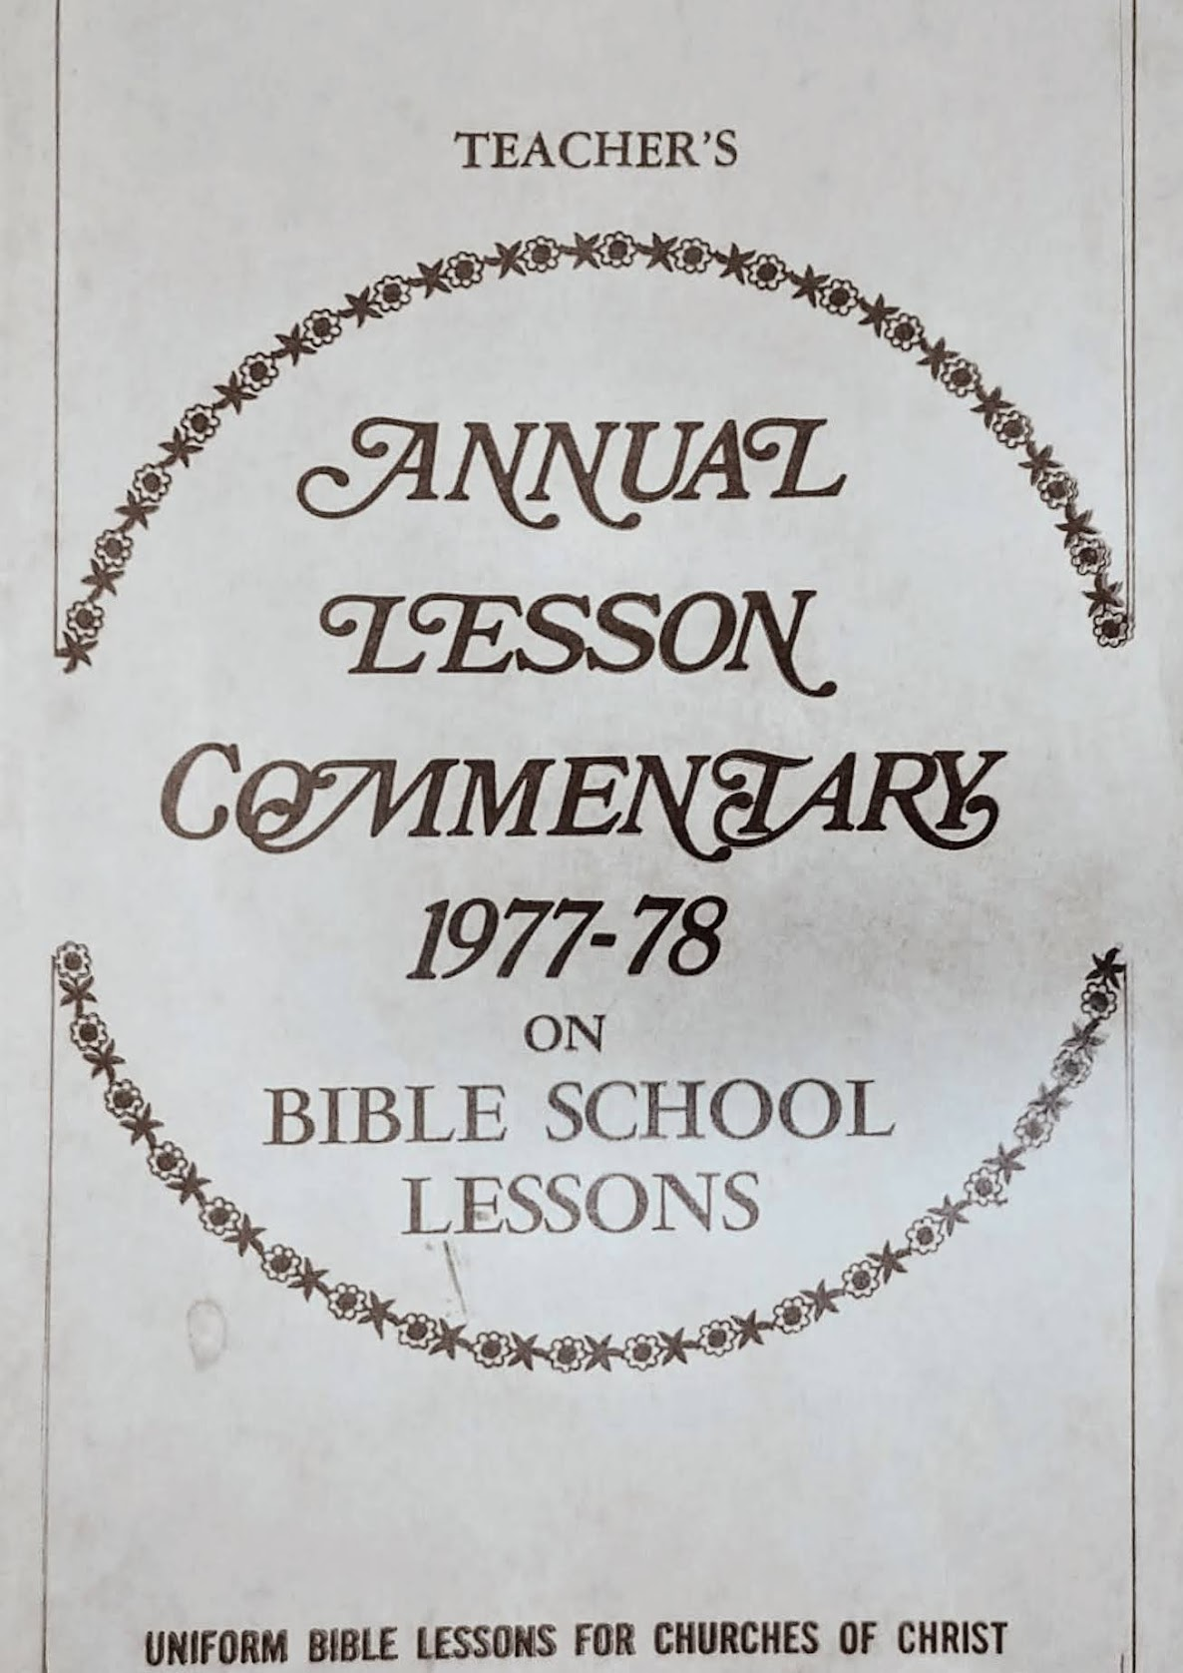
Rex Turner, Sr. As An Author And Writer

Slide 12
Sound Doctrine Beginning in 1941

Slide 14
1975-1979 Rex Turner edited the Gospel Advocate Teachers Annual Lesson Commentary

