Slide 1
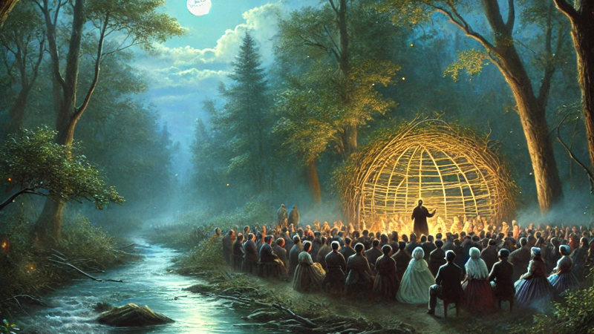
God Has Spoken: Scripture in the Restoration Movement - Experientialism, Creedalism, and Scripture: The Search for Confidence in the Early Restoration Movement
Freed-Hardeman University Lectures Monday, March 17, 2025, 8:45 AM CDT Scott Harp
ChatGPT graphic

Slide 2

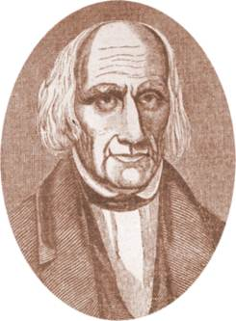
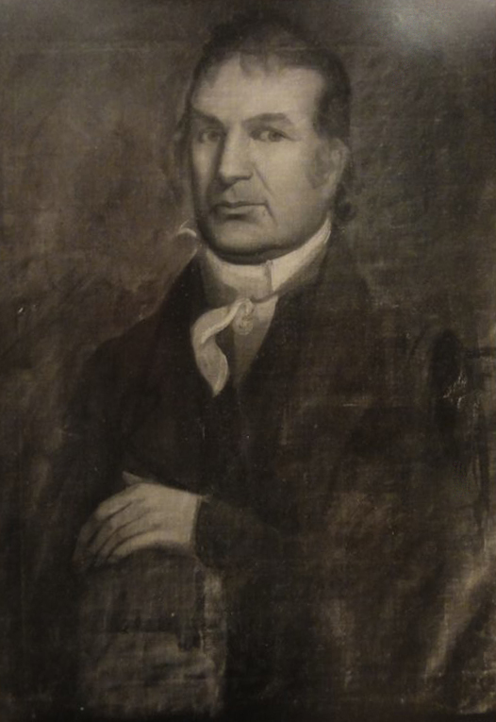
Experientialism’s Place In Salvation In The Kentucky Revival
Barton Warren Stone
1772-1844
David Purviance 1766-1847

Slide 3
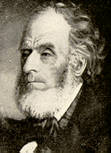
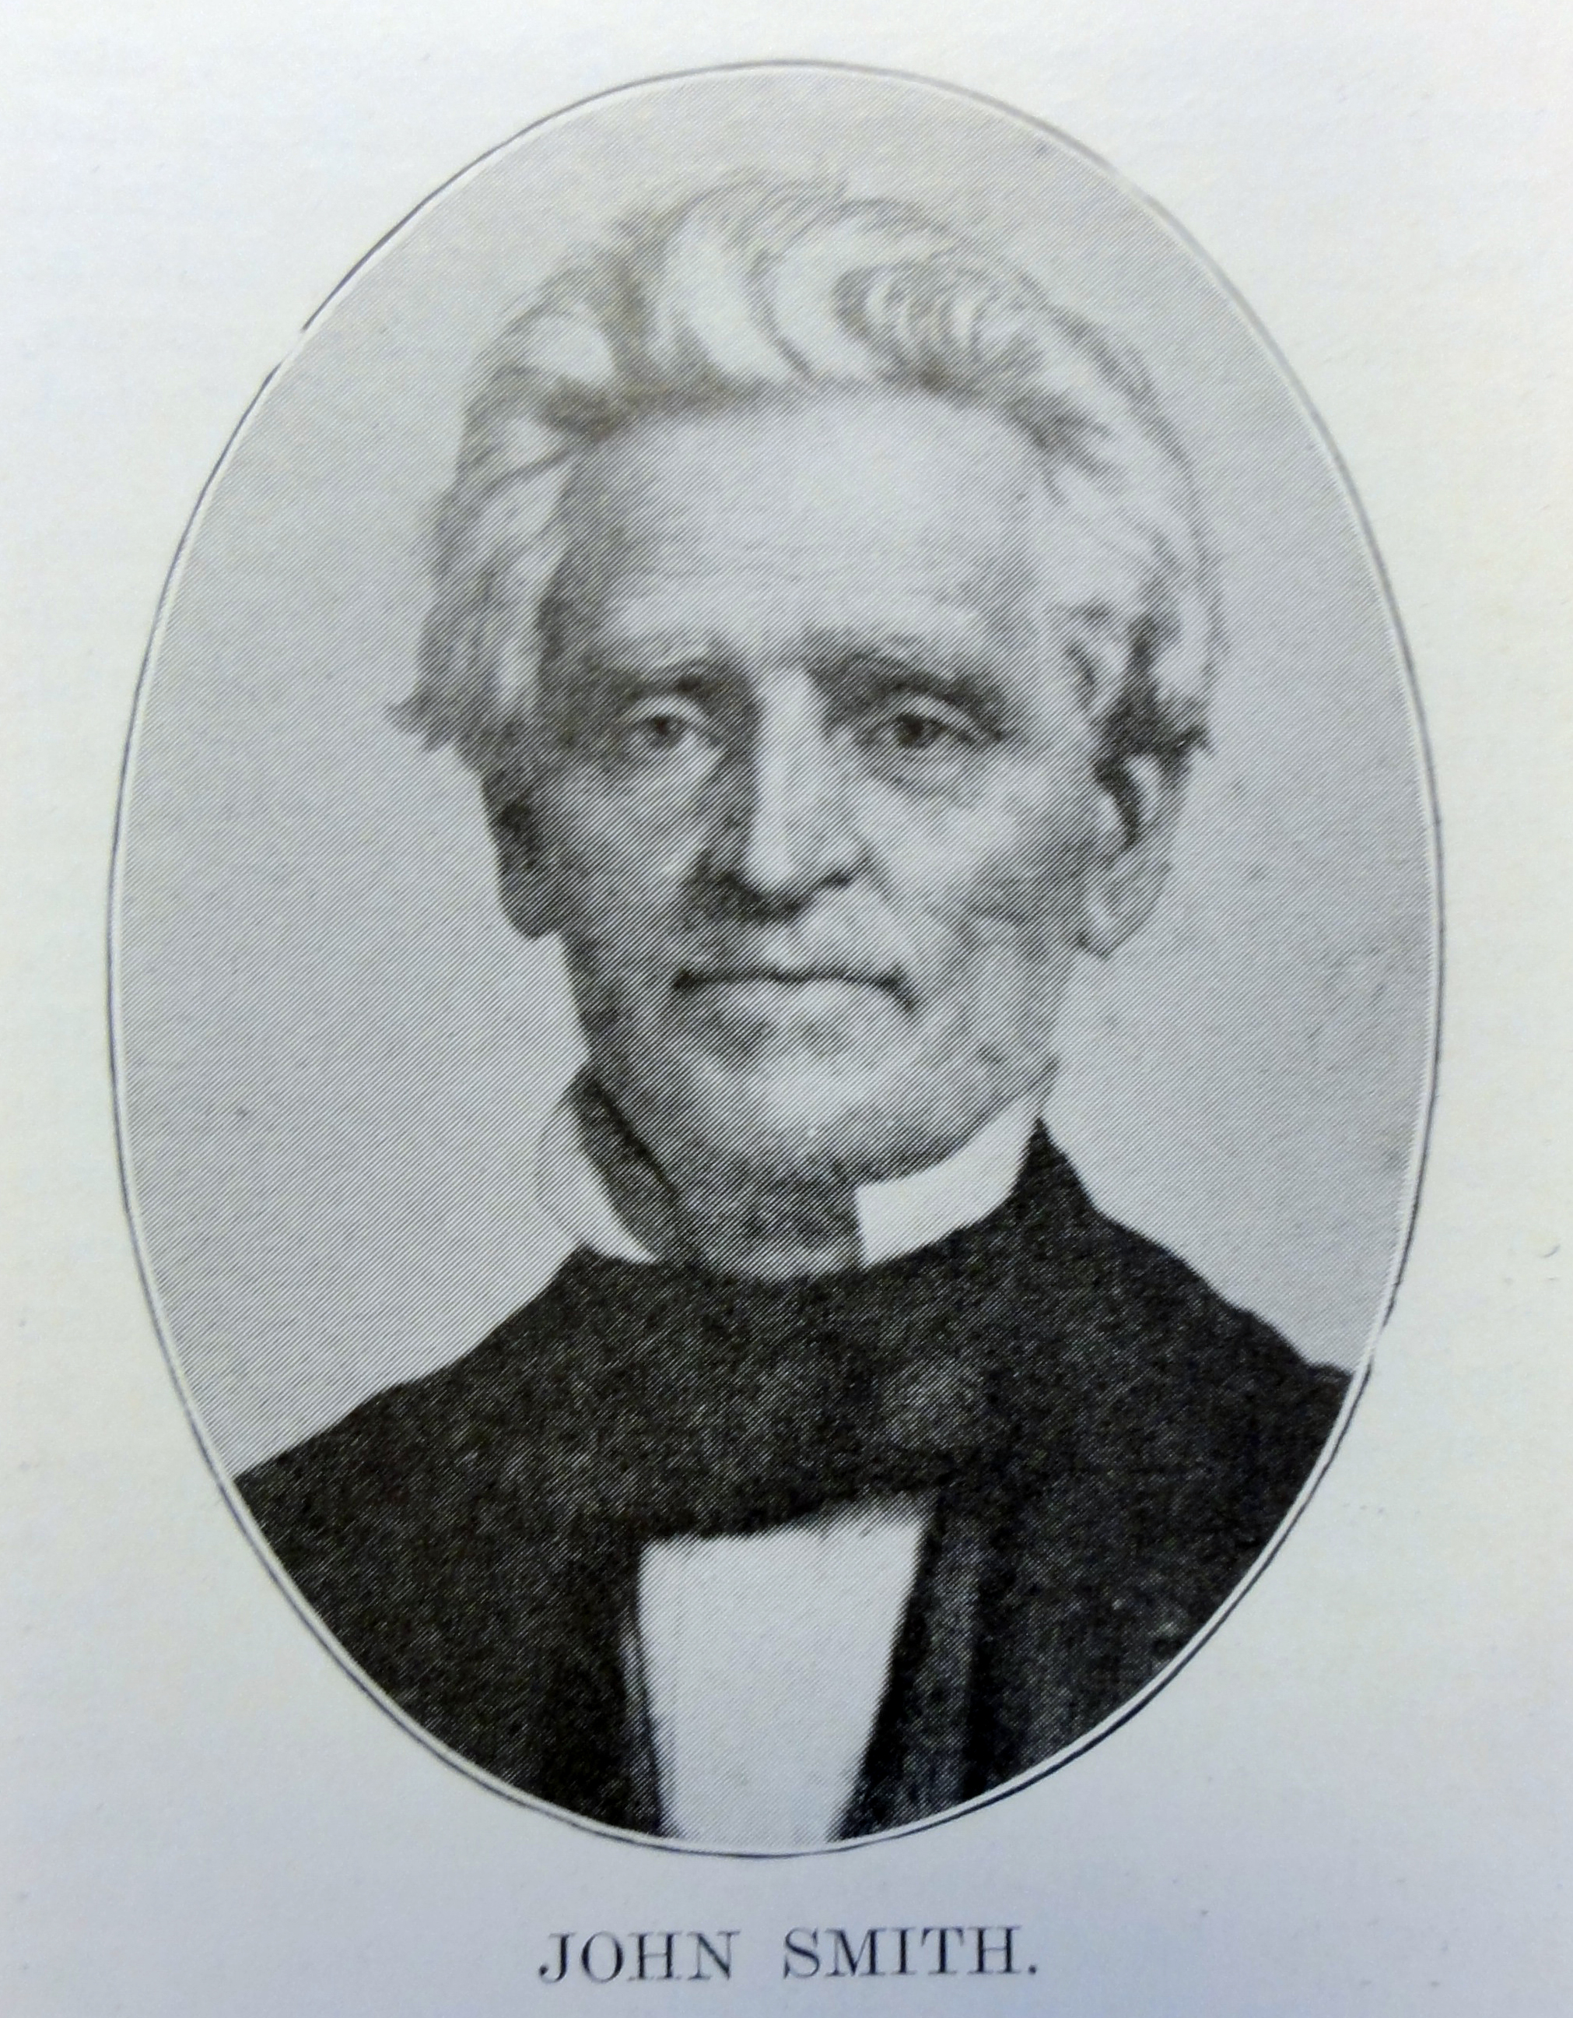
Experientialism And The Call To Ministry
Samuel Rogers 1789-1877
John Smith 1784-1868

Slide 4
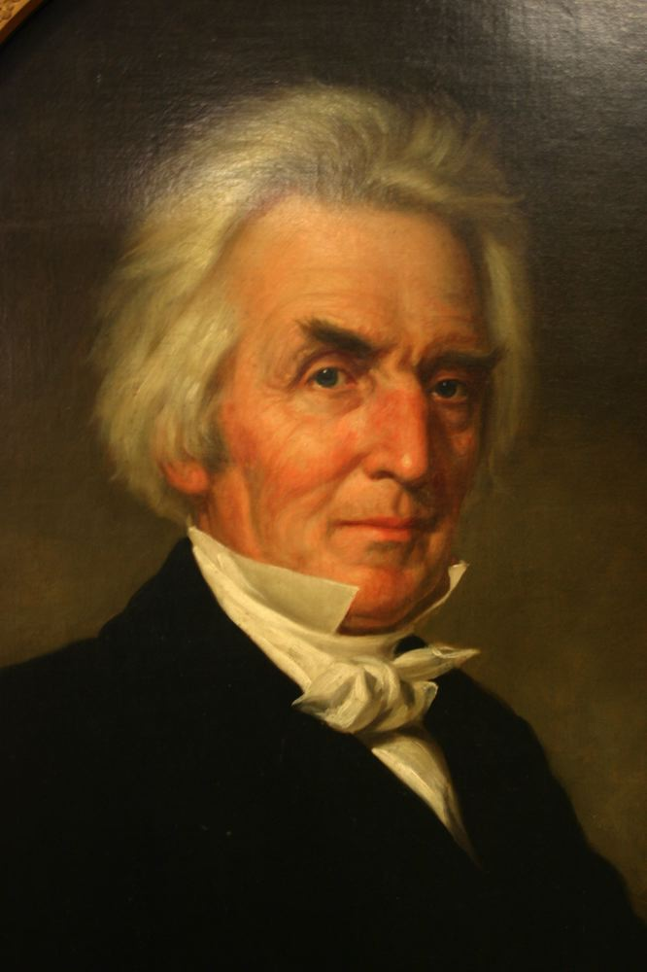
Experientialism And Church Membership
John Smith 1784-1868
Alexander Campbell 1788-1866

Slide 5
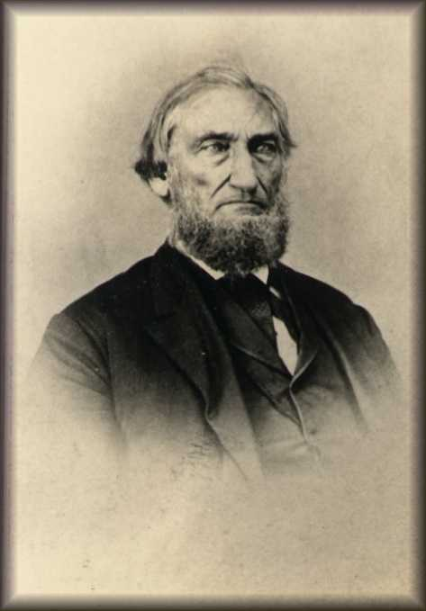
The Mourner's Bench: Experientialism's Last Stronghold
Barton Warren Stone
1772-1844
Benjamin Franklin Hall 1803-1873

Slide 6
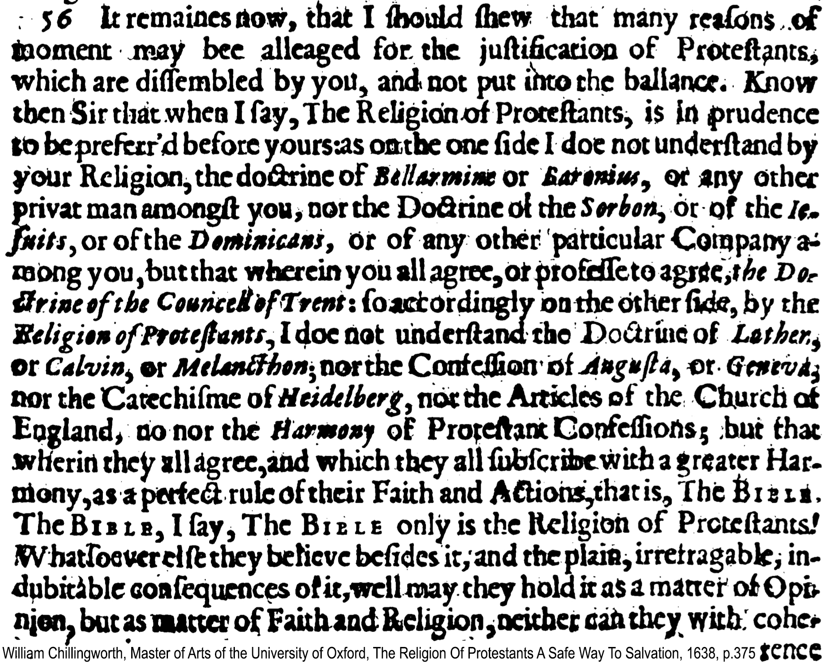
"The Bible. The Bible I say, The Bible only is the Religion of Protestants.” William Chillingworth, 1638

