Slide 1
Willie Claude Hall
Principal, Teacher, President, Preacher
March 12, 1883 – August 17, 1967
Friends of the Restoration Luncheon
John Robert Hall FHU Lectures 2019

Slide 2
Hall Family

Slide 3
Lelia Conner
February 4, 1885 – March 6, 1968

Slide 4
Hall—Moody Graduation --1907
Martin, Tennessee

Slide 5
High School Administration Years
1910 to 1920
High School Principal
Bells, Dyer & Clarksburg

Slide 6
Lipscomb 1920--1923
Chair Department of English
Residence Hall Matron – Sister Hall
Rolands living there as well
Preaching at Waverly-Belmont Church of Christ

Slide 7
Freed-Hardeman Presidency
1923 – 1925
C. P. Roland Dean
Student Newspaper -- Sky-Rocket (48 Years)
Sought Counsel from Predecessors
Intercollegiate Competition – Debate (Wilson/Endsley)
Enrollment Was Sustained
Tennis Courts
Membership in Tennessee Association of Colleges
May 1925

Slide 8
Freed-Hardeman Presidency
1923 – 1925
Presidency short but significant
Actually determined by Board agreement (two years)
New Year’s Day 1925 board met
Hardeman present
Proposed to resume the Presidency
Board asked Hall & Roland for their views
Gracious to step aside

Slide 9
Freed-Hardeman Presidency
1923 – 1925
Halls lived in Oakland Hall (Women’s Residence)
Cafeteria in basement
Hardeman wanted both Hall & Roland to remain
Roland stayed
Hall accepted the presidency of Oklahoma Christian College in Cordell, OK

Slide 10
Oklahoma Years – 1925-1933
1925 – 1927
Oklahoma Christian College invited Hall to become President
Hall accepted and arranged for Norman Parks, C. P. Roland, Lester Agee and others to go also.
Hardeman wanted all to stay. But since Hall had agreed—and signed—he had no option. Roland remained, others went with Hall
Depression especially severe in Oklahoma
Funds difficult to raise
Board agreed for Hall to leave the presidency IF . . .
He would become chief development officer

Slide 11
Oklahoma Years – 1925-1933
1925 – 1927
President of Oklahoma Christian College
Arranged for Norman Parks, C. P. Roland, Lester Agee and others to go also.
Hardeman wanted all to stay. But since Hall had agreed—and signed—he had no option. Roland remained, others went with Hall
Depression especially severe in Oklahoma
Funds difficult to raise
Board agreed for Hall to leave the presidency IF . . .
He would become chief development officer

Slide 12
Oklahoma Years – 1925-1933
1928—1933
Minister at Church of Christ in Altus, OK
Wrote for Gospel Advocate
Summers back in Tennessee --- Meetings
Invited by Dr. L. C. Sears to accept a faculty position at Harding College

Slide 13
Each Summer Return to Tennessee. . . .
For Gospel meetings & for grandma to see her family. The trip from Altus took three days. This was their “TOURIST COURT”

Slide 14
New Year’s Resolutions 1931

Slide 15
Prolific Writer for Gospel Advocate

Slide 16
Annual Income/Expenses Accounting Process

Slide 17
Invitation 1933
“. . . I do not know just how to answer Bro. Hardeman’s letter about going to Henderson. I want to go & I want to stay here. . . .”
February 28, 1933

Slide 18
April 6, 1933
“. . . . Haven’t had a letter from Henderson yet & am a little shaky about it. . .”
Moved to Henderson July, 1933
Bought I. N. Roland House 129 Hill Street
Later Acquired 7 acres between White and Hill
Remained in that house until death in 1967

Slide 19
Freed-Hardeman Years – 1933 -- 1967
Faculty Member -- English, Bible
Held Meetings Throughout the Region
Pulpit Minister at Central Church of Christ in Jackson for many years
Supply Preaching, Wingo, KY, Pilot Oak, KY, Juno, TN,
Added to President’s Cabinet in 1950
Roland, Witt & Hall hired faculty after Hardeman’s Departure

Slide 20
Freed-Hardeman Years – 1933 -- 1967
Spelling barrier – All students required to pass spelling
Spoken English
Colorful Chapel speeches
Discipline council
Preacher’s Club
“Permanent File” for best papers
Rolands & Halls dearest of friends – H. C. Roland (Mack)

Slide 21
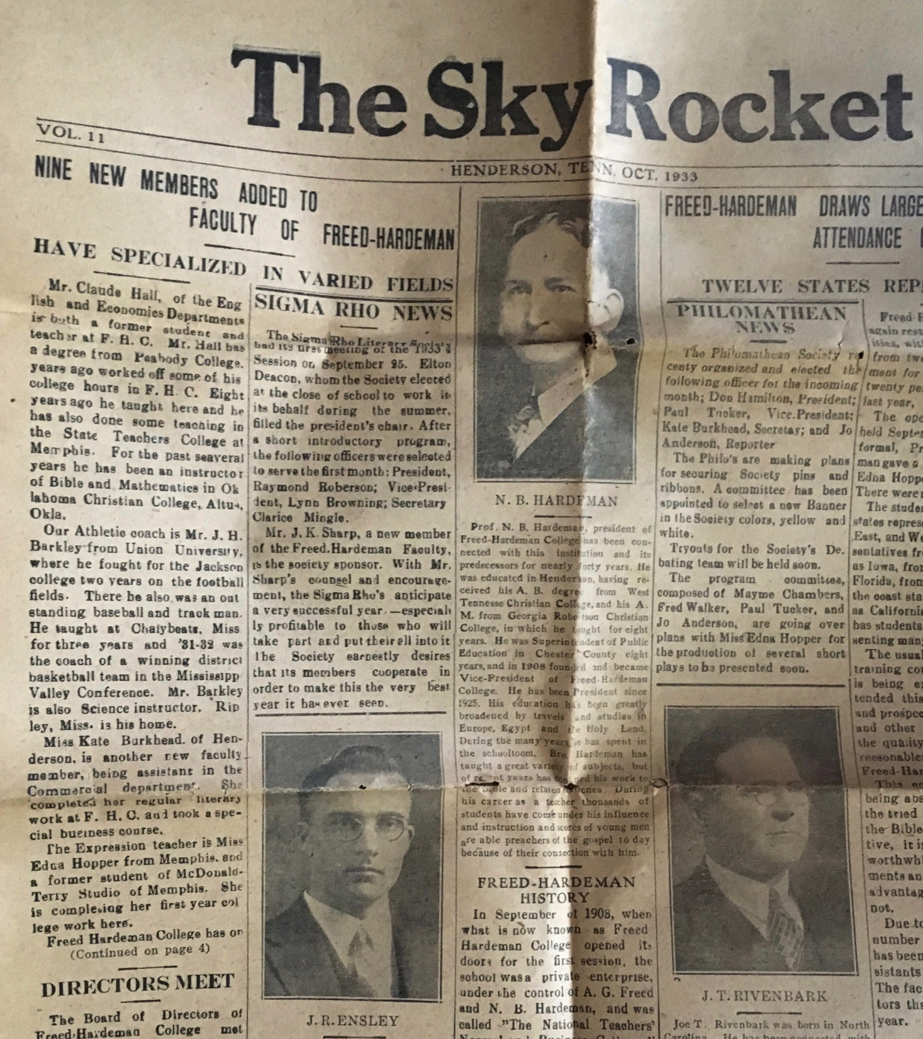

Slide 22
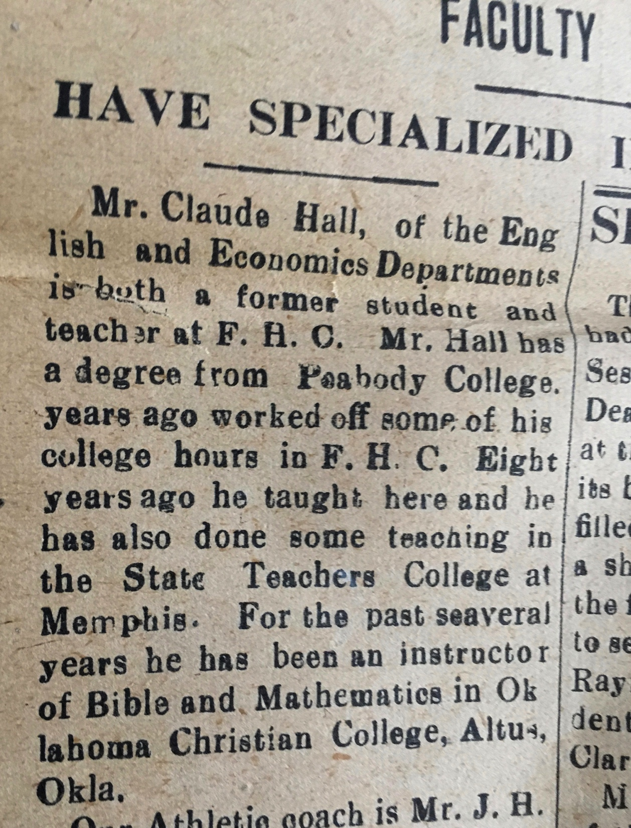

Slide 26
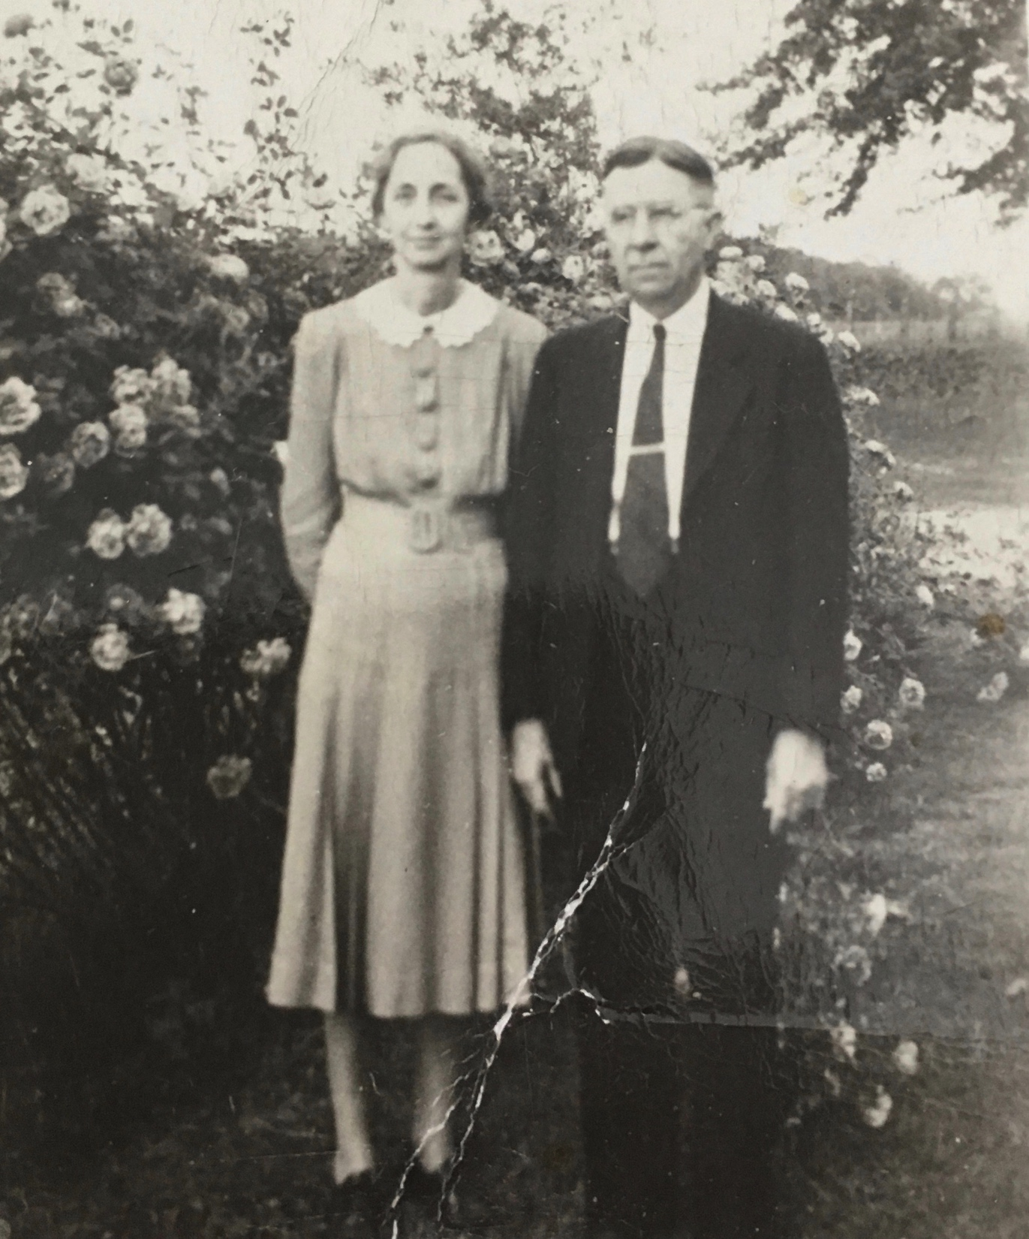

Slide 27
Coke
Always A Campaign Against Soft Drinks
(Jack Forbis—Central Congregation gave him hundreds of Coca Cola Pencils Annually, which he in turn, gave to the students.)

Slide 28
Student Drawn Image
Late 1940’s

Slide 29
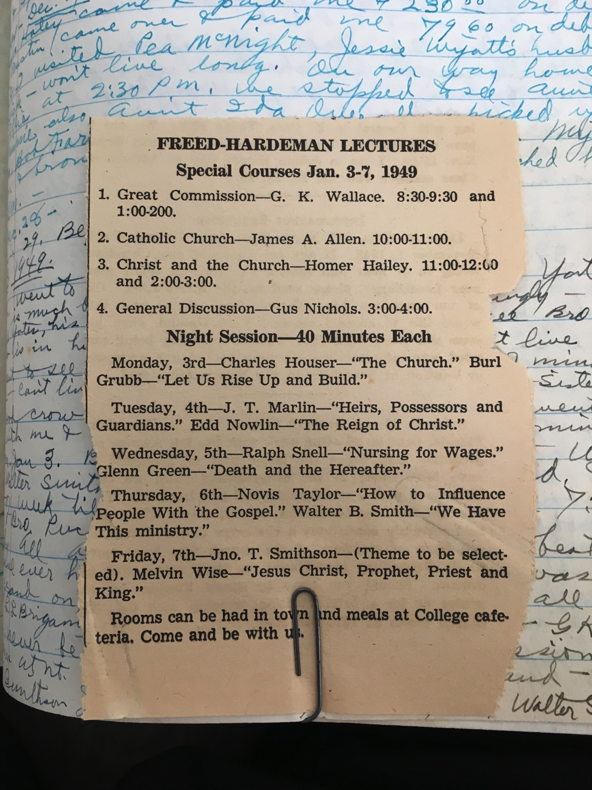

Slide 30
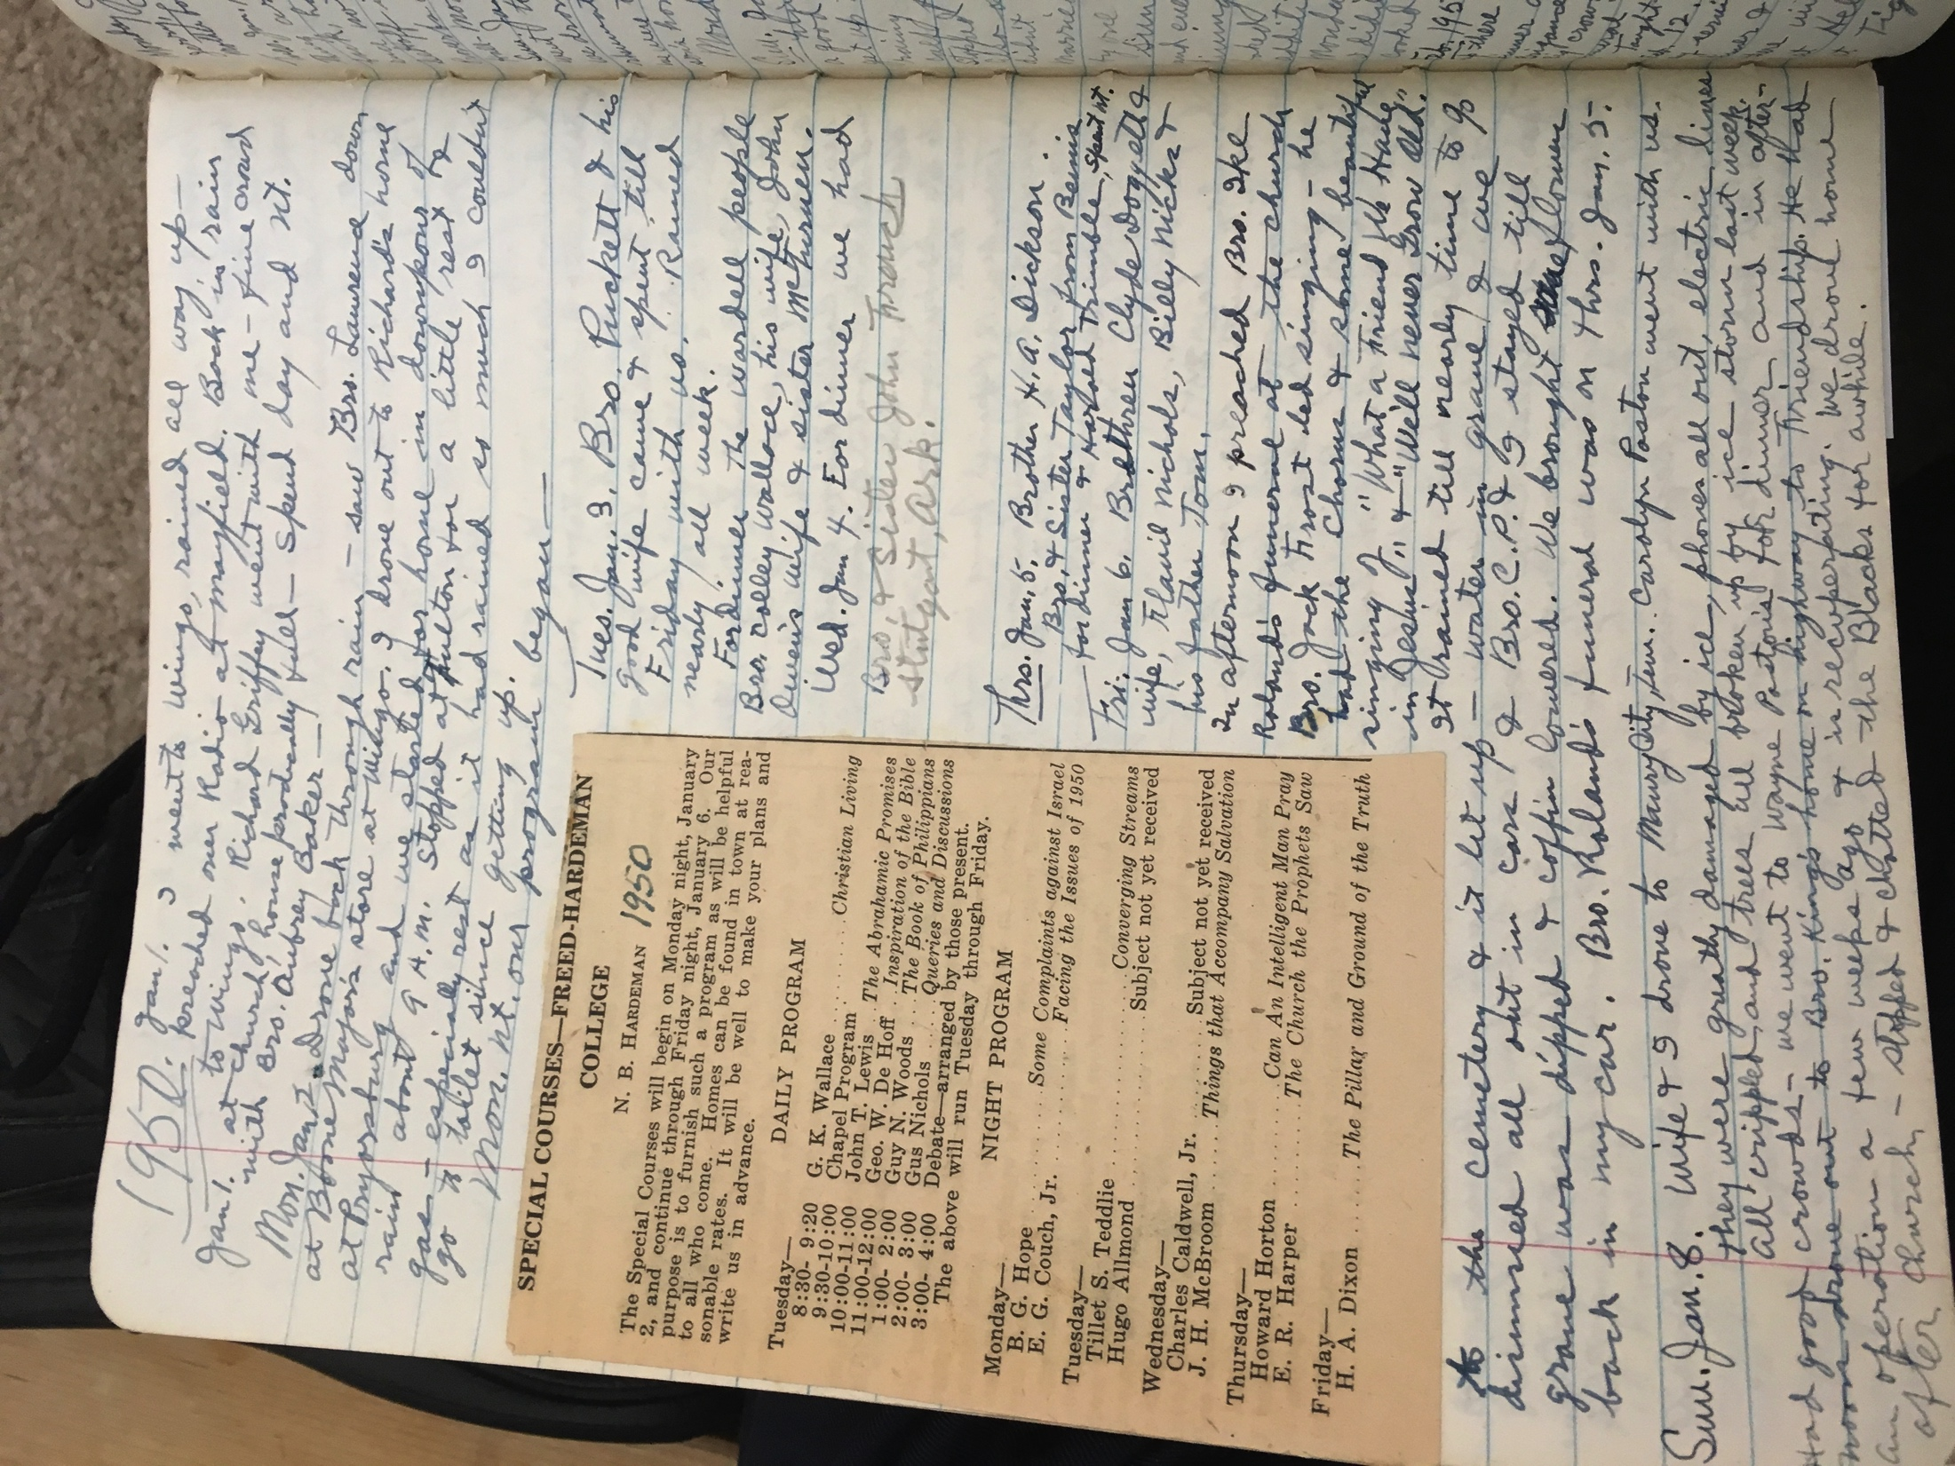

Slide 31
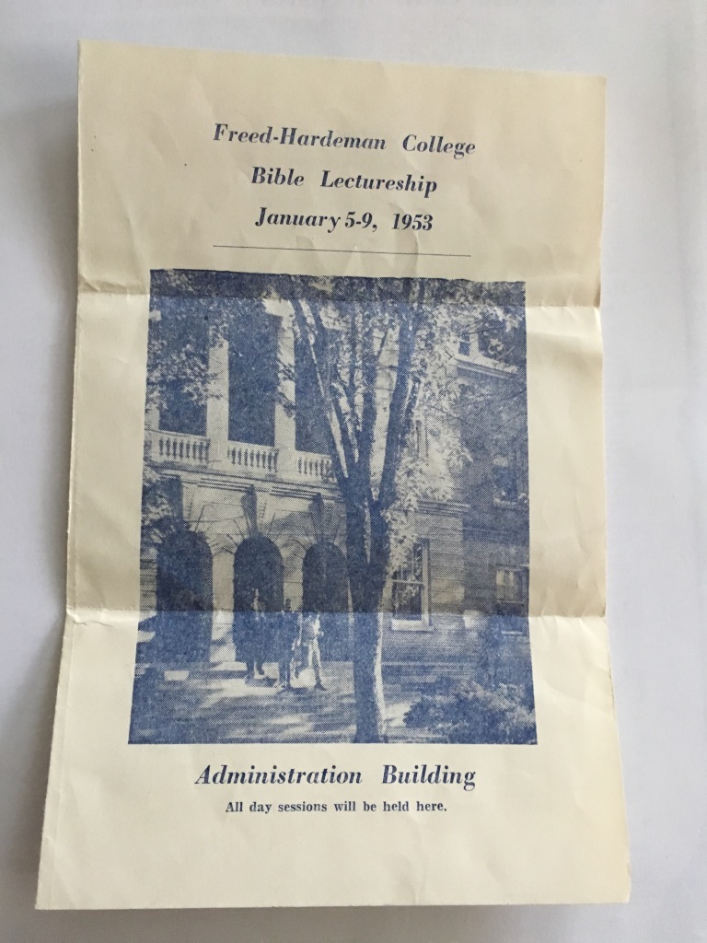

Slide 32
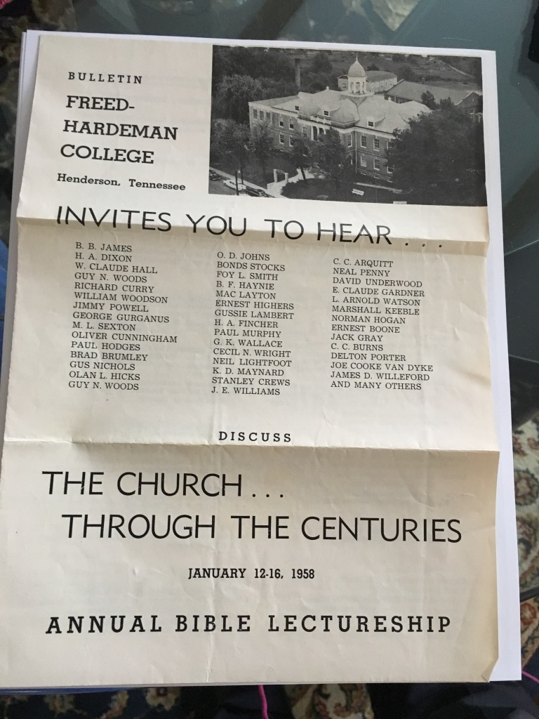

Slide 33
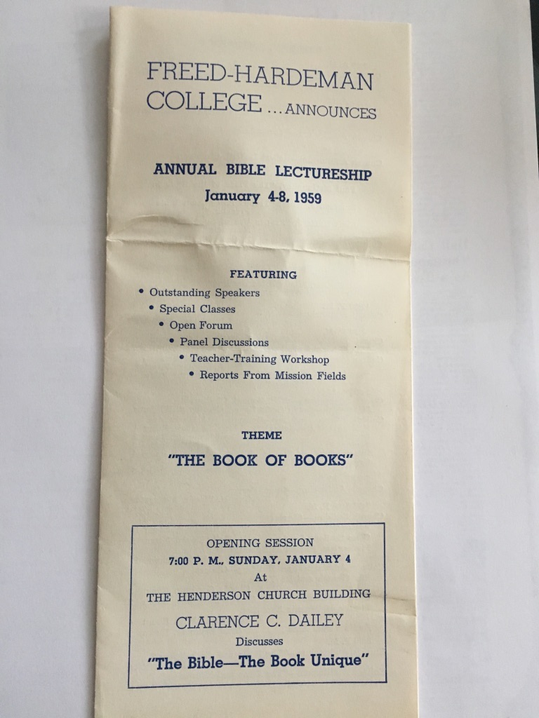

Slide 34
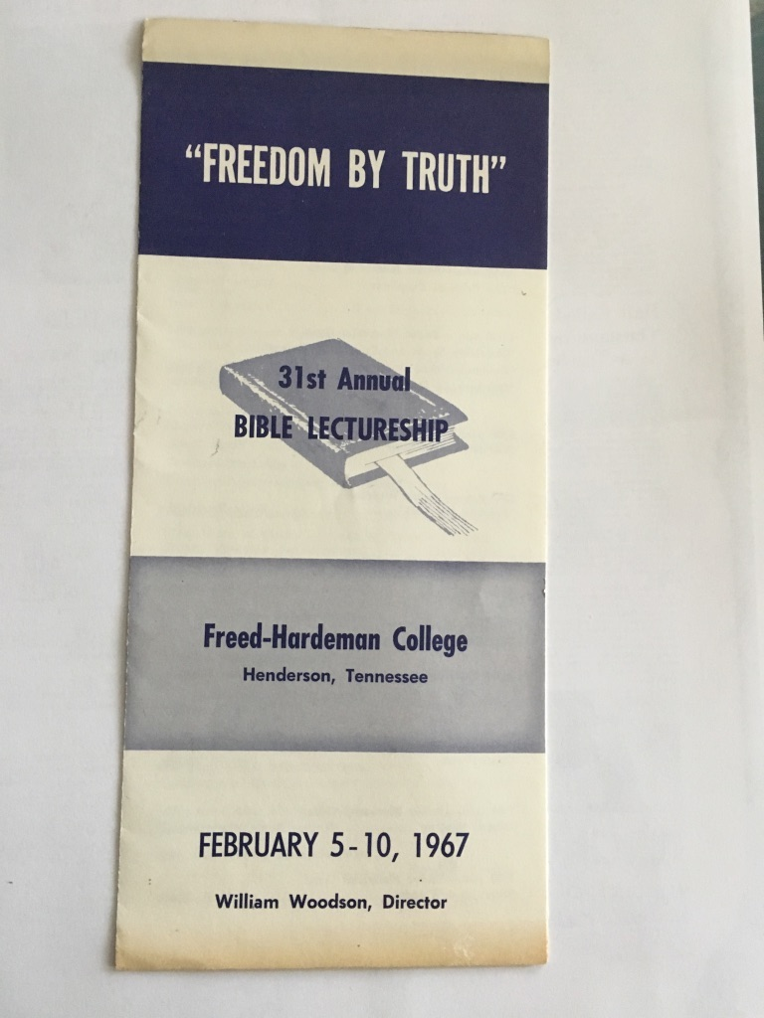

Slide 35
Billy & Jerry Nicks
Standard affair at the Hall’s Home that Guests Would Come for Lunch, Dinner, and Stay Overnight – or – for the Entire Week of Lectureship

Slide 36
Hall’s Collection Agency
September 27, 1956

Slide 37
C. P. Roland Gave Hall $5,000.00 of Debts to Collect
July 23, 1956

Slide 38
1955 Salary Agreement

Slide 39
His Take on Change . . . .
Change From Saturday to Monday Classes -- 1956
From Saturday to Monday Classes

Slide 40
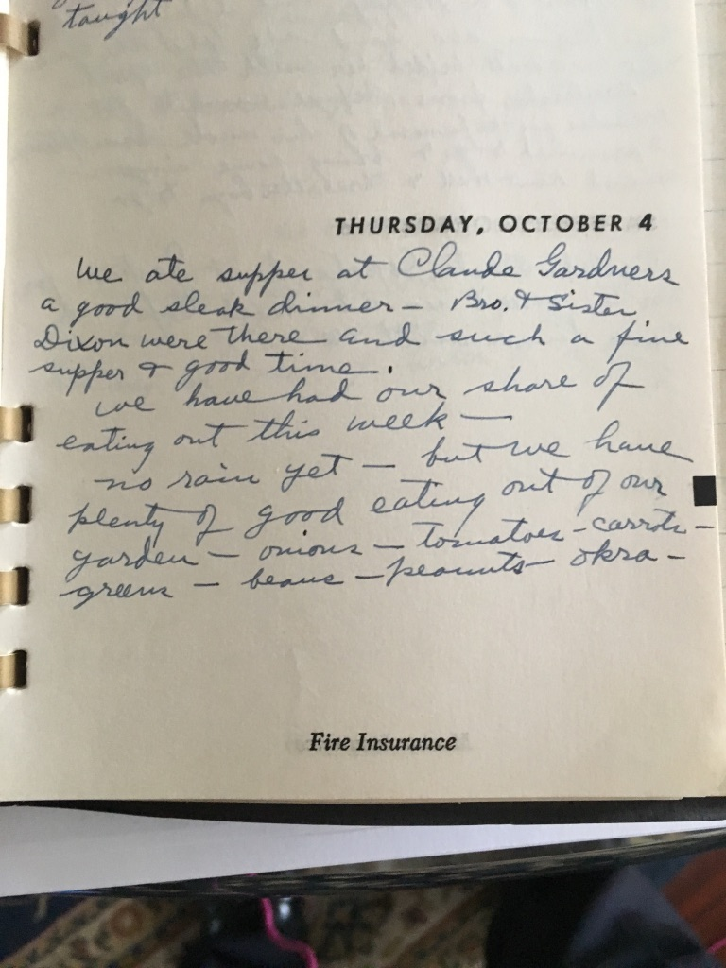
Dinner with Gardners & Dixons 1956

Slide 41
50th Wedding Anniversary Image

Slide 42
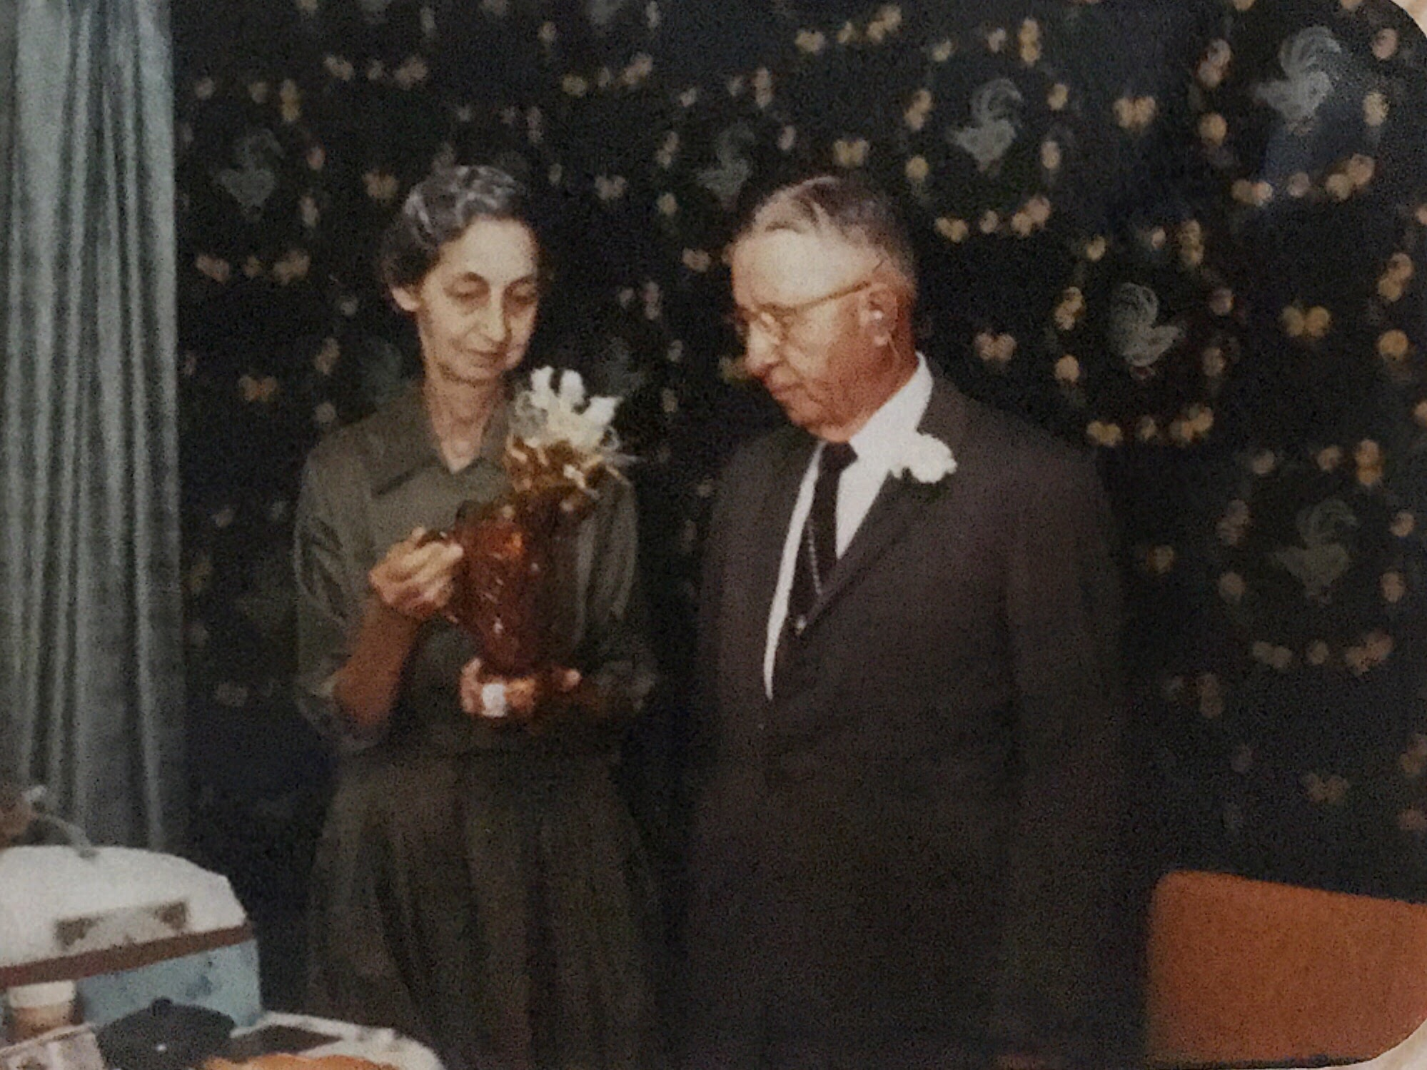

Slide 43
Thomas Scott, C. P. Roland & W. C. Hall
Front of their 129 Hill Avenue Residence about 1940

Slide 44
WCH, HAD, JMH

Slide 45
W. C. Hall – Last Formal Image

Slide 46
Gravestone in Henderson Cemetery

Slide 47
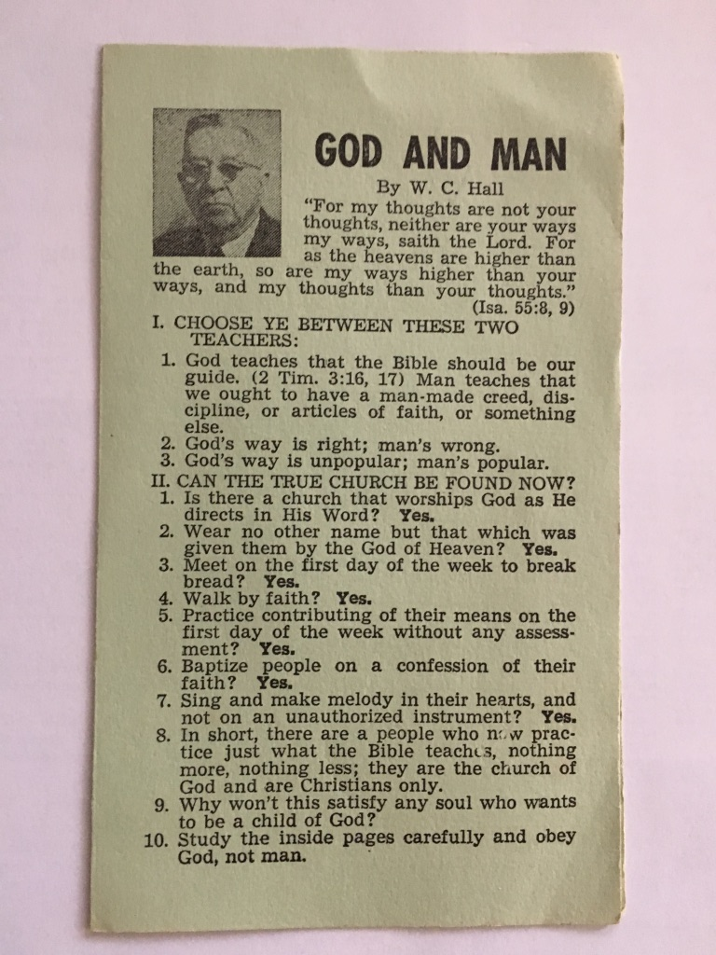

Slide 48
John M. Hall
March 5, 1919 -- February 25, 2017
About 12 years old in this image

